Slide 1
The DOE FY 2024 Phase II Release 1 FOA Webinar will begin soon
How to get sound?
This webinar is broadcast via your computer. You may need to turn your volume on or up as the sound for this webinar comes through your computer speakers.
We recommend using Google Chrome for this and other DOE SBIR webinars.
There is no dial-in number.
Will DOE provide access to the recorded webinar after the meeting?
  Yes, we will post the slides and the recorded webinar on the DOE SBIR/STTR web site.
Where can I find the FOA being discussed today?
  This link will take you to the FY 2024 Phase II Release 1 FOA: https://science.osti.gov/sbir/Funding-Opportunities
Q&A
  Please contact us by email at sbir-sttr@science.doe.gov if your question was not answered during today’s webinar.
  Put your questions in the Q&A box
  Don’t use the chat box! It will be used by our Administrative Support Specialist for information and relevant links.

Slide 2


DOE Phase II Webinar:
Phase IIA, IIB, and IIC Awards
DE-FOA-0003184
Eileen Chant
Office of DOE SBIR/STTR Programs
Outreach Program Manager
October 20, 2023

Slide 3
Webinar Outline
What’s New for Phase II Applications
Second Phase II: Phase IIA & IIB
  SBIR/STTR Reauthorization Act (December 31, 2011) permitted agencies to issue second Phase II awards
    DOE implemented these awards in FY 2014
Third Phase II (SBIR Only): Phase IIC
  FY 2019 National Defense Authorization Act (August 13, 2018) required agencies to issue third Phase II awards, if they issue second Phase II awards
    DOE began implementing these awards beginning with the FY 2019 Phase II Release 2 FOA
Notes:
Funding is for R&D with commercial potential. Basic science and deployment are not funded.

Slide 4
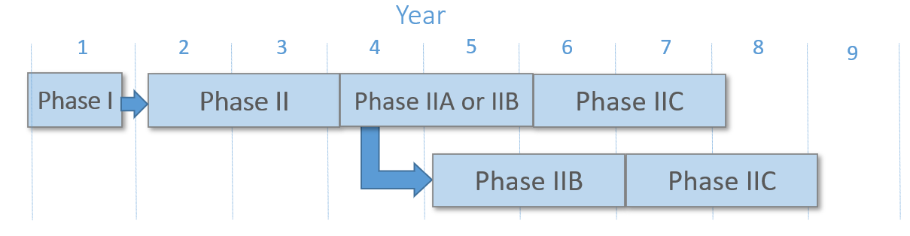
Terminology
Second/ Sequential
Third/Subsequent
Initial or First
  Bold terminology is per statute
  ALL Phase IIs - Initial (or first), second and third Phase II applications - are submitted through our “Phase II” FOAs

Slide 5
Preparing a Phase II Grant Application
New Phase II Application Web Page
https://science.osti.gov/sbir/Applicant-Resources/Grant-Application-Phase-II
Key Differences between Phase I and Phase II applications
Resources:
  ROI Template
  Pro-forma Template
  Level of Effort & Max Funding workbook
  Cooperative agreement template

Slide 6
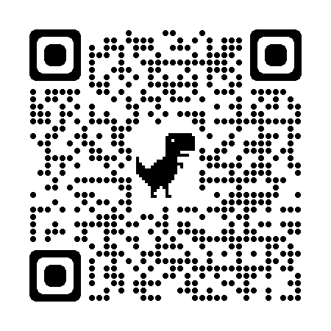
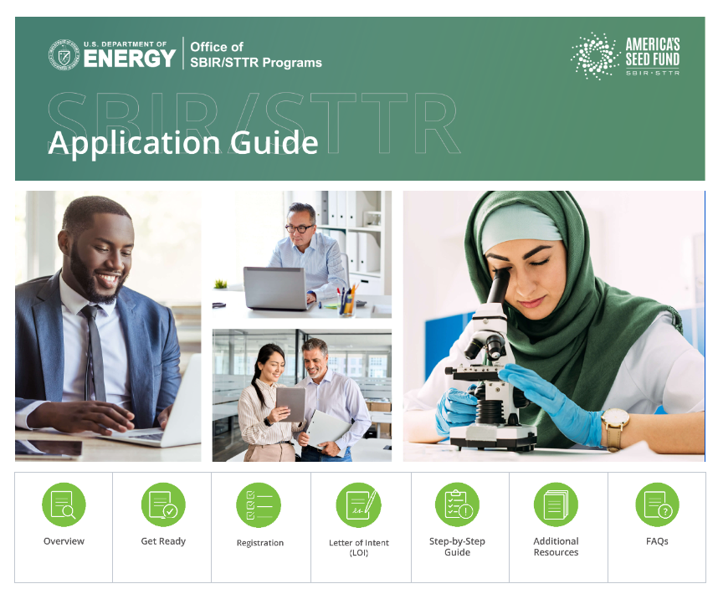
New Phase I Grant Online Application Guide
DOE SBIR/STTR Phase I Online Application Guide
Many resources suitable for Phase II applications
Replaces the PDF document that is on our web site
Houses all our application resources:
  PDF Application Guide content
  Preparing an LOI
  PIER Plan
  Tutorials
  Forms Download
  Examples
  & More…

Slide 7
Awardee Phase II Technical and Business Assistance Program (TABA)
Phase IIA, IIB and IIC – If you wish to use TABA funds, select your own vendor and include additional funding (above Max award amount) and vendor specifics in application.
  Up to $50,000 (Phase II) for TABA services over max award amount
  Example: $1,100,000 for R&D and $50,000 for TABA. Request is $1,150,000.
  Phase II services could include:
    Market research / segmentation
    Regulatory
    IP
    Pitch deck
    Networking group fees
    And more…

Slide 8
Company Commercialization Report Changes
Applicants who have had prior SBIR/STTR Phase II awards from any federal agency must provide the Company Commercialization Report (CCR) from SBIR.gov. SBIR and STTR awardees are required by the SBA Policy Directive to update and maintain their organization’s CCR on SBIR.gov. Companies may complete this report by logging into the company’s account on SBIR.gov and starting a new Company Commercialization Report.
For SBIR and Both applicants, the CCR is attached to Question 8 of SBIR/STTR Information Form, if applicable
For STTR-only applicants, the CCR is attached to Field 12 of the R&R Other Project Information Form
FOA contains instructions on generating this report (Section on Content and Format of Application)

Slide 9
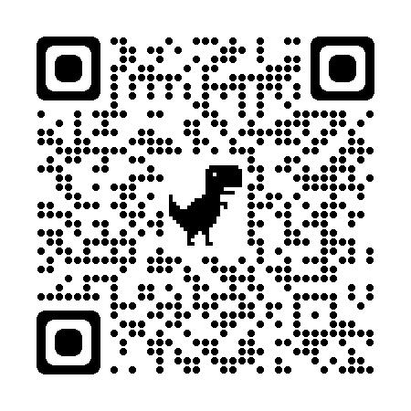
Foreign Relationships Disclosure Form
What you need to know now regarding the SBIR/STTR Extension Act of 2022:
  You are now required to submit a Disclosure of Foreign Relationships using the form on: https://science.osti.gov/sbir/Applicant-Resources/Grant-Application
  Please use posted version 6
  Your application may be declined if the form is not included
  The disclosure is attached to Field 12 of the Research and Related Other Project Information Form
  Even if your small business has no foreign relationships, you must complete the form and sign it to certify

Slide 10
Marking Proprietary Data
  An application may include technical data and other data, including trade secrets and commercial or financial information that are privileged or confidential, which the applicant does not want disclosed to the public or used by the Government for any purpose other than application evaluation.
  Certain documents are allowed to contain prop information:
    Examples of documents that may contain proprietary information include the commercialization plan and the project narrative.
    Note that the SBA Commercialization History and the Foreign Relations Disclosure forms are permitted to contain proprietary information, but do not require applicant markings as they are pre-populated with data protection legends.

Slide 11
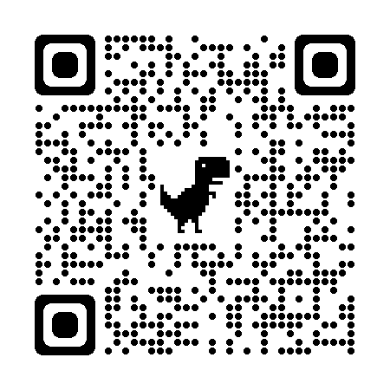
Marking Proprietary Data
1. The following legend must appear on the title/first page of the document:
This proposal contains information that shall not be disclosed outside the Federal Government and shall not be duplicated, used, or disclosed in whole or in part for any purpose other than evaluation of this proposal, unless authorized by law. The Government shall have the right to duplicate, use, or disclose the data to the extent provided in the resulting contract if award is made as a result of the submission of this proposal. The information subject to these restrictions are contained on all pages of the proposal except for pages [insert page numbers or other identification of pages that contain no restricted information.]
and
2. The following legend must appear on each page of the proposal that contains information the Applicant wishes to protect:
Use or disclosure of information contained on this sheet is subject to the restriction on the title page of this proposal.
Example doc at https://science.osti.gov/sbir/Applicant-Resources/Protecting-your-Trade-Secrets

Slide 12

Promoting Inclusive and Equitable Research (PIER) Plans
In pursuit of SC’s commitment to advancing DEI, the Office of Science has added a Promoting Inclusive and Equitable Research (PIER) Plan Requirement for all solicitations beginning in FY 2023.
Technology development and incorporation of diversity, equity, inclusion, and accessibility are not mutually exclusive. In fact, research has shown that the strong solution sets come from teams who recognize the importance of diversity of thought and reasoning to good sound scientific discovery.

Slide 13
Promoting Inclusive and Equitable Research (PIER) Plans
DOE SBIR/STTR Programs will begin requiring that applicants submit a plan for Promoting Inclusive and Equitable Research, or PIER Plan, along with their proposals, in our FY 2024 solicitations.
This is a requirement for proposals submitted to all Office of Science solicitations, as well as invited proposals from the DOE national laboratories.
PIER Plans are provided as an appendix to the Project Narrative (PN) and are limited to 3 pages. The plan should describe the activities and strategies that investigators and research personnel will incorporate to promote diversity, equity, inclusion, and accessibility in their research projects.
PIER Plan Basics:
  The PIER Plans are to be evaluated under a new merit review criterion as part of the peer review process
  Funds may be requested for execution of PIER Plan, within allowable cost guidelines.
  The scope should be integral to and tailored to the research project
  The complexity and detail of a PIER Plan should scale with the number of personnel to be supported and size of the Phase I award.

Slide 14

PIER Plan
  Applicants are encouraged to focus on areas, including but not limited to:
    The composition of the project team and partnering institutions
    The research environment—cultivating respectful, professional and accessible environments
    Equitable and inclusive implementation of the research project
    Partnering with underrepresented institutions and/or underserved communities

Slide 15
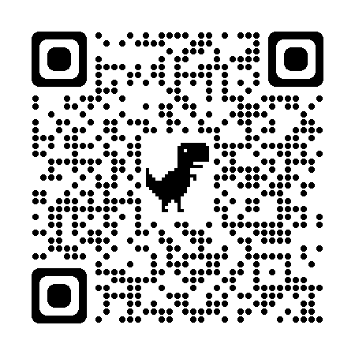
Changes to Technical Merit Review
Application Review Criteria
Ability to Carry Out the Project
Impact
Technical Merit
Promoting Inclusive and Equitable Research (PIER) Plan https://science.osti.gov/sbir/Applicant-Resources/PIER-Plan
The first three review criteria are equally weighted and of greater weight than the fourth criterion
PIER Plan

Slide 16
What are Suitable Topics for PIER Plans?
Mentoring underrepresented (UR) persons in STEM and entrepreneurship
Hiring UR intern(s) and/or staff
Providing professional development training and leadership experience to UR persons integral to the project
Provide professional learning and educational opportunities to small business employees to develop awareness, knowledge, and strategies for supporting diverse and innovative work environments.
Partnering with a Minority Serving Institution such as an Historically Black College and University
Engagement with organizations in the project that represent underserved communities as a core element of their mission, including Minority Business Entities, and non-profit or community-based organizations

Slide 17
Suitable PIER Topics Continued
Implementing inclusive workplace practices
Inclusion of community advisory boards or other relevant steering committees to inform technology development.
Technology development with future community benefit and/or Energy Equity implications for disadvantage communities, should the technology be successful, such as:
  Reduction in household energy burdens
  Reduction in environmental exposure
  Energy infrastructure resilience
  Future workforce impacts and opportunities
Projects that will lead to clean up of legacy nuclear waste and mitigate existing pollutions for an affected community and partner with that community.

Slide 18
Cybersecurity Self Assessment
DOE SBIR/STTR
FY 22 Phase I Release 1 Funding Opportunity
  DOE has added a new Phase II application requirement.
  Applicants must include a cybersecurity self-assessment with their Phase II application. Information on this new requirement is contained in Section IV.D of the FOA.
  Our office will host a webinar dedicated to this new requirement on Tuesday, October 24 for 3:00-4:00 pm ET, “Cybersecurity Self-Assessments for Phase II Applicants”
  All eligible to submit a FY 2024 Phase II Release 1 application will receive an email invitation to this webinar.
  The webinar will be recorded and made available

Slide 19
Phase II Diversity Supplement (for awareness only)
DOE SBIR/STTR
FY 22 Phase I Release 1 Funding Opportunity
  Not part of the Phase II application! Supplement applications are submitted in December prior to the second summer.
  The purpose of the Phase II supplement is to improve the diversity of the research workforce by recruiting and supporting undergraduate and graduate students from groups that have been shown to be underrepresented in federal SBIR/STTR research programs DOE SBIR / STTR Phase II awardees are eligible to apply for an administrative diversity supplement to be effective during the second summer of their award
  Phase II, IIA, IIB and IIC awardees are eligible
  Up to $20,000 in additional funding to support the recruited student for a 10-week summer internship.
  Definition of diversity can include:
    Women
    Individuals meeting the SBA definition of socially and economically disadvantaged students CFR 124.103 and CFR.124.104
    Other nationally underrepresented groups in STEM
    A candidate that demonstrates a commitment to diversity

Slide 20
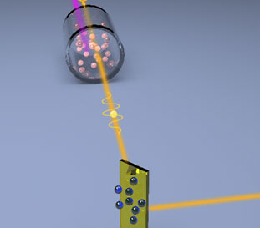

Second Phase II Awards
Phase IIA & Phase IIB
Office of SBIR/STTR Programs

Slide 21
Motivation: Phase IIA
Some Phase II projects are unable to be completed within two years and require more time and funding
  DOE program managers select the topics/subtopics for which Phase IIA applications will be accepted.
  Only a limited number of topics/subtopics will accept Phase IIA applications
    See section III.A beginning on FOA page 13 on eligibility
Historically, such projects required small businesses to complete two or more Phase I/II cycles to complete their R&D
Phase IIA awards will start immediately upon completion of the initial Phase II award
Note: Projects that require additional time, but no additional funding can request No Cost Extensions to their initial Phase II project

Slide 22

Phase IIA Timeline
No gap or overlap between end of Phase II and start of Phase IIA
Awarded in FY 2021
Awarded in FY 2022
Phase I
Phase II
Phase IIA
6-12 months
2 years
up to 2 years
Phase IIA application submitted in FY 2024

Slide 23
Motivation: Phase IIB
After successfully completing an initial Phase II R&D, some projects may require R&D funding to transition an innovation towards commercialization
DOE is utilizing Phase IIB to increase the number of positive commercialization outcomes resulting from Phase II awards
Phase IIB awards will start immediately after completing an initial Phase II or 1 year later

Slide 24
Phase IIB Timeline: Two Options
 | Awarded in FY 2021 | Awarded in FY 2022 | Phase IIB application submitted in FY 2024
 | 6 - 12 months | 2 years | Up to 2 years
Awarded in FY 2020 |  |  | Phase IIB application submitted in FY 2024
Phase I
Phase II
Phase IIB
No gap
Awarded in FY 2021
1 year gap
Phase I
Phase II
Phase IIB
6 – 12 months
2 years
Up to 2 years

Slide 25
Funding for Phase IIA & IIB Awards
Maximum Award Amount and Duration
  $1,100,000 up to 2 years
  Award amounts and duration require justification
Available Funding
  Is there separate funding for Phase IIA & IIB awards?
    NO, second Phase II award funding is obtained from DOE SBIR & STTR allocations used to make Phase I and initial Phase II awards
Number of Awards
  There is no target number of awards for Phase IIA or Phase IIB
  The number will depend on the number and quality of applications received under the FOA

Slide 26
FY 2024 Phase II Release 1 FOA, DE-FOA-0003184
Phase IIA
Eligibility Criteria
  DOE program managers have selected which topics and subtopics that received Phase II awards in FY 2022 that are eligible to apply
  Eligible Phase II grantees or Fast-Track grantees must complete their Phase II grants (including No Cost Extensions) to be eligible to receive a Phase IIA grant
DE-FOA-0002571 = FY 2022 SBIR/STTR Phase II Release 1 FOA
Eligible FY 2022 Phase II FOA | Eligible Topic(s) | DOE SBIR/STTR Funding Program
DE-FOA-0002571 (Phase I topics for C-49 can be found at DE-FOA-0002145. Phase I topics for C51 can be found at DE-FOA-0002359.) | C49-15c, C51-12a, C51-14a, C51-17a, C51-20b, C51-21a, C51-22a, C51-24d, C51-28a, C51-28b | Basic Energy Sciences
DE-FOA-0002571 (Phase I topics for C-49 can be found at DE-FOA-0002145. Phase I topics for C51 can be found at DE-FOA-0002359.) | C51-36d, C51-37b, C51-37c, C51-37f, C51-38b, C51-38c, C51-38d | Nuclear Physics

Slide 27
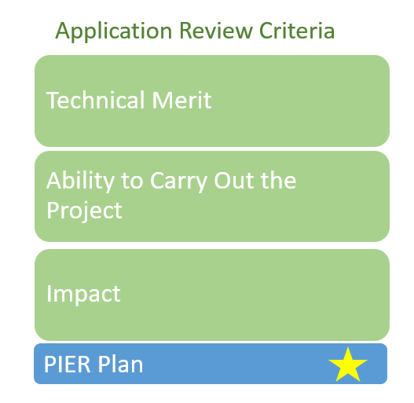
FY 2024 Phase II Release 1 FOA, DE-FOA-0003184
Phase IIA
Review Criteria
  The review criteria for Phase IIA is largely identical to that for initial Phase II with the following difference:
    Phase IIA: Phase I & II project performance is reviewed
    Initial Phase II: Only Phase I project performance is reviewed
  The first three review criteria are equally weighted and of greater weight than the fourth criterion

Slide 28
FY 2024 Phase II Release 1, DE-FOA-0003184
Phase IIB
Eligibility Criteria
  Only grantees from the following FY 2021 and FY 2022 SBIR/STTR Phase II FOAs AND topics may apply for Phase IIB awards
DE-FOA-0002380 = FY 2021 SBIR/STTR Phase II Release 1 FOA
Eligible FY 2021 Phase II FOA | Eligible Topic(s) | DOE SBIR/STTR Funding Program
DE-FOA-0002380 (Phase I topics can be found at DE-FOA-0002145) | C49-01a, C49-02a, C49-02b, C49-04a, C49-05b, C49-06a, C49-07a, C49-07b, C49-08c | Advanced Scientific Computing Research
 | C49-09a, C49-09b, C49-10a, C49-11a, C49-12a, C49-13a, C49-15a, C49-15b, C49-15d, C49-16a, C49-18a, C49-18b, C49-18c, C49-19a, C49-19b, C49-22a, C49-22c, C49-23c, C49-24c | Basic Energy Sciences
 | C49-26a, C49-26b, C49-27a, C49-27b, C49-29a | Biological and Environmental Research
 | C49-32a, C49-32b, C49-32c, C49-33a, C49-33c, C49-34a, C49-34b, C49-34c | Nuclear Physics

Slide 29
FY 2024 Phase II Release 1, DE-FOA-0003184
Phase IIB, Continued
Eligible FY 2022 Phase II FOA | Eligible Topic(s) | DOE SBIR/STTR Funding Program
DE-FOA-0002571 (Phase I topics for C-49 can be found at DE-FOA-0002145. Phase I topics for C51 can be found at DE-FOA-0002359.) | C49-04a, C49-08a, C51-01a, C51-02a, C51-03a, C51-04a, C51-04b, C51-05a, C51-05b, C51-06a, C51-07b, C51-07c, C51-08b | Advanced Scientific Computing Research
 | C49-15c, C49-19b, C51-09a, C51-11a, C51-12a, C51-13a, C51-14a, C51-15a, C51-16a, C51-16c, C51-17a, C51-19a, C51-19b, C51-20a, C51-20b, C51-20e, C51-21a, C51-21b, C51-22a, C51-24d, C51-26a, C51-28a, C51-28b | Basic Energy Sciences
 | C49-26a, C49-28a, C51-29a, C51-30a, C51-30b, C51-32a, C51-33a, C51-34a, C51-34b | Biological and Environmental Research
 | C49-33a, C51-35a, C51-36d, C51-37a, C51-37b, C51-37c, C51-37f, C51-37g, C51-38b, C51-38c, C51-38d | Nuclear Physics
DE-FOA-0002571 = FY 2022 SBIR/STTR Phase II Release 1 FOA

Slide 30
Technical Review Criteria
Review Criteria
  The first two review criteria are equally weighted, the Impact has a greater weight and all are of greater weight than the fourth criterion
  A greater importance is placed on Impact
  Applicants are strongly encouraged to include Phase II Funding Commitments and Phase III Follow-on Funding Commitments in their applications
    These will receive significant emphasis in the evaluation of Impact

Slide 31
Letter of Intent (LOI) Requirement
All Phase II applicants are required to submit a LOI through PAMS
  LOI Deadline: Tuesday, November 7, 2023 by 5:00 pm ET
  Content:
    Business Official name and contact information (telephone number and email address)
    Name(s) of any proposed subcontractor(s) or consultant(s), if any
    DOE Phase II Award Number DE-SC000XXXX
    Type of Second Phase II submission: Phase IIA or Phase IIB
    Second Phase II Project Title (same as your Initial Phase II project title)
    Phase I topic and subtopic number (same as your Phase I and Initial Phase II)
    Technical abstract that sufficiently describes your technology and application. The abstract should not exceed 500 words and two pages and it must provide sufficient technical depth to allow DOE to assign technical reviewers for your application. Please note that your abstract should not contain any proprietary information.
  No feedback is provided on Phase II LOIs

Slide 32
No Cost Extensions
Please note that a small business is eligible to receive a Phase IIA or IIB award only if their Initial Phase II project has completed
  Requests for No Cost Extensions should not conflict with the Phase IIA award start date (no later than 4/1/2024)
No gap or overlap between end of Phase II and start of Phase IIA
Awarded in FY 2020
Awarded in FY 2021
Phase I
Phase II
Phase IIA – starts 4/1/2024
6-12 months
2 years
up to 2 years
Phase IIA application submitted in FY 2023

Slide 33
No Cost Extensions
Phase IIB applicants should not request No Cost Extensions to their Phase II award that would overlap with the anticipated start date of the Phase IIB award (approximately 4/1/2024)
 | Awarded in FY 2020 | Awarded in FY 2021 | FY 2023 Application submitted in FY 2023
 | 6 - 12 months | 2 years | Up to 2 years
Awarded in FY 2019 |  |  | Phase IIB application submitted in FY 2023
6 – 12 months | 2 years |  | Up to 2 years
Phase I
Phase II
Phase IIB – begins 4/1/24
No gap
1 year gap
Phase I
Phase II
Phase IIB – begins 4/1/24

Slide 34
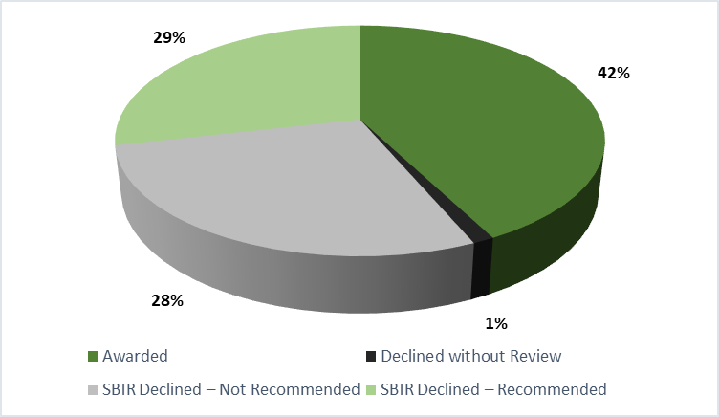
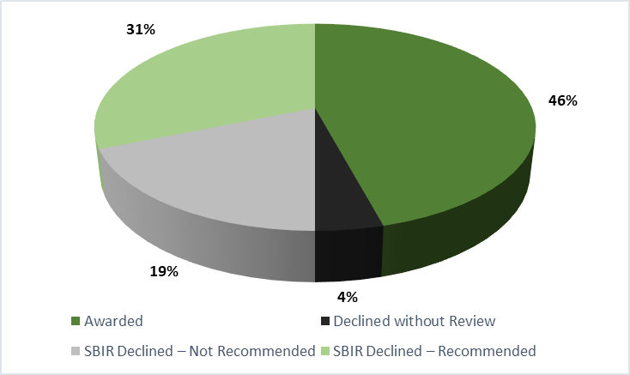
FY 2022 Phase II Application & Award Statistics
Phase IIA
  48 applications
  22 awards
Phase II
  413 applications
  175 awards
Notes:
Awards per topic: Generally 0 to many. It varies greatly by program. Some programs that are interested in many diverse areas will put out more topics than they plan to make awards. Others such as EERE have only two topics this year and I would expect each topic to have greater than 10 awards.

Slide 35
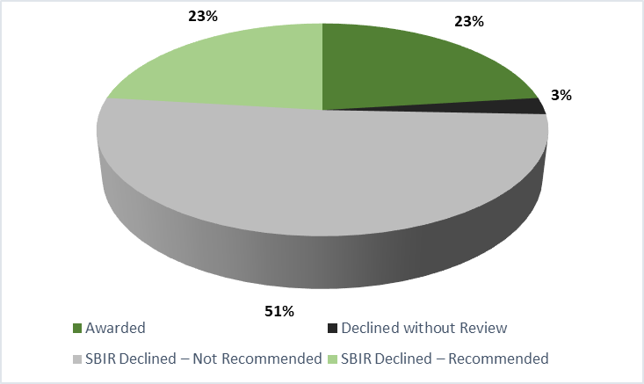
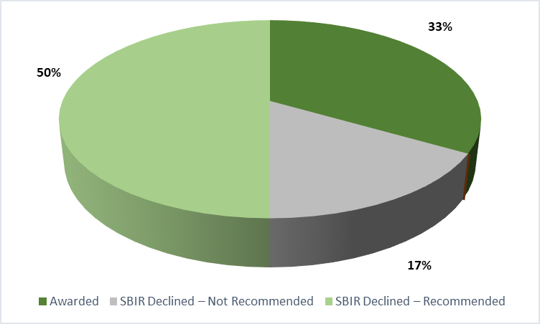
FY 2022 Phase II Application & Award Statistics
Phase IIC
  6 applications
  2 awards
Phase IIB
  78 applications
  18 awards
Notes:
Awards per topic: Generally 0 to many. It varies greatly by program. Some programs that are interested in many diverse areas will put out more topics than they plan to make awards. Others such as EERE have only two topics this year and I would expect each topic to have greater than 10 awards.

Slide 36
Frequently Asked Questions
If I’m eligible for both Phase IIA and Phase IIB, can I apply for both?
  NO, you may submit only one Second Phase II application per Phase II project
If I apply for a Phase IIA award this year and do not receive an award, may I apply for a Phase IIB next year?
  YES
If I apply for a Phase IIB award this year and do not receive an award, may I apply for a Phase IIB next year?
  YES, but it is recommended that you speak to your Program Manager about the reason for not receiving an award to understand if another IIB application would make sense.
If I receive a Phase IIA award, will I be eligible to receive a Phase IIB award in the future as I transition to commercialization?
  NO, you may receive only one Second Phase II award per Phase II project

Slide 37
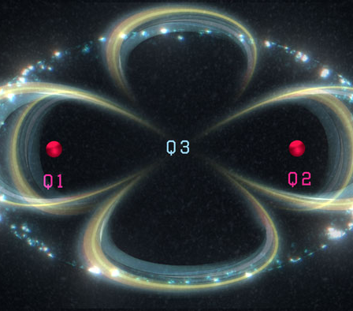
Third Phase II Awards
Phase IIC
Office of SBIR/STTR Programs

Slide 38
Motivation: Phase IIC
Phase IIC awards are available under a Congressionally mandated Commercialization Assistance Pilot Program, 5 U.S.C. § 638(uu). The intent of the program is reflected in the statutory considerations agencies must consider in making these awards:
  (A) the extent to which such award could aid the eligible entity in commercializing the research funded under the eligible entity’s Phase II program;
  (B) whether the updated Phase II commercialization plan submitted with the application provides a sound approach for establishing technical feasibility that could lead to commercialization of such research;
  (C) whether the proposed activities to be conducted under such updated Phase II commercialization plan further improve the likelihood that such research will provide societal benefits;
  (D) whether the small business concern has progressed satisfactorily in Phase II to justify receipt of a subsequent Phase II SBIR award;
  (E) the expectations of the eligible third-party investor that provides matching funding; and
  (F) the likelihood that the proposed activities to be conducted under such updated Phase II commercialization plan using matching funding provided by such eligible third-party investor will lead to commercial and societal benefit.

Slide 39
Eligibility
A small business concern must meet the following eligibility criteria:
  Have received an SBIR Phase II award and an SBIR Phase IIA or IIB award as specified in the FOA
  The SBIR Phase IIA or IIB award will have been issued two fiscal years prior to the time of eligibility for a Phase IIC award
  Note: Phase IIC awards are limited by statute to the SBIR program. No Phase IIC awards will be made under the STTR program. Also to be eligible for Phase IIC your prior Phase II and Phase IIA or IIB awards must be SBIR (not STTR) awards.

Slide 40
Phase IIC Timeline
Year
1
2
3
4
5
6
7
8
9
PHASE I
PHASE II
PHASE IIA or IIB
PHASE IIC
PHASE IIB
PHASE IIC
Phase IIC follows a Phase IIA or Phase IIB award. There will be only one opportunity to apply for Phase IIC - two years after you applied for your Phase IIA or Phase IIB award

Slide 41
Matching Funds
A Phase IIC award requires that the applicant has matching funds (excluding any fees collected by the small business concern receiving the Phase IIC award) equal to the amount of the Phase IIC award.
The matching funds must be from an eligible third-party investor
  The term ‘eligible third-party investor’ means a small business concern other than the eligible entity, a venture capital firm, an individual investor, a non-SBIR Federal, State or local government, or any combination thereof.
    Please note that SBIR/STTR Phase I, II, or III funding from a Federal agency may not be used as matching funds
The following types of funding do not qualify as matching funds:
  The eligible entity’s internal R&D funds.
  Funding in forms other than cash, such as in-kind or other intangible assets.
  Funding from the owners of the eligible entity, its family members, or affiliates of such owners.
  Funding attained through loans or other forms of debt obligations.

Slide 42
Matching Funds (cont.)
When do the matching funds need to be available?
  The small business concern must have the total amount of the matching funds available for expenditure at the grant start date listed in the FOA. A small business concern that fails to meet this requirement is ineligible for award
  Your matching funds must also be contingent upon receiving the DOE Phase IIC award
When must the matching funds be expended?
  The matching funds must be expended during the period of performance of the Phase IIC award
  Failure to expend the full amount of the matching funds will reduce the amount of award funding correspondingly, and DOE may take other remedies
Will a no cost extension be available for a Phase IIC awards?
  Yes, but only if the award funding has not been fully expended at the end of the initial period of performance of the Phase IIC award

Slide 43
Funding for Phase IIC Awards
Maximum Award Amount and Duration
  $1,100,000, up to 2 years
  Award amounts and project duration require justification
Available Funding
  Is there separate funding for the Phase IIC awards?
    NO. Second Phase II award funding is obtained from DOE SBIR & STTR allocations used to make Phase I & II awards
  Is there a maximum amount of funding that can be used for Phase IIC awards?
    YES. An agency may not use more than 5 percent of its SBIR funding for Phase IIC awards
Number of Awards
  There is no target number of awards for Phase IIC
  The number of awards will depend on the number and quality of applications received under the FOA

Slide 44
Letter of Intent (LOI) Requirement
Phase IIC applicants are required to submit a LOI through PAMS
  LOI Deadline: Tuesday, November 7, 2023 by 5:00 pm ET
  Content:
    Business Official name and contact information (telephone number and email address)
    Name(s) of any proposed subcontractor(s) or consultant(s), if any
    DOE Phase II Award Number, “DE-SC000XXXX”
    Type of Phase II submission: please select the Phase IIB (Phase IIC selection is not yet available)
    Third Phase II Project Title (same as your second Phase II project title)
    Phase I topic and subtopic number (same as your Phase I)
    Technical abstract that sufficiently describes your technology and application. The abstract should not exceed 500 words and two pages and it must provide sufficient technical depth to allow DOE to assign technical reviewers for your application. Please note that your abstract should not contain any proprietary information.
  No feedback is provided on Phase II LOIs

Slide 45
No Cost Extensions
A small business concern is eligible to receive a Phase IIC award only if its Phase IIA or Phase IIB award is completed before the start of the Phase IIC grant start date (no later than 4/1/2024)
Phase IIA or IIB
Phase IIC (starts no later than 4/1/2024)
2 years
up to 2 years

Slide 46
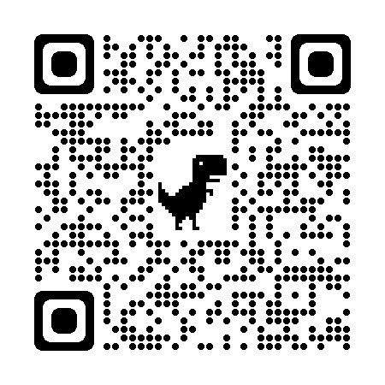
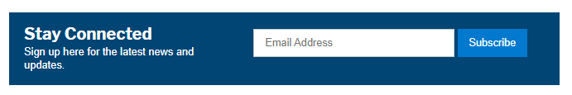
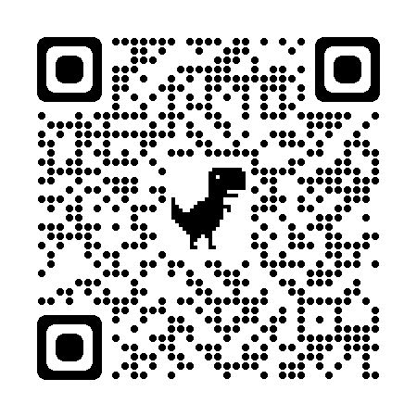


Thank you!
Please submit any question you may have via the Q&A box, at the bottom of your screen
Email us!
sbir-sttr@science.doe.gov
eileen.chant@science.doe.gov
Phone: (301) 903-5707
Join our mailing list!
Home page: https://science.osti.gov/sbir
Follow us on X (Twitter) and LinkedIn!
Phase II Application Process Q&A Webinars
November 1, 8, 22 and 29 @ 3 PM ET
Phase II eligible will receive an invitation
Partnering needs?
Tech-2-Market Advisor
carol.rabke@science.doe.gov
https://science.osti.gov/sbir/Partnering-Resources
Commercialization Tech-2-Market Advisor (TABA)
dave.mccarthy@science.doe.gov

