Slide 1

Novel Cryogenic High Voltage Breaks and Bushings (CHVBs) for Nuclear Physics, Electric Power, Fusion Energy, and LNG/Hydrogen Based Technologies
DE-SC0021608
Christopher Rey, Ph.D.
Tallahassee, FL 32304
www.e2pco.com
Notes:
logo
1

Slide 2


DOE Phase II Program Overview
Work Scope A: Thermally Insulating CHVB for ANL w/ R. Vondrasek
  V_{op} ~ 50 kV →200 kV
  Interior medium: flowing low pressure LN2, Exterior medium: atmosphere
  Radiation: No
  Mechanical/Structural: NA
  Quantity: 2-3
  Commercial opportunity: Low
Work Scope B: Radiation Tolerant CHVB for NP & Commercial Fusion
  V_{op} ~ 30 kV
  Interior medium: GHe, Exterior medium: vacuum
  Radiation: 10 MGy
  Mechanical/Structural: 500-1000 PSI internal pressure
  Quantity: > 1000⁺
  Commercial Opportunity: Very high

Slide 3
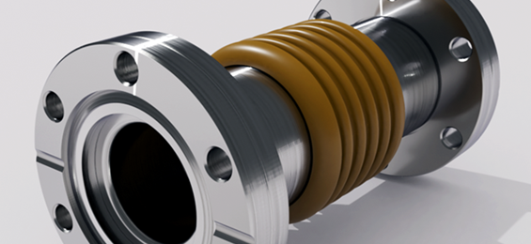
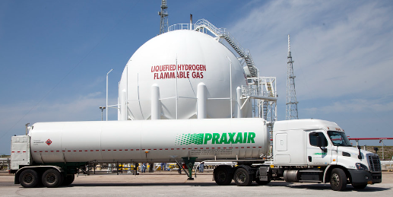

Need Addressed
Cryogenic High Voltage Breaks & Bushings-(power function) are ubiquitous devices needed in a variety of Technologies:
  NP experiments @ ANL (ATLAS & CARIBU)
  LNG & LH2 storage, transfer, and transportation
  Fusion Energy
    > 1,000 per tokamak machine
    2025 over 44 fusion startups w/ > $7B in funding
  Electric Power utilizing High Temperature Superconductors (HTS)
Current state-of-the-art ceramic CHVB’s are unreliable and prone to micro-cracking leading to leaking.
For V_{op} > 100 kV or non-magnetic there is
no suitable commercial product
Notes:
Cryogenic High Voltage Breaks (CHV-Breaks) & Bushing (CHV-Bushings) electrically isolate cryogenic devices & equipment operating at High Voltages (HV) from grounded components & structures. CHV-Bushings also transmit electrical power into cryogenic space.
Leaking into cryogenic vacuum spaces can be prohibitively expensive to repair (ITER, CERN, etc.) or lead to premature failure (power equipment)
For Vop > 100 kV or non-magnetic there is no suitable commercial product
Customers require low cost, mechanically robust, HV standoff, radiation resistant, hermetic, repeated thermal cycling, high internal pressure, non-magnetic…

Slide 4
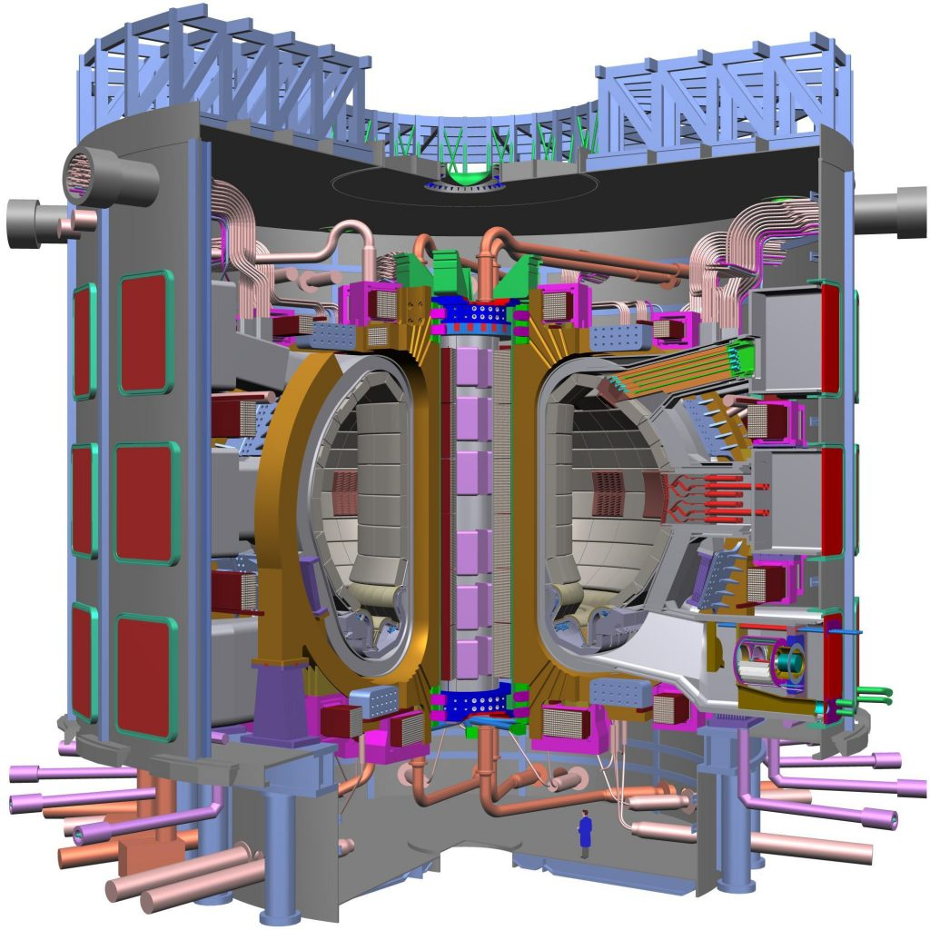
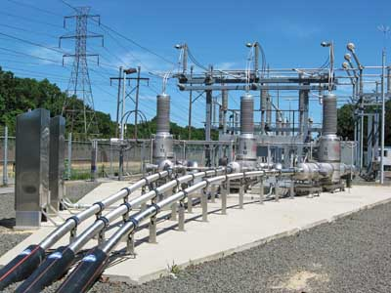
Customer Requirements…
  low cost
  mechanically robust
  HV standoff
  radiation resistant (fusion)
  Hermetic (TF coils in tokamak not accessible after D-T)
  repeated thermal cycling
  high internal pressure
  non-magnetic…
  Electric Power transmission

Slide 5
CHV-Breaks Design Process
Rapid Virtual Prototyping
Down selection based upon E-field Stress Reduction (EFSR)
Detailed designs
Manufacture typically 3D printed process
Accelerated Life Test
Iterate designs as needed

Slide 6

The e2P CHVB Solution
  3D printed main body using cryogenically robust composite materials
  CHV-Bushing operate >1 kW-100 MW
  Ability to withstand repeated thermal cycles w/o cracking
  Radiation resistant up to 10 MGy
  Non-magnetic
  > 100 kV operation
  Manufactured in sizes up to 16” diameters
  New type: Thermally insulating CHVB allows for in-situ continuous transfer of cryogenic fluids @ > 200 kV standoff (patent pending
  US 19/093,880)

Slide 7
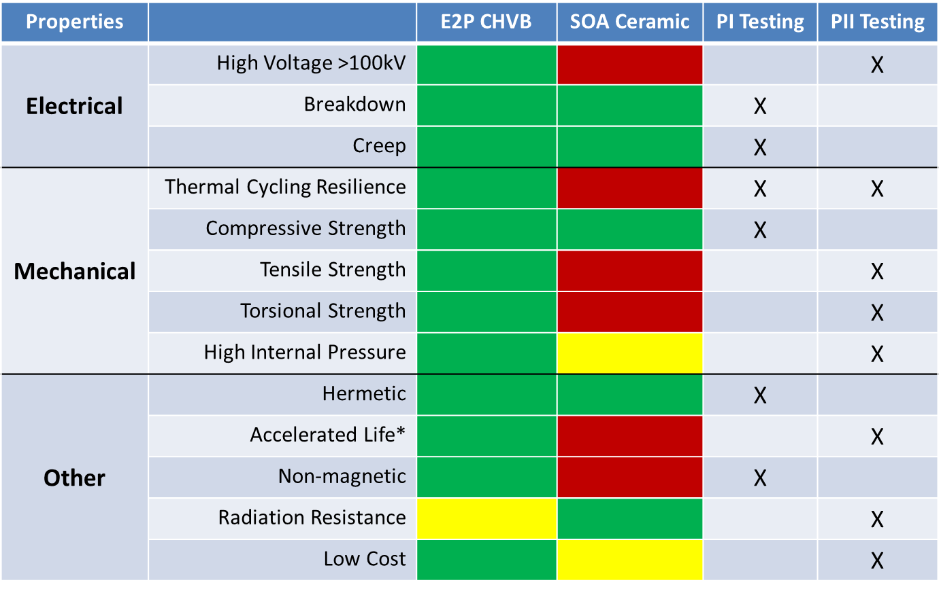
Comparison with SOA Ceramic

Slide 8
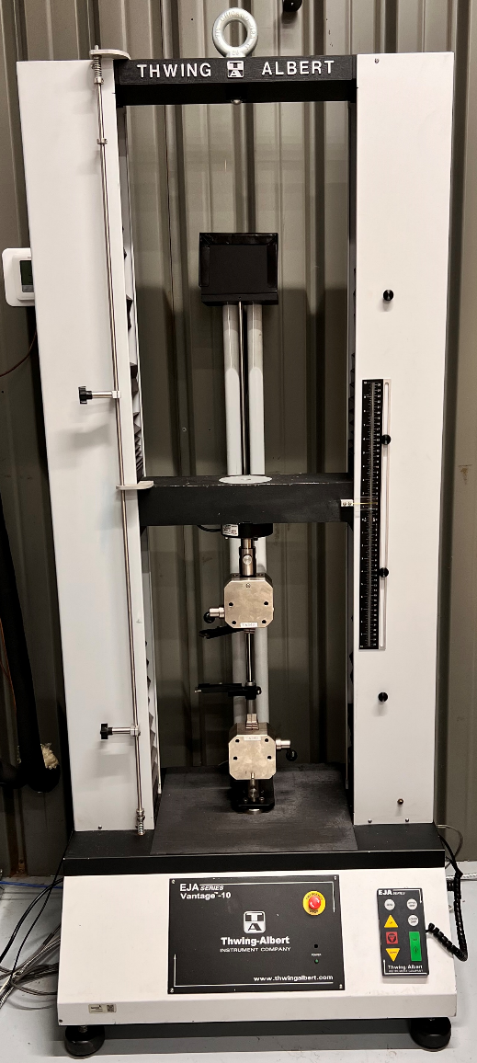
Radiation Tolerant Epoxy Evaluation
Mechanical testing of:
  Tensional Strength (ASTM D638)
  Compressive Strength (ASTM E9)
  Torsional Strength (ASTM D4065)
ASTM compliant procedures include:
  sample design
  Fabrication
  Testing
  post-processing of data
Procedures will be used to determine compliance of materials and components

Slide 9
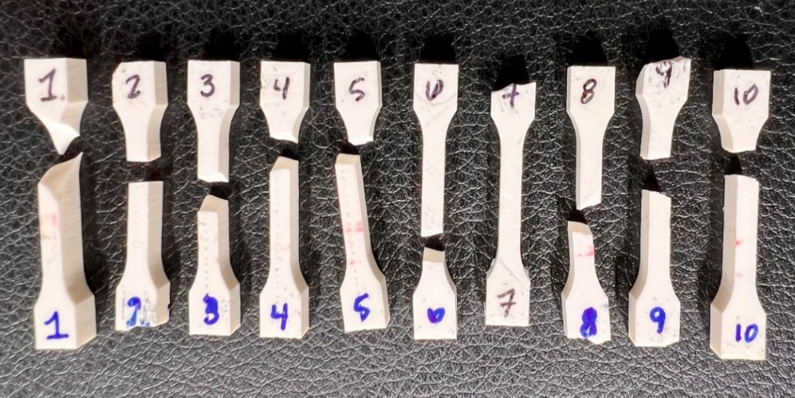
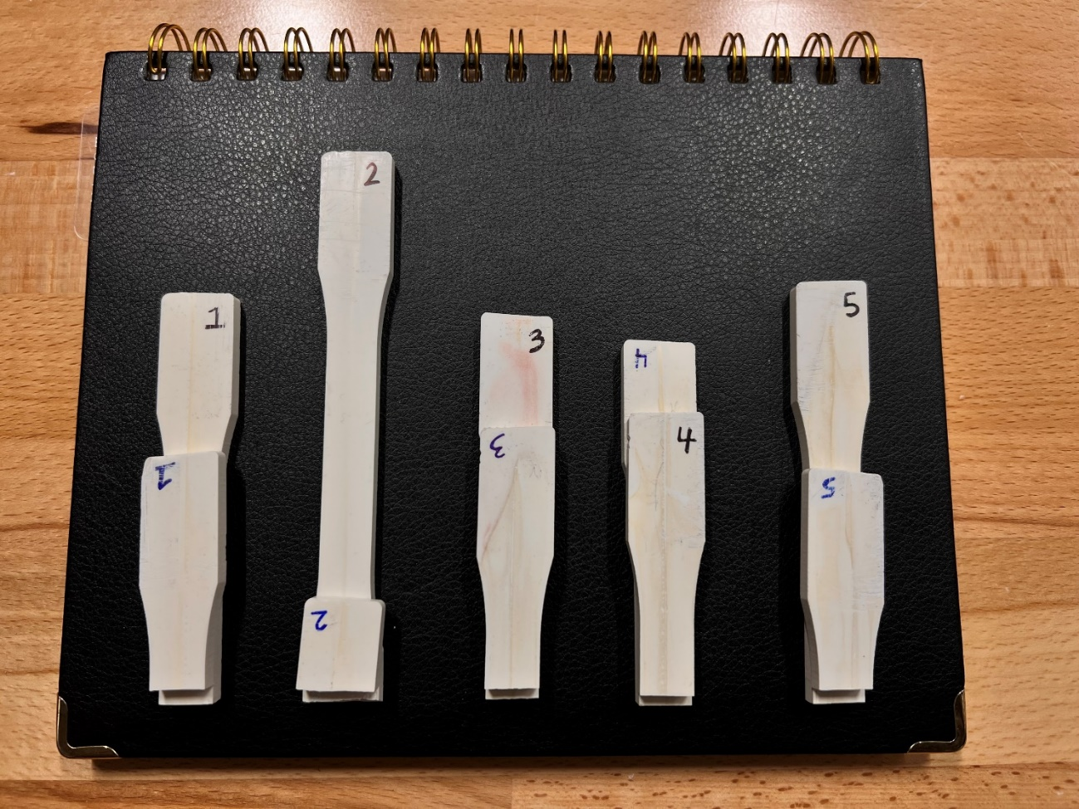
Radiation Tolerant Epoxy Evaluation
Mechanical Testing:
Pictured top: Small form factor (SFF)¹ tension samples
Pictured bottom: Large form factor (LFF) tension samples
Both small and large samples utilize the same ASTM D638 & E9 “dog-bone” shape and proportions i.e. gauge² length is ~4x the gauge width
1) shape, proportions
2) reduced cross-sectional area section of sample

Slide 10
Testing: Mechanical Data
UTS data for epoxy PEB-C
Results inconsistent: emphasizing need for process improvement
Sample | Ultimate Tensile Strength (MPa)
 | Small FF | Large FF
1 | - | 14.96
2 | 29.52 | -
3 | - | 25.65
4 | - | 22.10
5 | 27.66 | 13.36
6 | 25.32 | -
7 | - | -
8 | 24.05 | -
9 | 26.12 | -
10 | 28.24 | -
Average ± Standard Deviation | 26.82 ± 2.02 MPa | 19.02 ± 5.82 MPa

Slide 11

Opportunity/Strategy
Generating revenue TODAY - commercial orders received from commercial fusion start-ups & Fortune 500 DOD Primes…received orders in SBIR Phase I.
Short Term (2025-2027) target is R&D community
(universities & national labs); < $ 1M
Mid-term (2027-2030)> 10 Fusion energy start-ups w/ > $4B in funding. Typical tokamak fusion energy machine requires > 1,000 ($1-5M)
Long Term (2030+) move into LNG and LH2 storage, transportation, and data centers; $5-20M
Total Serviceable Market Opportunity
$5-20 M
LH2/LNg & data centers
Fusion Energy Companies
$1-5 M
Target Market
<$1M 2-3 yrs
Notes:
Speak to the Opportunity
Size of your niche opportunity
Type of market (emerging, established)
Speak to the Societal Impact, if appropriate
The Association for Unmanned Vehicle Systems International (AUVSI) projects that within a decade, yearly sales of agricultural UAS will top 80,000 new units in the United States alone. The USDA 2012 Census corroborates this figure, identifying 300,000 mid-to-large (bigger than 500 acres) farms that would benefit most from the technology.

Slide 12
Path Forward
Work scope A: 100 % complete
  Field test @ ANL (R. Vondrasek)
Work scope B: Low Cost, High Throughput Manufacturing & Component Testing (100 % complete)
  Develop low-cost volume manufacturing techniques
  Develop low-cost/repeatable/reliable high volume LN2 thermal cycle testing techniques
  Develop low-cost/repeatable/reliable high volume GHe testing techniques
Work scope C: CHV-Bushing Design 100 % Complete
Commercial Outreach
  Commercial Fusion companies
  LH2 or LNG for transportation & storage
  Electrical Grid for Data Centers (possible PII-B or PII-C)

Slide 13
e2P Ask
Seeking additional R&D Funding (~ $1M) to extend product line into flammable cryogenic fluids market e.g. LNG & LH2
Seeking additional cryogenic customers that utilize CHVBs
    CHVB Users: ANL, BNL, LBNL, LANL, LLNL, INL, NHMFL, ORNL, PPPL, SNL, Universities
.

Slide 14
THANK YOU
Christopher Rey, Ph.D.
President
(865) 250-0237
cmrey@e2pco.com
www.e2pco.com

