Slide 2


“WHAT??? I have to present a presentation?”

Slide 3

Tips for organizing and presenting presentations
Tip #1-Organize Your Presentation
Tip #2-Use Effective Delivery Skills
Tip #3 –Control Speaking Fears

Slide 4

Tip #1 Organize Your Presentation
Pattern
Tell them what your going to tell them
Tell them
Tell them what you told them
Written/Oral Communication

Slide 5
Tip #1 Organize Your Presentation
Introduction
Gain audience attention
Explain why you are credible to talk about topic
Link topic to audience
Preview your main points (Tell them what your going to tell them)

Slide 6
Tip #1 Organize Your Presentation
Introduction
Gain audience attention
“Human activities currently release about 37 billion metric tons of CO2 per year” (Justfacts, n.d., Para 10).
Explain why you are credible to talk about topic
I have studied this topic for the past two months.
Conducted a research project for science class.
Link topic to audience
The release of CO2 impacts our lifestyle and the lifestyle of our children.
Preview your main points (Tell them what your going to tell them)
Carbon dioxide is produced when animals breathe.
Carbon dioxide is produced by volcanic activity.
Carbon dioxide is produced by burning oil, coal, natural gas, or wood.

Slide 7
Tip #1 Organize Your Presentation
Body (Tell Them)
Carbon dioxide is produced when animals breathe.
II. Carbon dioxide is produced by volcanic activity.
III. Carbon dioxide is produced by burning oil, coal, natural gas, or wood.

Slide 8
Tip #1 Organize Your Presentation
Conclusion
Summarize your main points (Tell them what you told them)
Memorable ending

Slide 9
Tip #1 Organize Your Presentation
Conclusion
Summarize your main points (Tell them what you told them)
Carbon dioxide is produced when animals breathe.
Carbon dioxide is produced by volcanic activity.
Carbon dioxide is produced by burning oil, coal, natural gas, or wood.
Memorable ending
“Human activities currently release about 37 billion metric tons of CO2 per year” (Justfacts, n.d., Para 10). How many of those tons have you and I released?

Slide 10

Tip #2-Use Effective Delivery Skills
Eye Contact
Gestures
Facial Expression
Personal Appearance
Thought Rate vs. Speech Rate

Slide 11
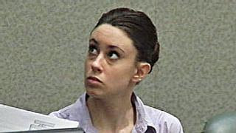

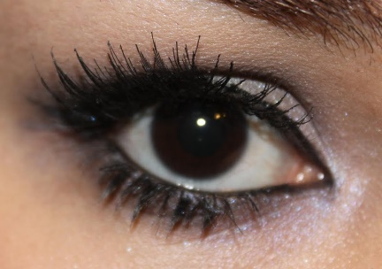


Tip #2 Eye Contact
E. Guilty or Arrogant
F. Thoughtful or Arrogant
G. Flirting or Happy
H. Arrogant or Guilty
Baron-Cohen, Weelwright, and Jolliffe (1997) study on identifying emotions from the eye areas.

Slide 12
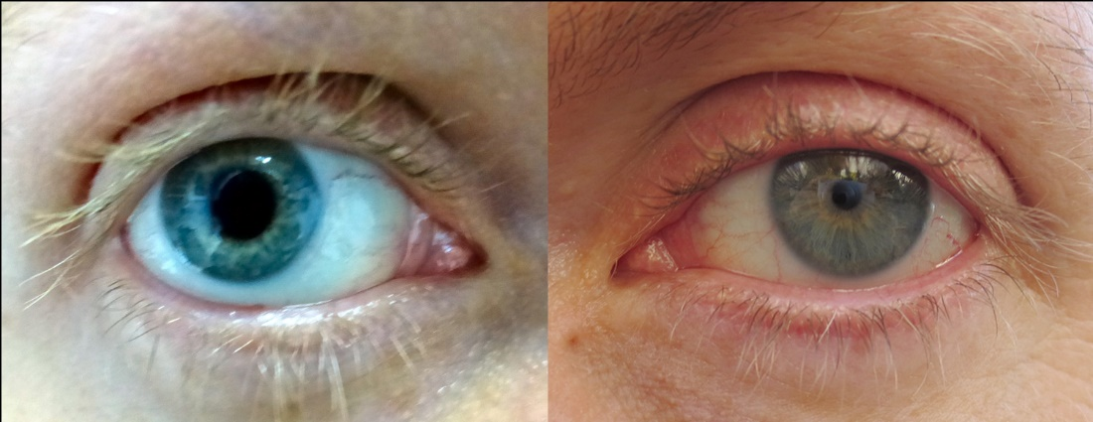
Eye Contact
Establish and Maintain Eye Contact
Begin Without Looking at Your Notes
Send/Receive Messages from Audience
Hess(1975; Hess & Petrovich, 1987) study on increased pupil size resulting in increased positive attributes.

Slide 13
Gestures
Use Natural Gestures
Allow Nonverbal to Support Verbal Message
Speaking Notes
Mehrabian, Albert (1971). Silent Messages (1st ed.). Belmont, CA: Wadsworth.
7% Words
38% How you say it
55% Nonverbal/ Facial Expressions

Slide 14




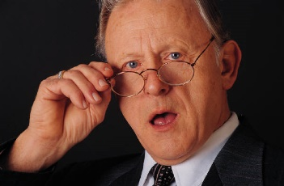





Facial Expression
Anger, fear, boredom, doubt, surprise Paul Ekman facial expression study
Emotions are contagious

Slide 15



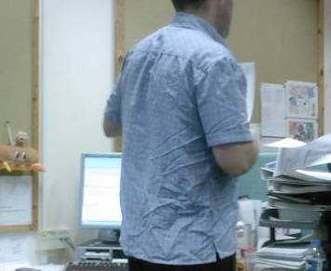




Personal Appearance

Slide 16

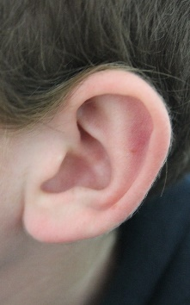
Thought Rate vs. Speech Rate
Words/ minute average person speaks?
125
Words/ minute average person has ability to listen to?
700

Slide 17
Thought Rate vs. Speech Rate Solution
Vocal Delivery
Vary speech (rate, tone, pitch)
Use pauses/vocalized pause
Speak with enthusiasm and sincerity
Speak loud enough to be heard
Extemporaneous delivery

Slide 18
Tip #2-Use Effective Delivery Skills
Eye Contact
Gestures
Facial Expression
Personal Appearance
Thought Rate vs. Speech Rate

Slide 19


Tip #3 –Control Speaking Fears

Slide 20

Tip #3 –Control Speaking Fears
Deep Abdominal Breathing (Dwyer, K. K. (2005). Training exercise pg. 67).
Performance Vs. Communication Orientation (Motley 1997).
Mental Rehearsal (Visualization)
Physical Exercise
Interpersonal Support
Skill Training
Cognitive Restructuring
Systematic Desensitization

Slide 21
“WHAT??? I have to present a presentation?”

Slide 22
Tips for organizing and presenting presentations
Tip #1-Organize Your Presentation
Tip #2-Use Effective Delivery Skills
Tip #3 –Control Speaking Fears

Slide 23
References
Baker, M. (2010, December 10). Ekman's Studies on Facial Expression of Emotion [video file]. Retrieved from https://www.youtube.com/watch?v=umhb95CyyUk
Baron-Cohen,S., Weelwright, S., and Jolliffe, T. (1997). Is there a “language of the eyes”? Evidence for normal adults, and adults with autism or Asperger syndrome. Visual Cognition 4, 311-331.
Dwyer, K. K. (2005). Conquer your Speech Anxiety. Belmont, CA: Wadsworth
Hess, E. H. (1975). The tell-tale eye. New York: Van Nostrand Reinhold.
Hess, E.H., & Petrovich S.B. (1987). Pupillary behavior in communication. In A.W. Siegman & S. Feldstein (Eds.) Nonverbal behavior and communication (2nd ed.). Hillsdale, NJ: Erlbaum.
Just Facts (N.D.) Just facts :A resource for independent thinkers. Retrieved from https://www.justfacts.com/globalwarming.asp#overview
Knapp, M. L., and Hall, J. A. (2002). Nonverbal communication in human interaction (5th ed.). Albert complex, Singapore: Thompson Learning
Mehrabian, A. (1971). Silent Messages (1st ed.). Belmont, CA: Wadsworth
Motley, M. T. (1997). Overcoming your Fear of public speaking. Boston, MA: Houghton Mifflin.
Ralph G. N. & Leonard A. S. (1957) “Six bad listening habits.” In Are your Listening? (New York: McGraw-Hill 1957).

