Slide 1
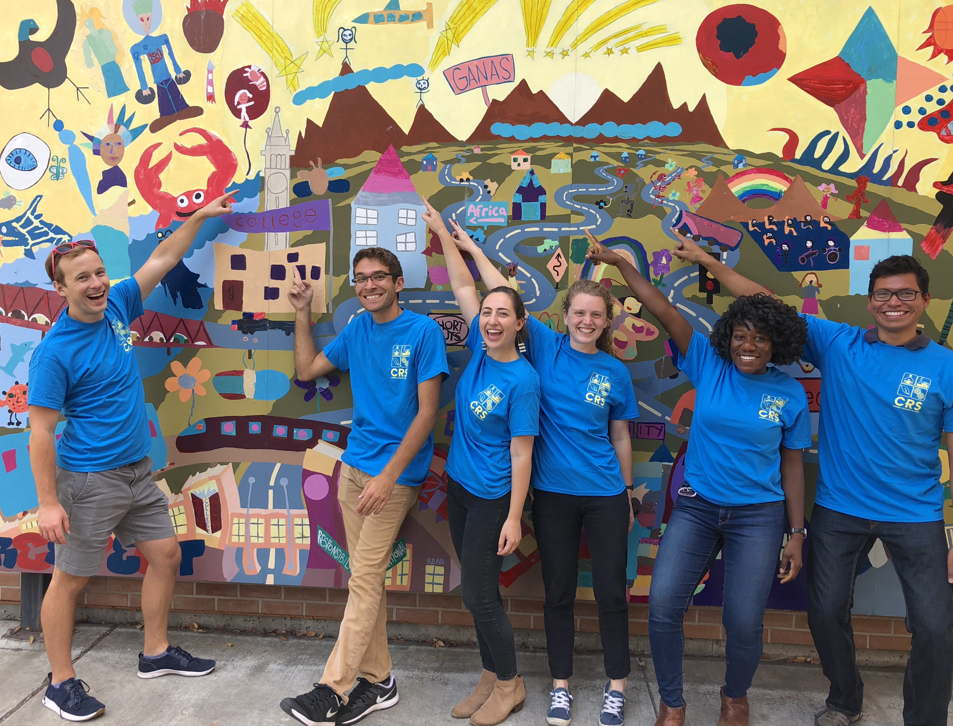

Empowering Scientists & Engineers to Engage in K-12 Outreach
Teresa Barnett, Executive Director
April 29, 2019
www.crscience.org

Slide 2

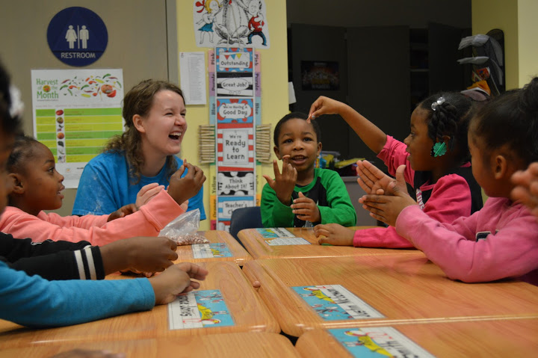
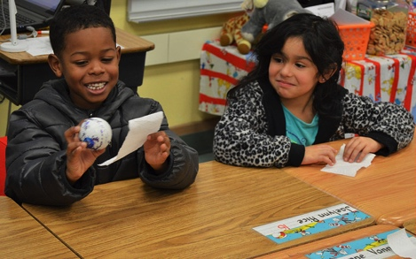
Agenda
Introduction of CRS
In what ways are scientific experts beneficial to educators and students? What role can they play?
Best practices for connecting with teachers & schools
Preparing scientists to be effective in classrooms & teacher PD
Determining best fit (lessons, topics, grade levels)
Special considerations for elementary

Slide 3
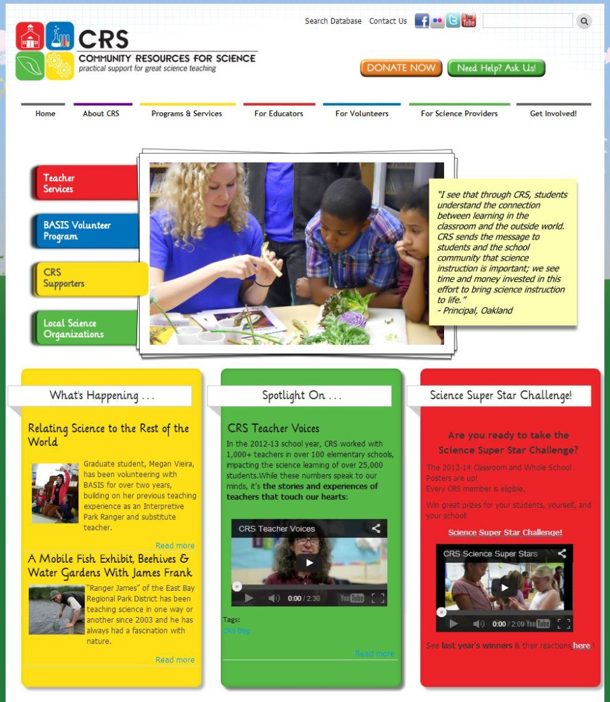
Community Resources for Science
(CRS)
www.crscience.org
“For Volunteers” tab
Planning tools
Lesson plans
Volunteer resources
Standards info
Spotlights

Slide 4
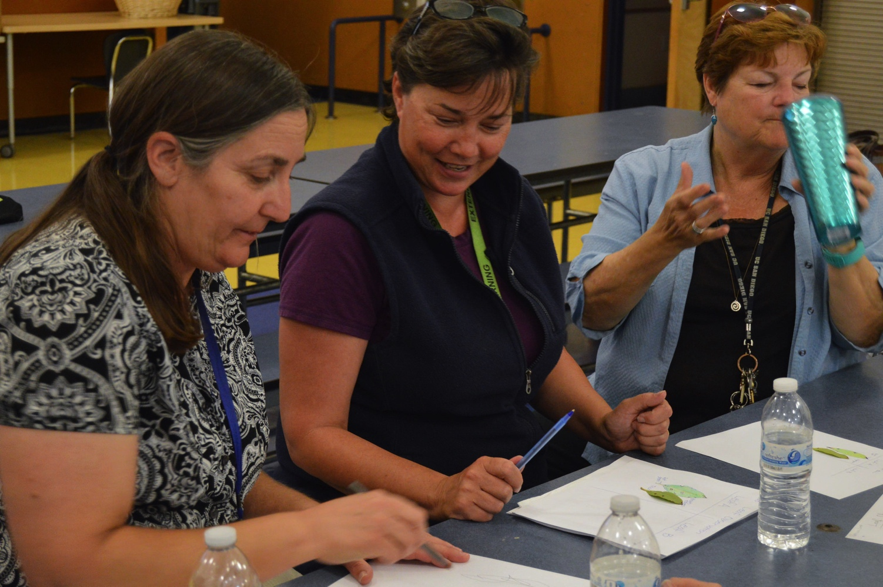
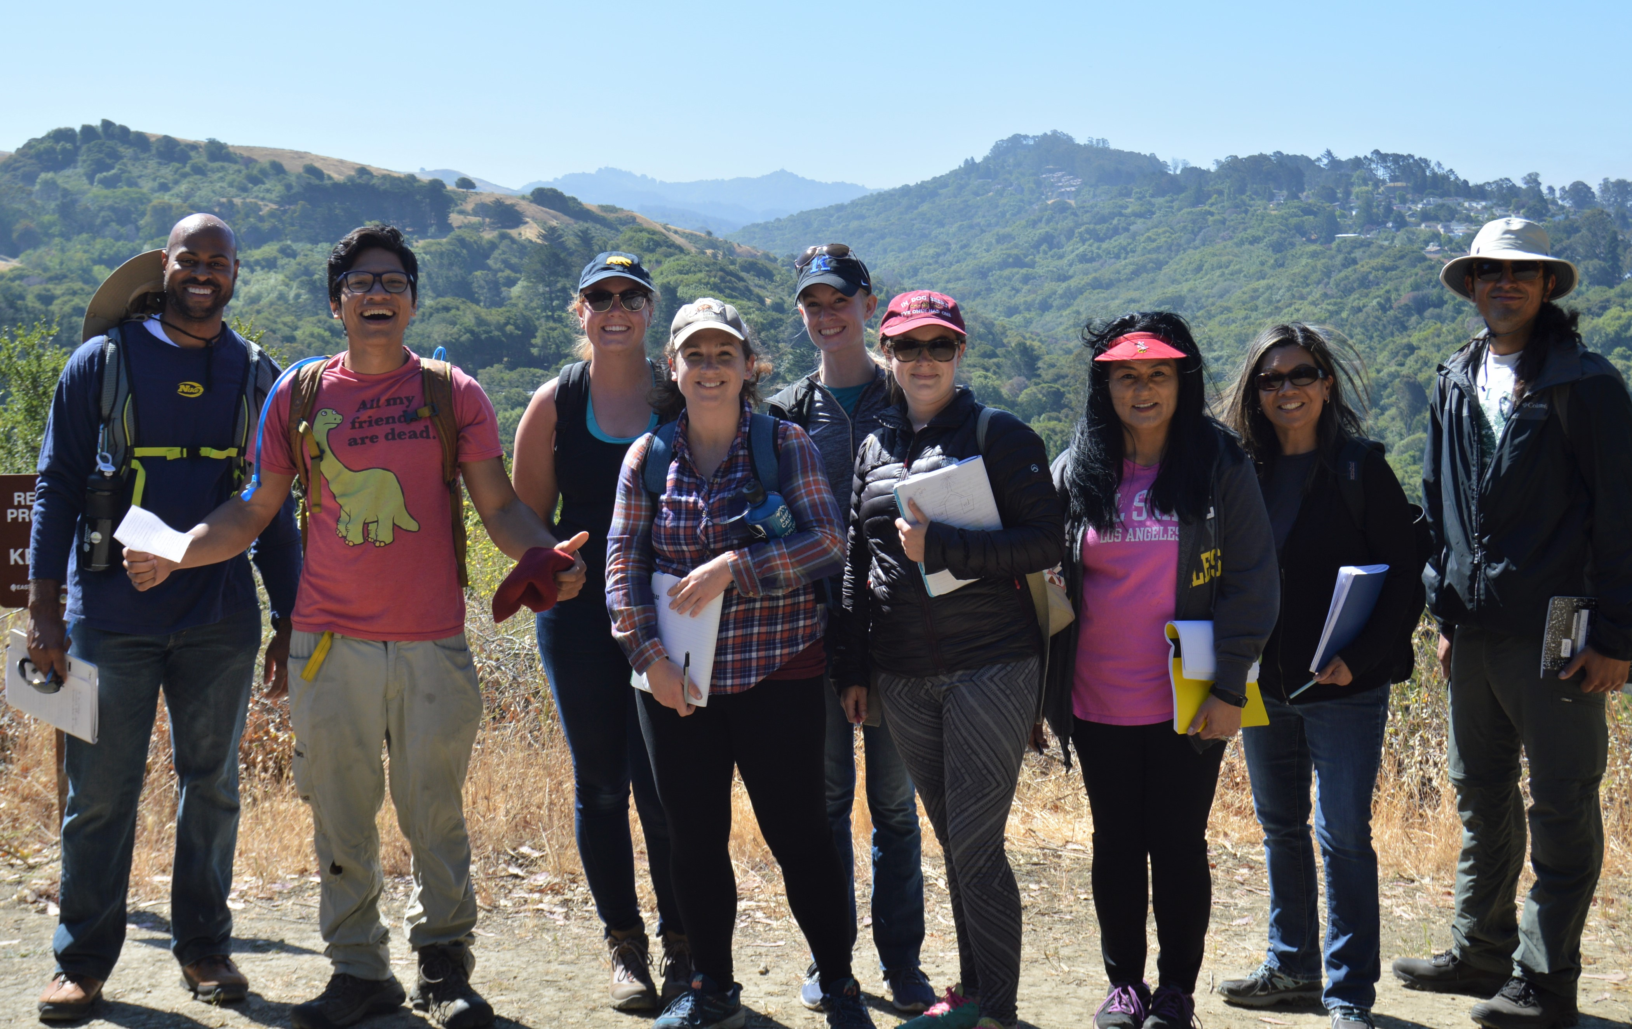
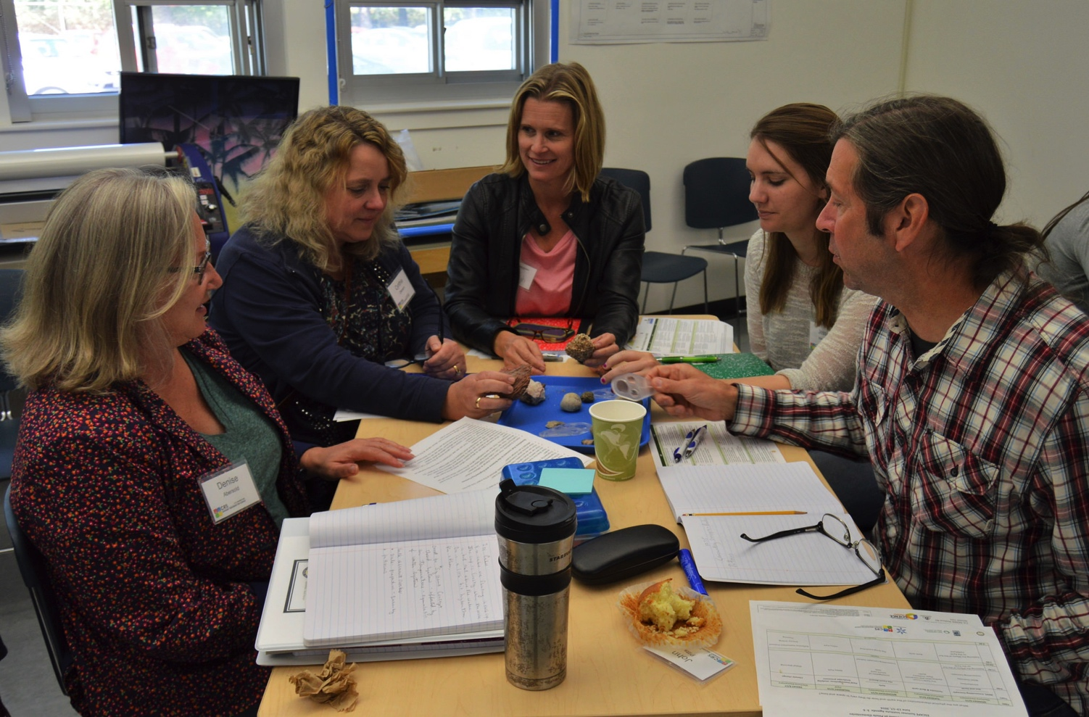
Community Resources for Science
Providing nearly 1,800 K-8 Teachers Direct Support since 1997

Slide 5
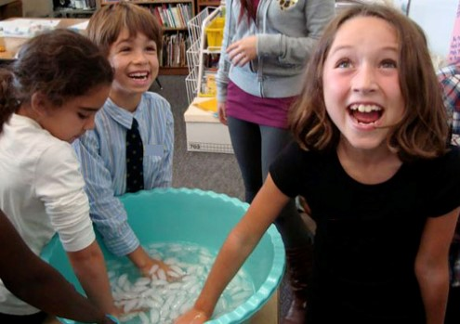
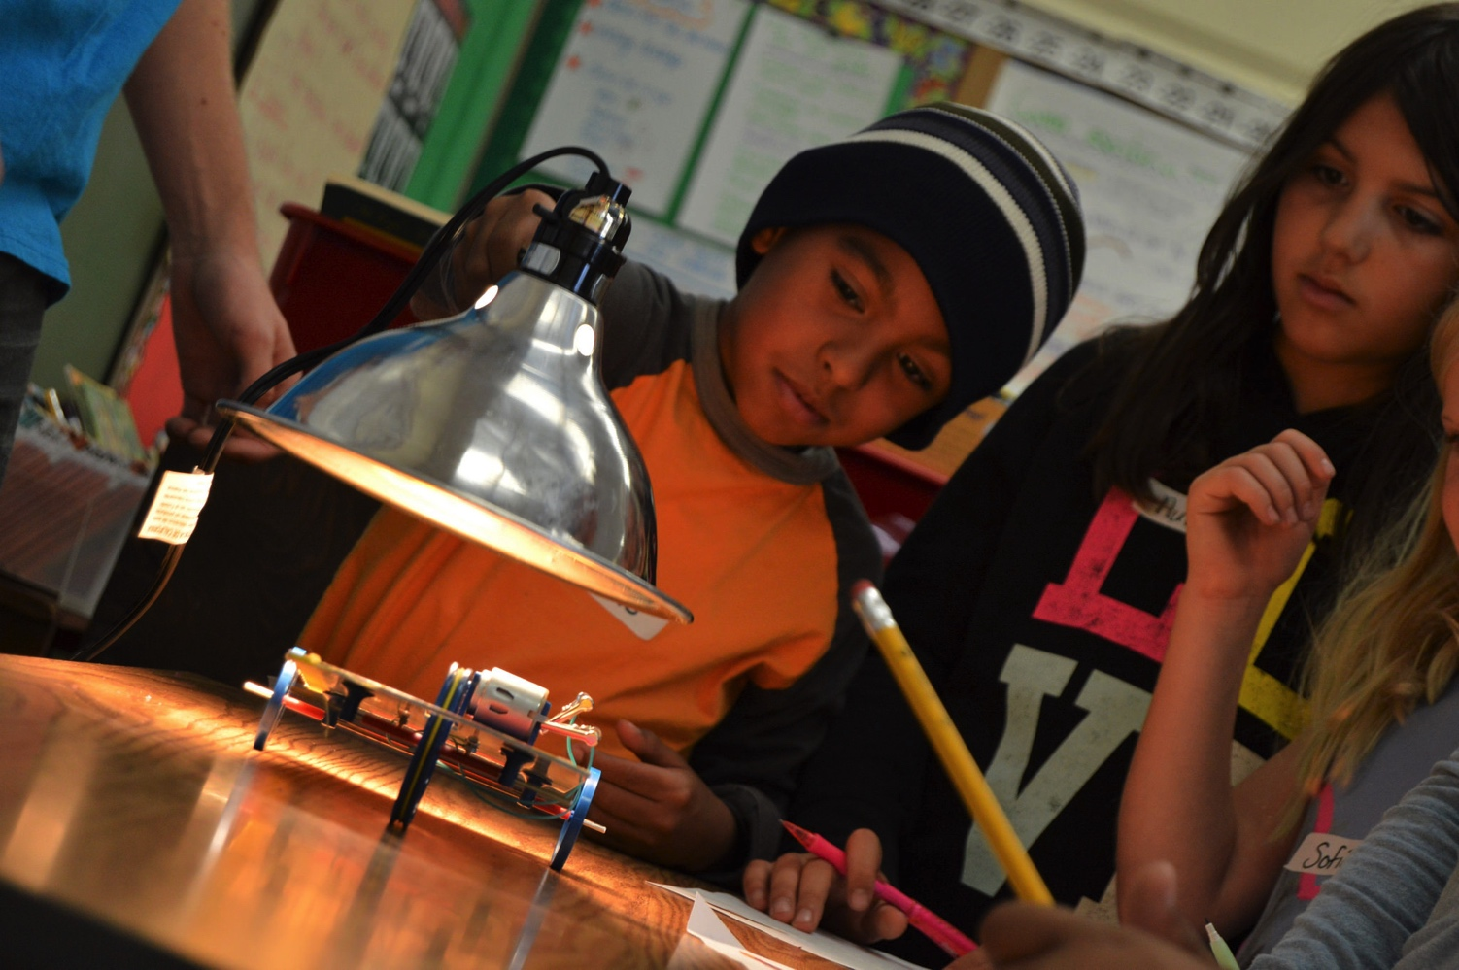
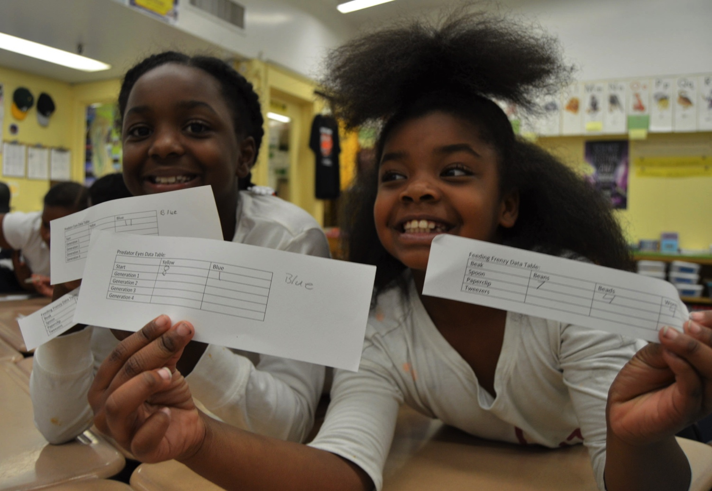
Community Resources for Science
Inspiring Students to Image Their Own Future in STEM through Role Model & Mentor interactions

Slide 6
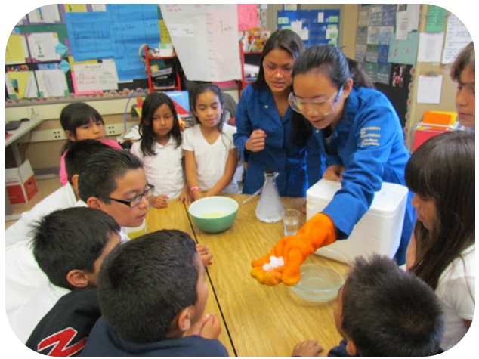
Bay Area Scientists in Schools (BASIS)
Provide Diverse Science Role Models
  1-hour in-class lessons aligned with standards
  Dispel stereotypes
  Equity focus
Inform and Inspire Students
  Share hands-on STEM experiences
  Supplement limited hands-on science teaching in many areas
Support and Motivate Teachers
  Model authentic inquiry
  Demonstrate students’ engagement
  Create a ripple effect
700 scientists & engineers from UCB and industry
500+ K-6 in class visits
15,000+ students

Slide 7
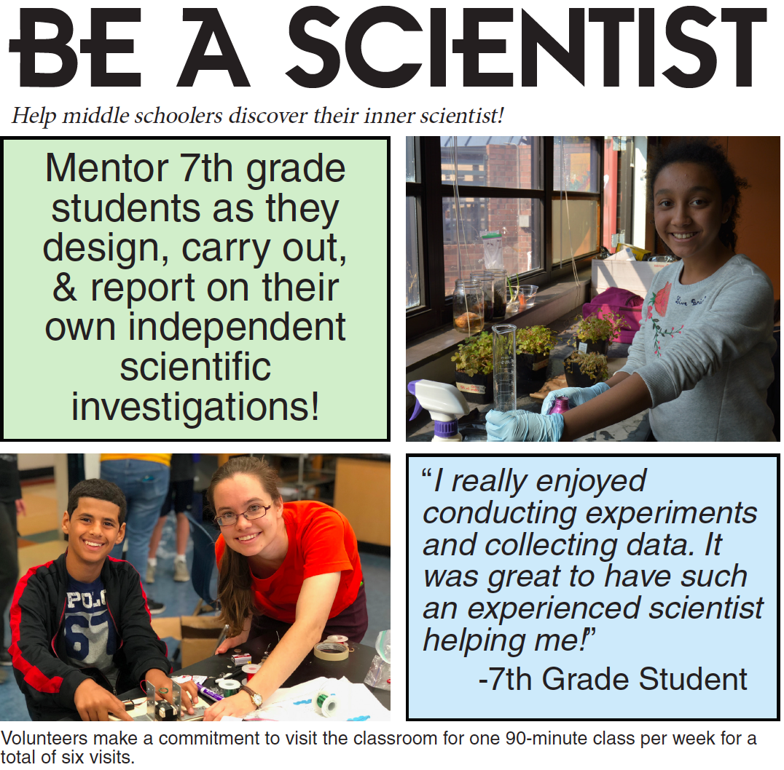
Notes:
Intro section: 5 minutes

Slide 8
In what ways are scientific experts beneficial to educators and students? What role can they play?
Show, don’t tell: Dispel misperceptions – Research shows we cherry pick to confirm pre existing views; learners can’t build “good new” understanding on a wobbly base.
Engagement: Increasing teacher interest, understanding is key to getting them enthusiastic and confident to teach.
Inspiration: Share about your own research, pathway, questions you are exploring, equipment/field research
Notes:
What it the unique value that scientists and engineers bring to the table? Beyond deep content knowledge, it is the understanding of the systematic process for trying to figure things out. Experiences, providing opportunities for learners to experience the power of wonder, investigation, discovery

Slide 9
In what ways are scientific experts beneficial to educators and students? What role can they play?
Authentic experiences: Understand standards, prepare teachers for success in meeting the goals they are evaluated on. NGSS in most states
Build understanding Focus on process, and the purpose of science – not just “dispensing facts”
Share about the nature of your research (where do collaboration, communication fit in?) LOCAL connections
Invite participation: Share ways teachers or kids could learn more about the topic (citizen science, good videos or books, local exhibits or experiences)
Notes:
Understand the standards in your state, curriculum and resources in your target schools (district, community) Those who say “I’m a people person” don’t feel science is a career – stereotypes need to be dispelled.

Slide 10
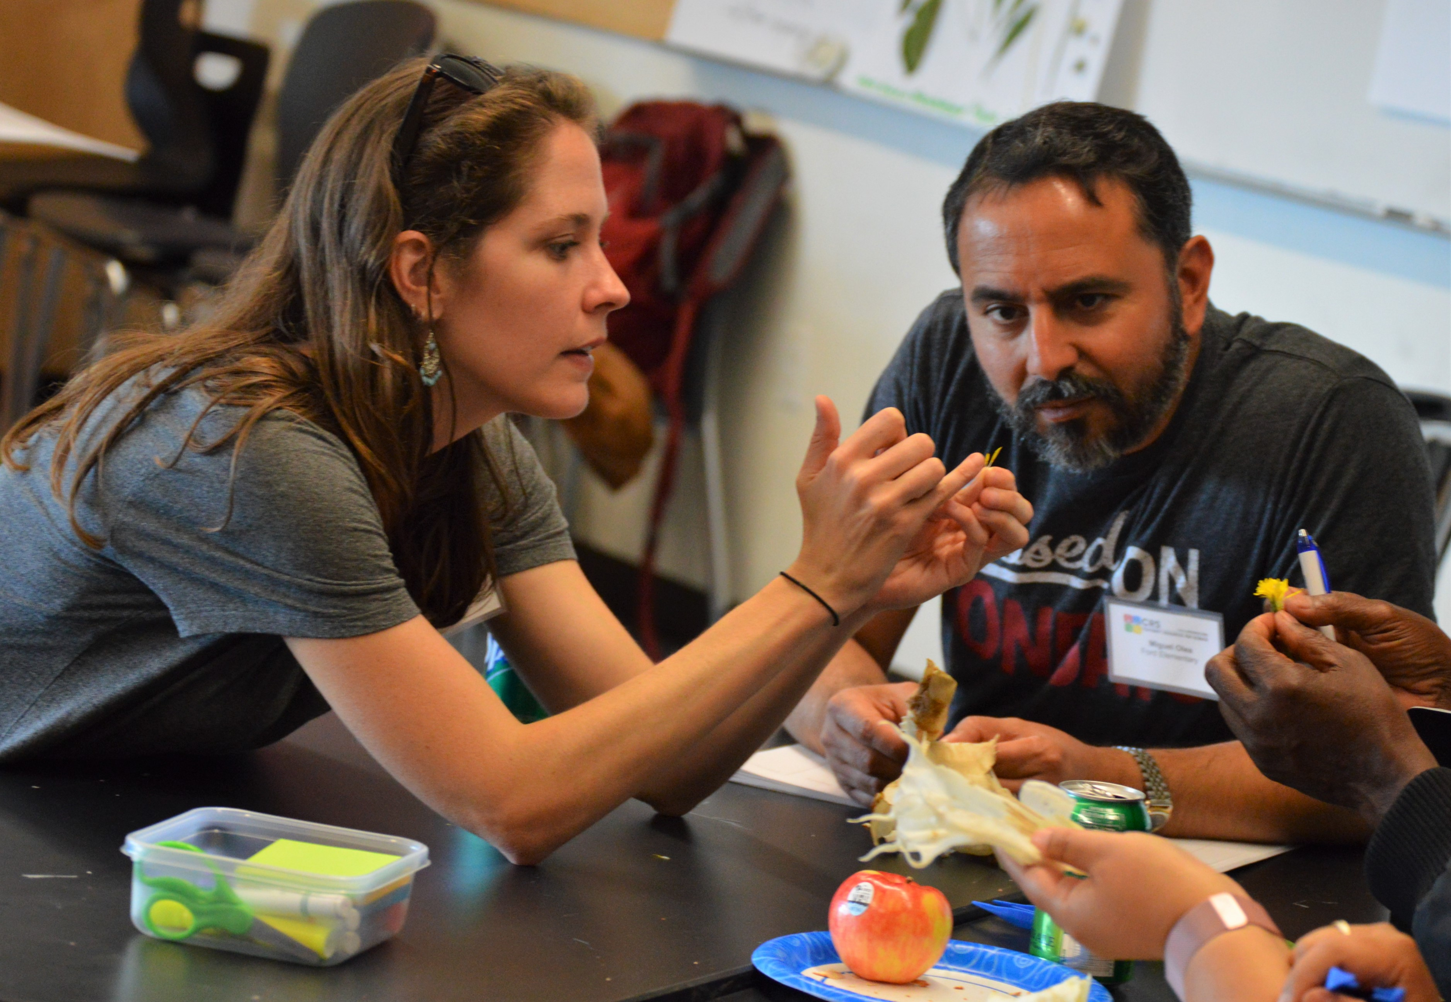
Best practices for connecting with teachers & schools
Understanding their needs, and available resources
Listening!
Notes:
How can you meet needs and fill gaps? Be purposeful about building mutually beneficial, mutual learning partnerships. What do you get out of it, and what do you bring to the table? Humbleness goes a long way. You have some, but not all, of the answers!

Slide 11
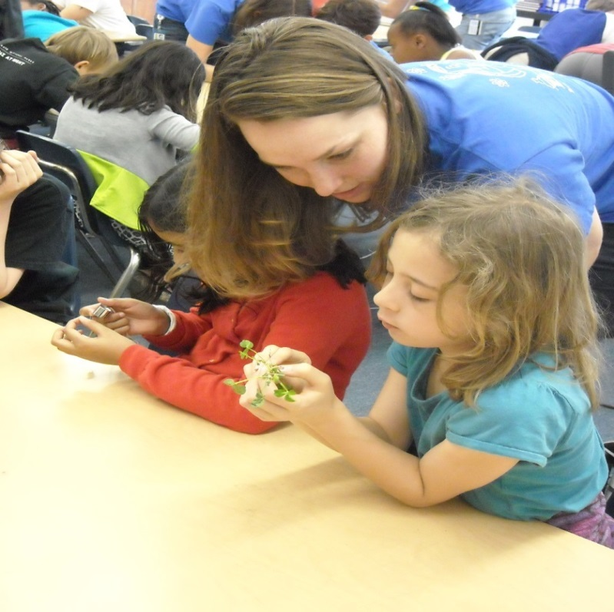
Building Bridges with Teachers
What are teachers generally looking for?
  Scientist-student dialogue, encouraging, nurturing curiosity
  Authentic inquiry, exploration, discovery
  Content support
  Resources
Notes:
So, we see why it’s such an exciting and crucial time for scientists to be engaging with schools. What can we help with? To generalize, teachers tend to be looking for:
Scientist-student dialogue (interaction, not just lecturing)
Scientists provide real-world connections for science content
Role models
College and career insight
Content support
The most obvious way to do that is through the activities you bring in, or through citizen science opportunities
You can also provide Specialist perspective on controversial areas, like climate change or GMOs,
Or support teachers in helping scientists understand what science actually is, and how it’s practiced
Which you’re the expert on
Teachers want visits that support their curriculum
And in many places, lessons that integrate with NGSS
Teachers tend to be spread very thin, and they want to know that they’re taking time out of their busy class schedules for something that won’t detract from their students progress
They want resources for continued learning
Activities, data sets, books, images, videos, resources that they can draw on to extend the lesson
And they want prepared scientist volunteers
By that I mean, it’s an important sign of respect to arrive in a classroom well prepared
What you’re going to present
To some degree, how you’re going to interact with students
It’s useful to train yourself a bit in the basics of classroom management
There are plenty of simple articles and videos online
I’ll share a few key tips at the end of this webinar, too
You’ll also want to think about what you can realistically offer, given your resources and especially how much time you have for outreach
One-off visits in one or more classrooms
Recurring lessons forming a unit
Personalized visits integrated into teacher’s curriculum
One visit template designed to be transferable to a variety of classrooms
It’s not that any one format is better than any other
They all offer different benefits to students

Slide 12
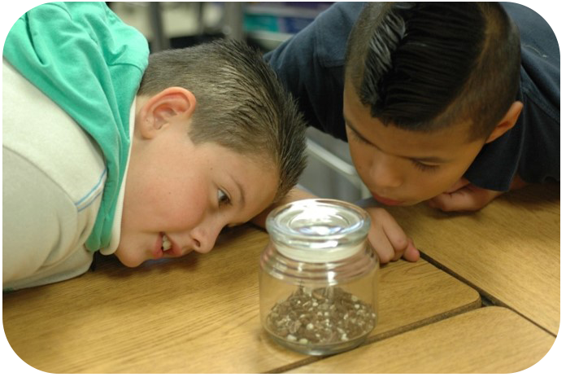
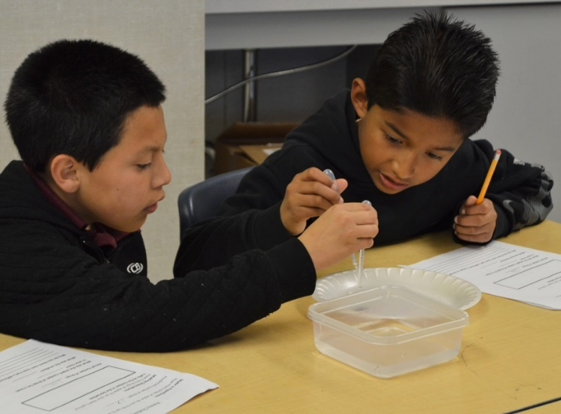
Build Partnerships: What Role will You Play in a Larger Ongoing Network of Support?
Campus resources
  Existing in-school outreach programs in STEM
  Teacher training programs
  Student groups
  Outreach or community partnership office
  Public-facing institutions (museums, botanical gardens)
Extracurricular programs, afterschool & summer
Private industry partnerships
Science centers, outdoor education

Slide 13
Preparing Scientists to be Effective
Communicators in Classrooms & Teacher PD
Training is key – match for audience and goals of outreach (CRS best practices resources online)
As with any communication task, key questions for the presenter/speaker/writer: who is my audience, and what is my key takeaway or goal
No lecturing! Be encouraging. Model uncertainty: ‘That’s a great question – I don’t know. How could we find out?’
How do you use the same tools/skills kids are learning? (notebooks, sketching, discussion/debate, supporting claims with evidence, learning from failure)

Slide 14
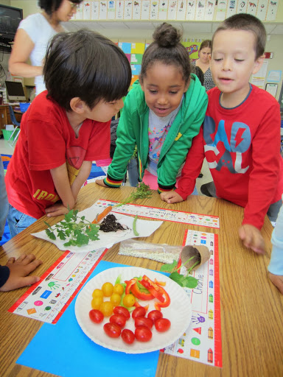
General Tips: Science Communication
Choose your words – replace jargon with familiar language
Use visuals
Integrate your audience into the story – how does your topic touch their lives?
Vocab comes in context, not front loaded. Kids feel empowered to learn new words.
Goal isn’t to build a vocab list – it’s to tickle curiosity and demonstrate that it’s possible to use scientific approach to systematically find answers, build understanding.

Slide 15
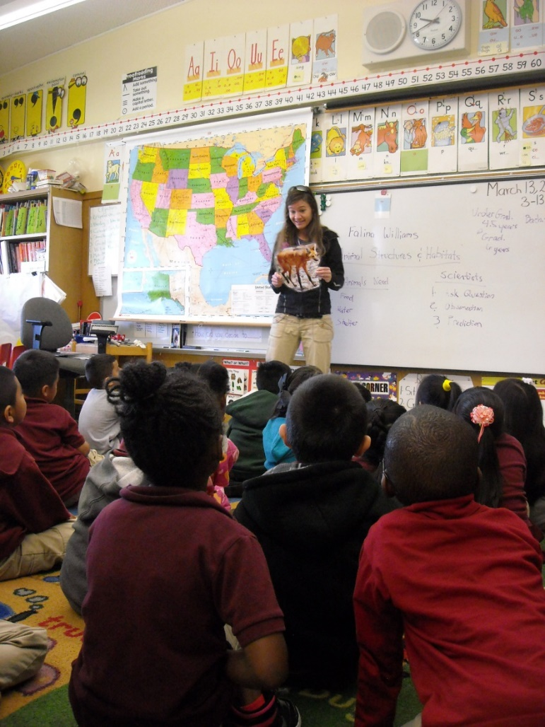
Role Model Intro: Be A Good Storyteller
Your personal “elevator pitch”
Simplifying vs. dumbing down
The take-away: why should kids relate?
  How did you get into science?
  What do you study?
  How do you do your research?
  How does your topic connect to kids’ everyday lives?
  Does your topic have backyard impact?
Notes:
Kids love to hear that the scientists are in “Grade 18” – it makes a big impression!

Slide 16
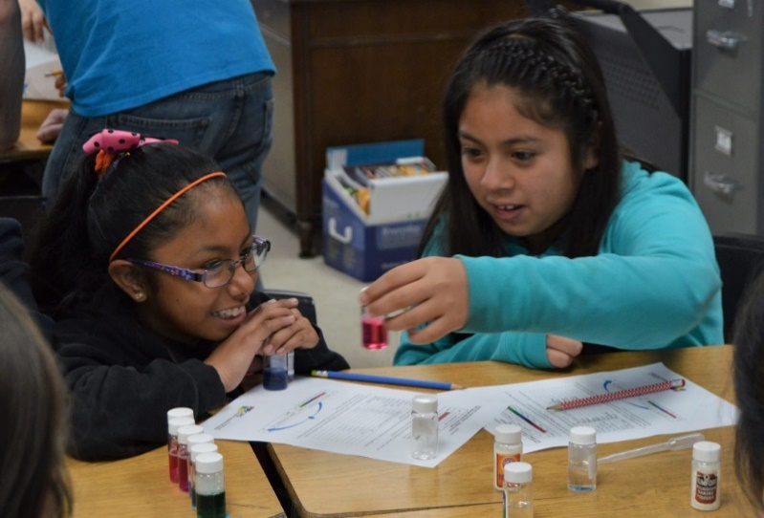
Communicating Science In Schools
Be adaptable: every school, grade, and student is different
  Ask the teacher – good advance communication is important
  Assess for learning – how will students show what they learn?
  Use age-appropriate vocab, concepts, and metaphors
Have a clear checklist of pre-outreach tasks
Have a clear materials management strategy
Teams are effective when possible (sustainability)
Encourage participation
  Keep it interactive
  Say, write, show
Have fun!

Slide 17
Planning Outreach: Determining Fit
Format, Topic, Grade Levels
Understanding the standards is key
“Your” research is likely relevant at a few key grade levels, so develop variations for the different levels
What time, resources, logistical support, funding, etc. do you have available?
Looking for short- or long-term impact?

Slide 18
New Directions in Science Education
Transitioning from “old” California Science Standards to the new Next Generation Science Standards (NGSS)
“Old” way of teaching science | NGSS approach
Learning info from textbooks | Doing hands-on science; Analyzing real-world examples
What scientists know | What scientists do; How scientists think; What scientists learn
Content-driven | Question-driven
Learning about | Figuring out
Emphasis on real world connections
Will be implemented in all CA public schools by 2018
Notes:
Many of you may remember science learning as mostly memorization from textbooks – remembering lots of facts. That way of teaching is still the norm in many classrooms across the country and I’ll be referring to that as the “old’ way of teaching. But California and many other states recently adopted the Next Generation Science Standards or NGSS (I’ll use this acronym many times throughout the presentation). The NGSS approach emphasizing doing hands-on science, analyzing real-world examples. They are moving away from memorizing lots of facts and focus more on what scientists are actually doing, how they’re thinking, and what they’re learning. The new standards are question-driven and focus on figuring out a problem.

Slide 19
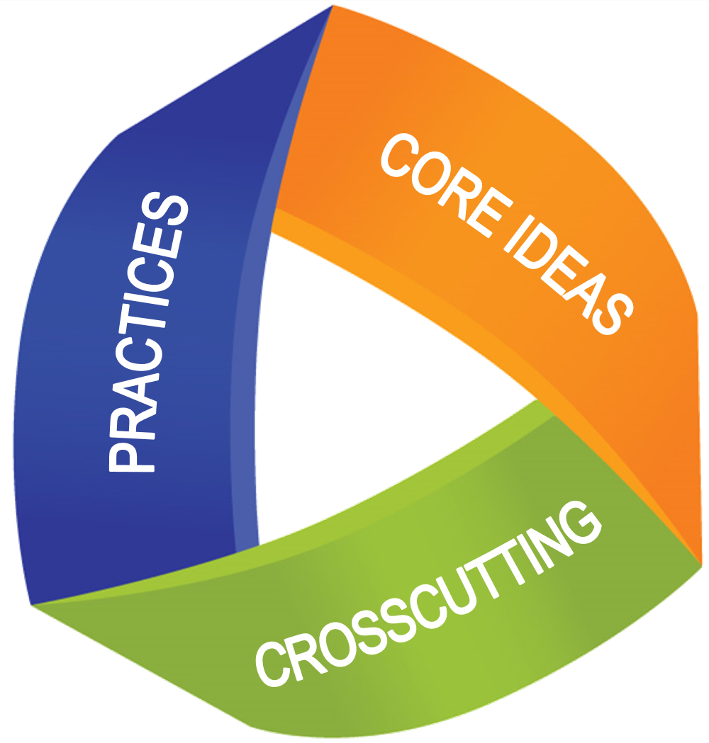
Next Generation Science Standards
Phenomenon
Question
Investigation
Big-Picture Connection
New Questions
http://www.nextgenscience.org/

Slide 20
NGSS: Science & Engineering Practices
Asking questions (science) and defining problems (engineering)
Developing and using models
Planning and carrying out investigations
Analyzing and interpreting data
Using mathematics and computational thinking
Constructing explanations (science) and designing solutions (engineering)
Engaging in argument from evidence
Obtaining, evaluating, and communicating information

Slide 21
NGSS: Crosscutting Concepts
Patterns – organization and classification
Cause and effect – mechanism and explanation
Scale, proportion, & quantity – recognize what is relevant
Systems and system models – define the system under study
Energy and matter – flows, cycles and conservation
Structure and function – determine properties of things
Stability and change – determine rate of change/evolution

Slide 22
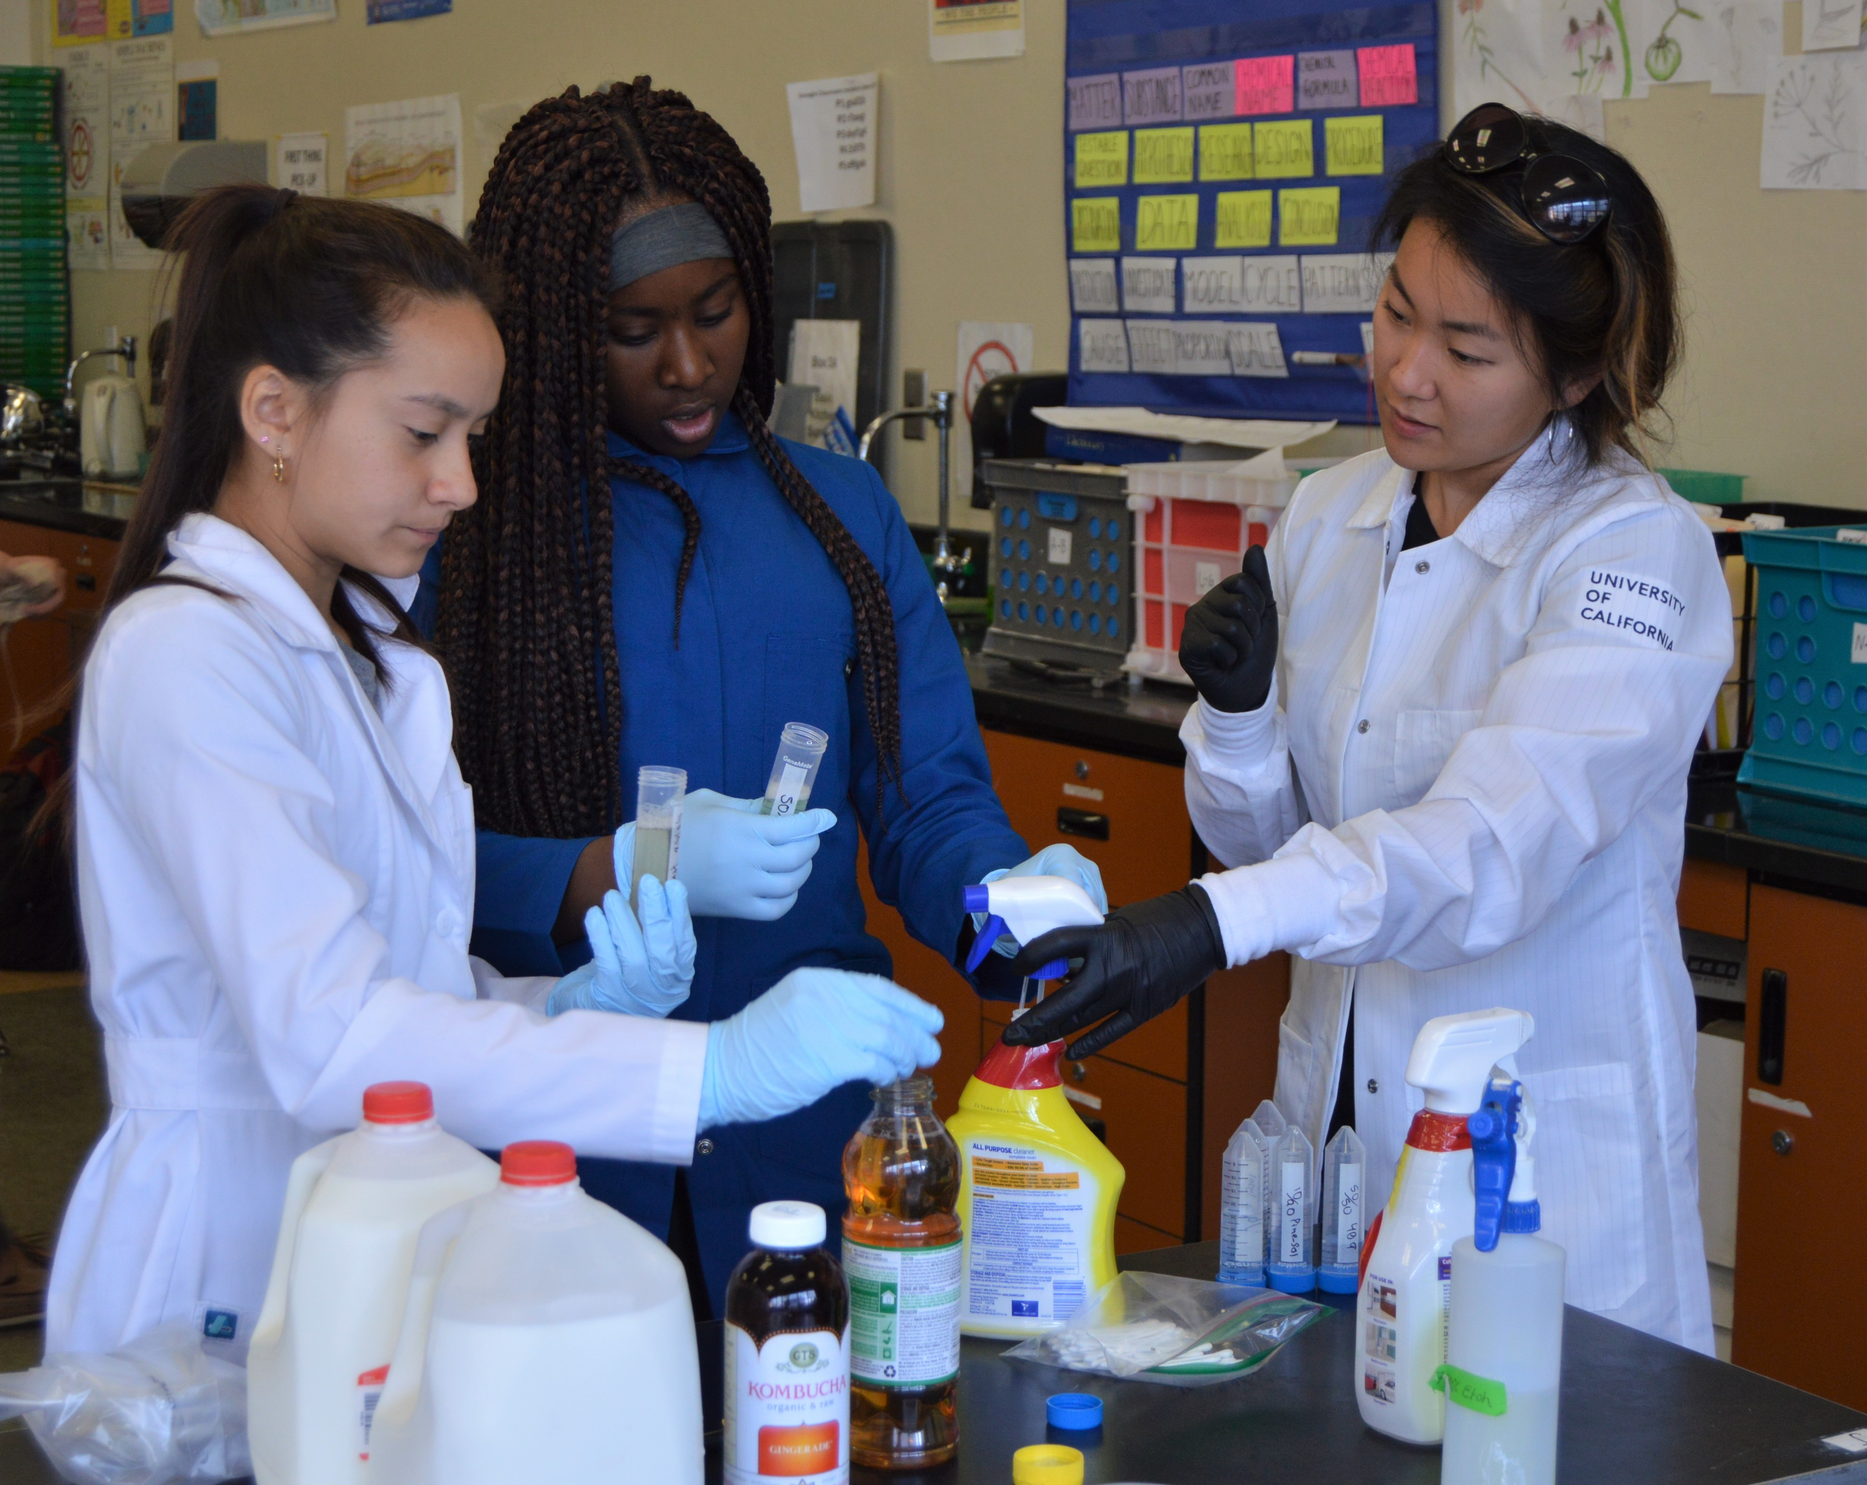
NGSS: Disciplinary Core Ideas
Life Science
Earth/Space Science
Physical Science
Engineering, Technology & Society
Human impact on environment
DCIs spiral from K-12, so “your” research is particularly relevant at a few key grade levels, so develop variations for the different levels
https://www.nextgenscience.org/sites/default/files/resource/files/AppendixE-ProgressionswithinNGSS-061617.pdf

Slide 23
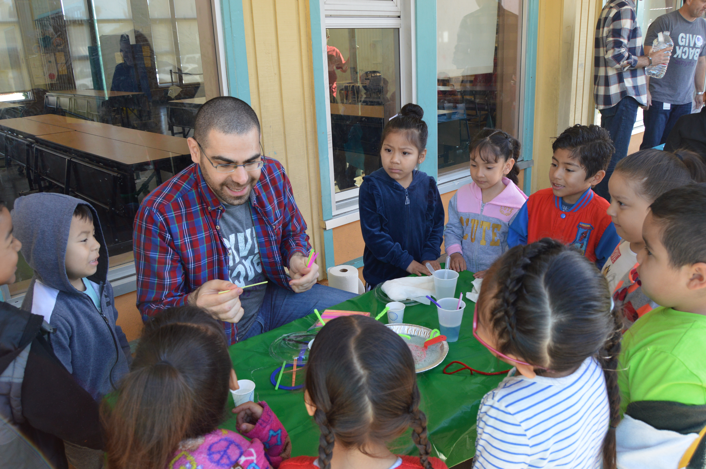
Examples of Types of Science Outreach – Different Goals, Formats
Classroom visits with hands-on activities
In class mentoring
Afterschool programs & Family science nights
Science fair judging & Career events
“Festival” events
Teacher PD
Notes:
There are a number of different ways to bring your research to a broader audience.
One of the most common – and, I would argue, most valuable – is to visit individual classrooms with a hands-on activity. Classroom visits tend to help you reach a broad range of students and meet a variety of outreach goals; facilitates personal interaction with students; and opens the possibility of creating a ripple effect by inspiring and supporting teachers. But if classroom visits won’t work for your schedule, you might also consider: Afterschool programs, school science events (family science nights or science fairs), or workshops for teachers in your area of specialization

Slide 24
What age group fits my outreach goals?
Elementary School
Middle School
High School
Broaden participation
in science
Broaden participation
in science
Beginning science identity formation
Science identities largely formed
Inform / raise awareness
Inform / raise awareness
Disciplinary building blocks
Higher-level concepts
Share your specific interests
Share your specific interests
More flexible curriculum
Less flexible curriculum
Support teachers
Support teachers
One group of students; less specialization
Several periods; specialists
Notes:
To help you decide how to allocate your scarce time and resources and maximize your impact, it’s helpful to think about your goals and how they fit into different grade-level contexts
Again, given that there’s no one-size-fits-all when it comes to education, these are broad generalizations
It’s useful to think about what your local landscape looks like, and where the gaps are in your community
But overall this a good place to start
If your goal is to broaden participation in science
You’re probably thinking about science identity formation and the pipeline
We might jump straight to high school where students are considering careers and college…
But if those students arrive at the doorstep thinking science isn’t for them, there’s only so much we can do
Research shows that science identities are really formed around age 11 or 12, which leads a lot of scientists to target middle school in their outreach
…an excellent idea
although by the time they arrive in middle school they’ve already begun to form ideas about what “science” is, which will influence whether they end up identifying as “science people”
…making exposure during elementary school crucial
There are important benefits to working with students of all ages
The key thing is to think about where you’re the most comfortable
If your goal is to convey specific information or raise awareness
Keep in mind that at the youngest ages you’ll be explaining the foundations of your discipline – what is ice? how does it form? Why do we care?
At older ages, higher-level concepts like how you use remote sensing to monitor changing ice sheets, or how your ice core data reveals the history of carbon dioxide on Earth dating back 800,000 years
If you’re more flexible about what information you share, but your goal is still to share your particular interests,
Keep in mind that teachers have more flexibility in designing their own curricula in the earlier grades, when testing is more limited
At older grades, and especially by high school, it will probably be more important to develop a lesson that really supports the existing curriculum so you’re not taking away from students’ preparation for exams
Especially depending on the time of year
If your goal is to support teachers (help achieve that ripple effect)
You’ll find more science specialists at upper grades
Whereas elementary school teachers who are generalists might be less comfortable teaching certain topics
But also, keep in mind that middle and high school teachers tend to teach multiple periods the same content each day
Which means that the best way to support them might be to stick around all day and provide the same opportunity for all of their students
Really a question of what YOU are comfortable with
Whomever you choose to target, you can and will have impact

Slide 25
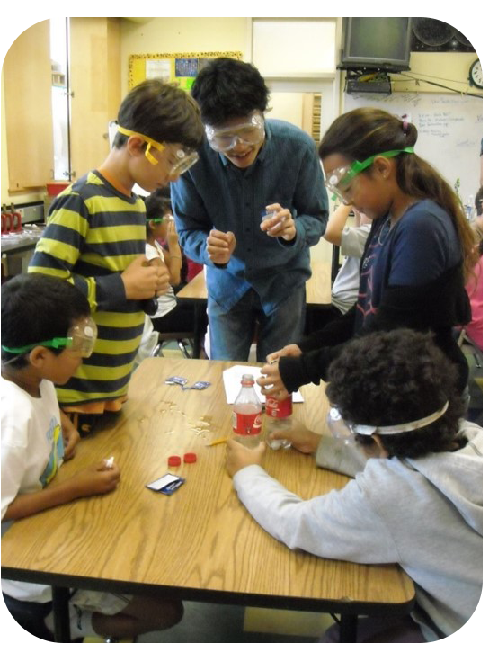
General Tips: Develop An Outreach Activity
What is your phenomenon?
How will you “hook” student interest?
Simplify, simplify, simplify
What is the one big question?
Hands-on, active learning, interactive
Use visuals
Carefully consider logistics, materials
Be a role model
Have fun!

Slide 26
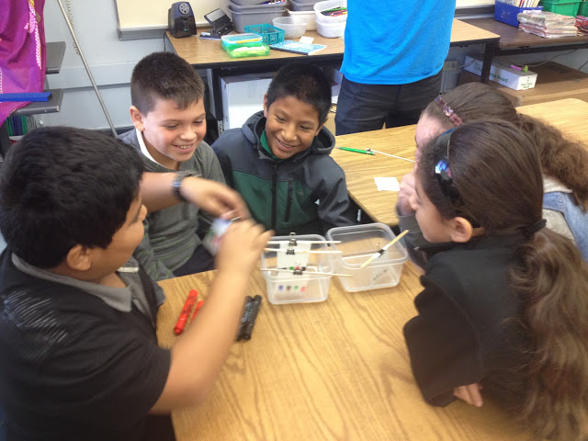
Developing a lesson: Template
  Introduce yourself (elevator pitch)
  Engage! Introduce your topic
    Phenomenon
    What do students already know?
    What background information do they need?
  Explore! Facilitate a hands-on activity
    Investigations / Experiments / Games / Citizen science
  Explain! Guide students to figure something out
    Be clear about WHY students are doing each aspect of the activity
  Evaluate! How will students show what they learned?
  Wrap-up with real world connections
    Why should students care?
  http://www.crscience.org/lessonplans/BASIS_LessonTemplate.docx

Slide 27
Special considerations for elementary
Clear communication about expectations, roles in advance is key
Do you need the class divided for station rotations?
A water source?
Are there any special needs in the classroom you should be aware of
Role of teacher during visit?
Content is interesting, but addressing equity & inclusion is critical at early age
Focus outreach where it is needed most
Be welcoming, encouraging all kids to discover connections to their interests and talents
Emphasize ways that you collaborate, communicate, work with others in teams, and have fun Share about pathways into science
in the rearview everything looks linear and predetermined.
It helps kids to understand that it’s not that way moving forward in your life!
Teachers often lack training, comfort with science
So much of education is driven by testing: having the “right answer”
Teachers need to see that science is about figuring out when there isn’t a “right answer” in the back of a book
Share times that your own research didn’t go as planned

