Slide 1
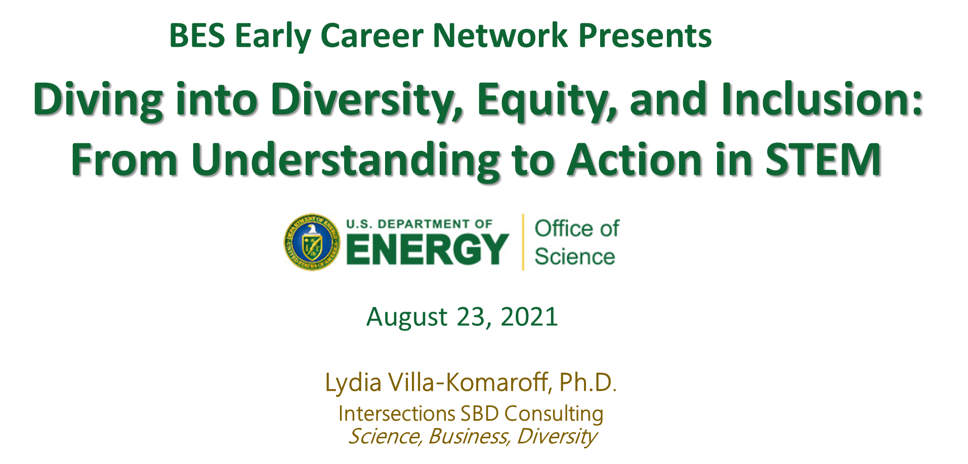
Notes:
I’m happy to answer additional questions at LVK@IntersectionsSBD.com

Slide 2
The Current Reality
Teams and institutions benefit from diversity
Talent is distributed equally, access and opportunity are not
Individual STEMM professionals from historically excluded groups continue to be less likely to be successfully integrated into STEMM environments
Generally, individuals from under-represented groups receive less mentorship or attention than their well-represented peers.
Notes:
Three recent films “Picture a Scientist”, “Coded Bias”, and “Crip Camp” all on Netflix provide recent documentation and insights.

Slide 3
Implicit Bias: A Summary
Data from many sciences support the long-standing recognition by psychologists and other social scientists that humans make systematic errors in judgement
The human brain has evolved mechanisms to deal with the massive data provided by the senses
Much human brain development occurs after birth, influenced by the environment it is embedded in
That these mechanisms are the result of evolution does not mean that we cannot change behavior as needed in response to challenges in our world
Scientists in the natural sciences have been particularly resistant to the notion that unconscious mental processes affect their decisions

Slide 4
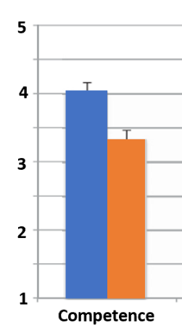
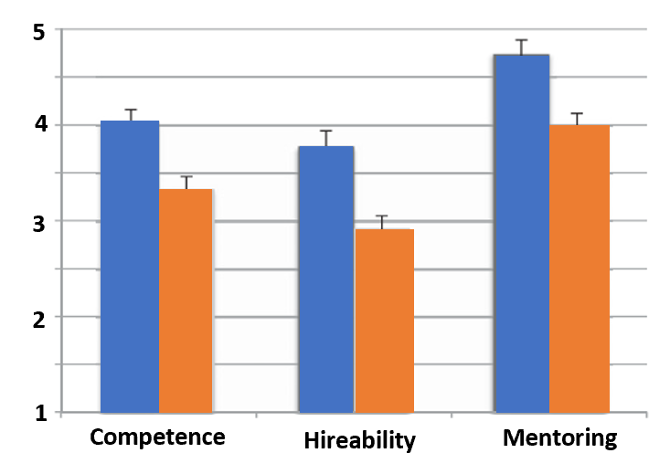
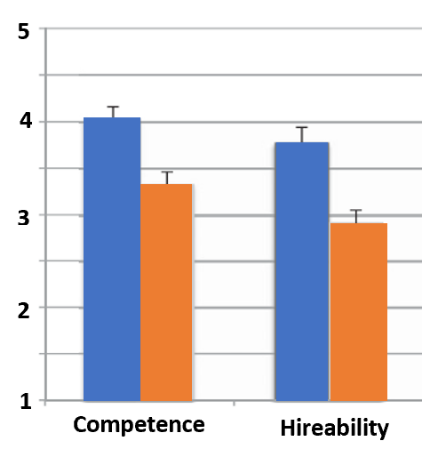
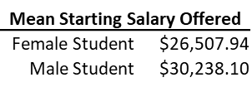
Implicit Gender Biases Favor Male Students
Moss-Racusin, Dovidio, Brescoll, Graham, Handelsman. PNAS 2012
“…faculty members of both genders appear to be affected by enduring cultural stereotypes about women’s lack of science competence that translate into biases in student evaluation and mentoring.”
Moss-Racusin et al, PNAS 2012
Evaluation of male and female candidates with identical CV’s
Male (John)
Female (Jennifer)

Slide 5
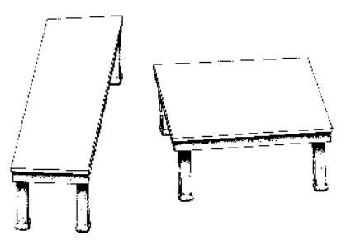
Optical Illusions are Perceptual Errors
Adapted from Shepard, Mindsights, 1990

Slide 6
Implicit Bias Stems from Associative Errors
Reflexive associative thinking that results from our cultural milieu
May be counter to what we believe about ourselves
Mental content of which we are unaware
Shared by all members of the culture
Hidden (implicit) biases can guide behavior without our awareness
Good people well intentioned, strive to align behavior with intentions, but often fail
https://implicit.harvard.edu/implicit/
NASEM Webinar: The Science of Implicit Bias: Implications for Law and Policy https://vimeo.com/showcase/8500358

Slide 7
Implicit Bias: an Example
“We put down briefly in Khartoum, where we changed to an Ethiopian Airways flight to Addis.
Here I experienced a rather strange sensation.
As I was boarding the plane, I saw that the pilot was black.
I had never seen a black pilot before,
and the instant I did, I had to quell my panic.
How could a black man fly an airplane?”
Nelson Mandela
From: Long Walk to Freedom: The Autobiography of Nelson Mandela. Little, Brown and Company.

Slide 8
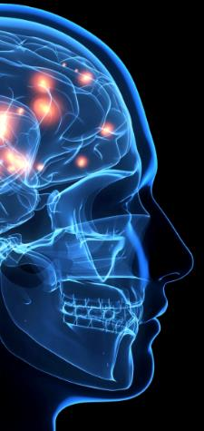
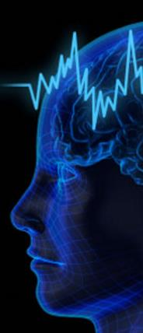
Two Systems of Thinking
Fast, Automatic, Intuitive, or System One
Operates automatically, unconsciously, rapidly
Requires little or no effort
No voluntary control, freewheeling
Active all the time
Any information automatically triggers related information
Slow, Deliberate, Controlled, or System Two
Allocates attention to effortful mental activities
Requires energy
Orderly, deliberative
Normally operates in comfortable, low effort mode
Generally accepts System 1 suggestions

Slide 9
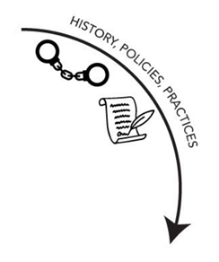
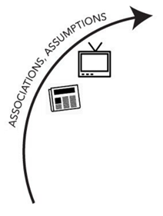
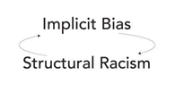
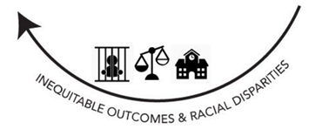
Relationship between Structural Racism
and Implicit Biases
Treatment of Native Americans by Spanish, English, French
Enslavement of African peoples
Chinese laborers on Transcontinental railroad
Internment of Japanese during WWII
Residential Segregation
Unequal access to education, jobs, medical care, safety
Disproportionate arrest and incarceration of Black and Brown people
Osta & Vasquez, 2019 www.NationalEquityProject.org Icons from TheNounProject.com

Slide 10
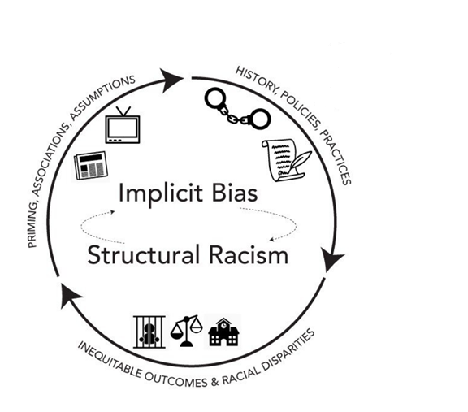
Relationship between Structural Racism
and Implicit Biases
Harsher punishment for students of color than for white students for the same behavior
Black students more likely to be viewed as angry when they are debating or commenting
We may be unwilling or uncomfortable raising current issues or events that affect PEERs (People Excluded because of Ethnicity or Race*)
Kubota J. NASEM webinar on the Science of Implicit Bias. 22Mar1921
https://www.nationalacademies.org/event/01-12-2021/the-science-of-implicit-bias-implications-for-law-and-policy-a-workshop
*Asai. Race Matters. Cell 181:754, 2020

Slide 11
If we don’t acknowledge
our implicit biases
they will direct our choices
and we will call it fate
Paraphrase of Carl Jung
Notes:
“Until you make the unconscious conscious, it will direct your life and you will call it fate.”
Carl Jung

Slide 12
Selected References
Some selected references are pictured in the next 2 slides
All publications from the National Academies Press can be downloaded as a PDF for free
Thinking, Fast and Slow is very readable but is a very dense and long.
You can get a great and entertaining synopsis of Kahneman’s book in The Undoing Project by Michael Lewis, who wrote Moneyball.
Blind Spot is the definitive work on implicit biases. It is a thorough but somewhat academic in tone. It was written by the people who introduced the term “implicit bias” and developed the implicit association test.
Whistling Vivaldi shows the consequences when individuals from marginalized groups internalize cultural implicit biases.
Thinking Race is a short (136 pages) highly readable book that spans human evolution to the current day and provides a succinct and dispassionate summary of the social myths and biological realities around race. Goldsby is an immunologist and entrepreneur, and Bateson is an anthropologist.

Slide 13
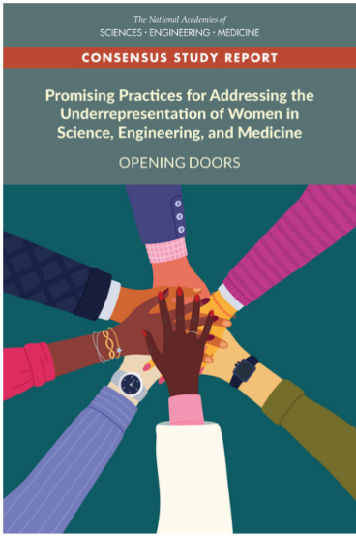
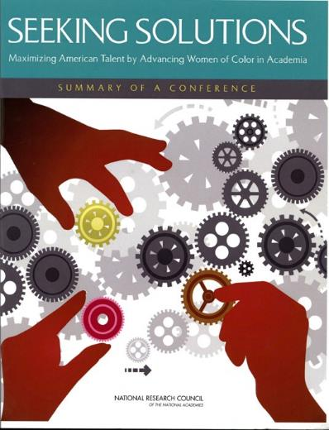
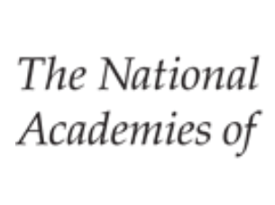


THE NATIONAL ACADEMIES PRESS
www.nap.edu

Slide 14

