Slide 1
Post-Combustion CO₂ Capture:
Beyond 2020
Basic Energy Sciences Advisory Committee
November 5, 2009
Mary Galvin
Division of Materials Sciences and Engineering
Office of Basic Energy Sciences

Slide 2
Outline
Post-combustion Capture: Background and Challenges
Carbon Capture 2020 Workshop
  held Oct 5th and 6th, University of Maryland
Carbon Capture Beyond 2020

Slide 3


Carbon Capture and Sequestration
Oct. 2008, Volume 4, Number 5
Perspective by Dr. Steven Koonin, Under Secretary For Science
25 September 2009, Vol 325, Issue 5948
Perspective by Dr. Steven Chu, Secretary of Energy

Slide 4
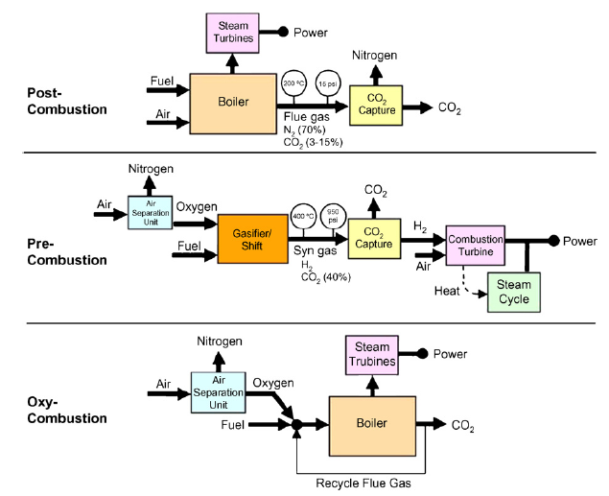
Carbon Capture
Challenges
Low CO₂ concentration
High energy for regeneration
Build new plants
Oxygen production – expensive (chemical looping and ion transport membranes)
Air Separation Units consume considerable energy
Expense - corrosion resistant materials
IGCC

Slide 5
Carbon Capture Goals
DOE Fossil Energy
By 2020
  have available for commercial deployment, technologies that achieve:
    90% CO₂ capture
    < 35% increase in COE (cost of electricity)
Source: DOE Fossil Energy (FE)

Slide 6
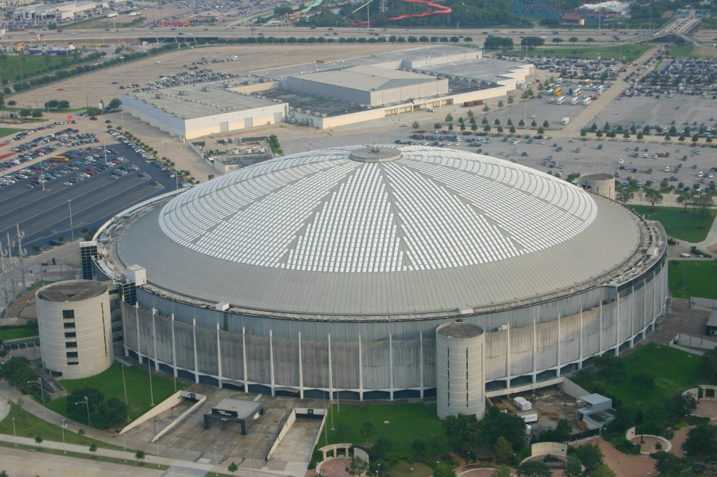
Challenge - Scale
~30 Giga tons of Anthropogenic CO₂ produced globally in 2004¹
  Requires 13.5 million Houston Astrodomes at atmospheric pressure²
CO₂ from US electricity 2006 – only 1.05 million Houston Astrodomes
Source: ¹Technical Summary IPCC, ²George C. Marshall Institute Policy Outlook, June 2008.
Notes:
6

Slide 7
Status of Current Technology
Amines
  Monoethanolamine (MEA) or amine blends - MEA with methyldiethanolamine (MEDA) or sterically hindered amines
  NH₃
  Can be aqueous solution in post-combustion
Chilled ammonia (35 F)
  ammonium carbonate to ammonium bicarbonate
Advantages - amines
    Selective, reversible, nonvolatile and somewhat inexpensive
Disadvantages - amines
    Corrosive, degrade esp. with O₂ or SO₂ present, require large thermal energy for stripping
    NH₃ – less energy to strip but toxic vapor to deal with
Notes:
7

Slide 8
Post-Combustion Capture
Conundrum
To remove CO₂ from flue gas selectively and rapidly → strong chemical bond
To strip the CO₂ from scrubber with little energy need → weak chemical bond
Scrubbing
Stripping
Materials Challenges
Absorb/adsorb fast
High selectivity vs. N₂
Desorb fast
Chemically stable
Physical properties stable
(Viscosity, mechanical integrity)
Non-corrosive
CHEAP
Science
Build knowledge base that will provide guidance for rational design of next generation sorbents
CO₂ + Steam
33%
loss
CO₂
H₂O
10 – 15 % CO₂
Predominately N₂
1 atm.
H₂O
Trace or more SO_{x}, NO_{x}
Flue gas
ΔT (Steam)
5% of efficiency loss
60% of efficiency loss

Slide 9
Carbon Capture 2020 Workshop
Joint FE (lead) and BES October Workshop
Workshop Goals
  Communicate status so that the research community understands:
    The scale and nature of the problem that needs to be addressed
    What parameters need to be defined for research activities
    The potential of new ideas emerging from basic research
    The status of existing Fossil Energy capture research
  Produce a roadmap for a coordinated effort that will impact carbon capture by 2020
    Identify ongoing research projects that could be connected to applied research goals
    Propose and critique a numeric modeling approach to quickly assess the full-scale performance of new concepts
http://www.netl.doe.gov/publications/proceedings/09/CC2020/index.html
Held Oct 5th and 6th, University of Maryland

Slide 10
Carbon Capture 2020: Overview
Welcome
  Dr. James J. Markowsky – Assistant Secretary, Office Fossil Energy
  Dr. William F. Brinkman – Director, Office of Science
Background talks
  FE, NETL and BES
  Overview of EFRCs – Berend Smit, Director: Center for Gas Separations Relevant to Clean Energy Technologies, UC-Berkeley
  Background talks – Oxy-fuel combustion, Power Plant Configurations and Models for CC Scale-up
Breakout Sessions & Poster Session
  Solid sorbents – MOFs, ZIFs
  Liquid adsorbents/solvents
  Membrane Concepts
  Cross-cutting
  Chemical and Biological analogues

Slide 11
Recommendations from Breakout Sessions
Solid Sorbents
  Further development of Carbon Capture technologies needs industry wide communication and collaboration on projects (Academia, DOE, Industry).
  Determine materials performance targets: Thermodynamics, kinetics, capacity, requirements, cost, etc.
Liquid Solvents
  Specific details and challenges for several types
  For BES/FE collaboration : Going from atoms and molecules to thermodynamic design and functions
Membranes – identified technical barriers for different classes
  Work presently constrained by existing materials
  Lack of common measure to rank or to identify how far new materials are from optimum

Slide 12
Recommendations from Breakout Sessions
Cross-cutting
  Good assessment of different areas – chemical looping, computation and modeling, oxy-fuels etc.
  Communication: Find ways to build a broader and more cohesive carbon capture community, including sub-communities
Chemical and Biological Analogues
  Considered challenges for algae, carbonic anhydrase mimetics, biological analogue for oxygen production
  Falls into BES domain

Slide 13
Next - Carbon Capture: Beyond 2020
Joint by BES (Lead) and FE
Goal - Identify priority research directions for the challenges beyond 2020
Run like a Basic Research Needs Workshop
  Plenary talks on technical and scientific challenges
  Breakout panels focused on development of priority research directions
  Crosscutting panel focused on identification of grand challenge science themes
  Dedicated report writers to ensure rapid progress on written report
Co-Chairs
  Paul Alivisatos – Lawrence Berkeley National Lab, UC-Berkeley
  Michelle Buchanan – Oak Ridge National Laboratory
Venue in the DC area
Held February or early March

Slide 14
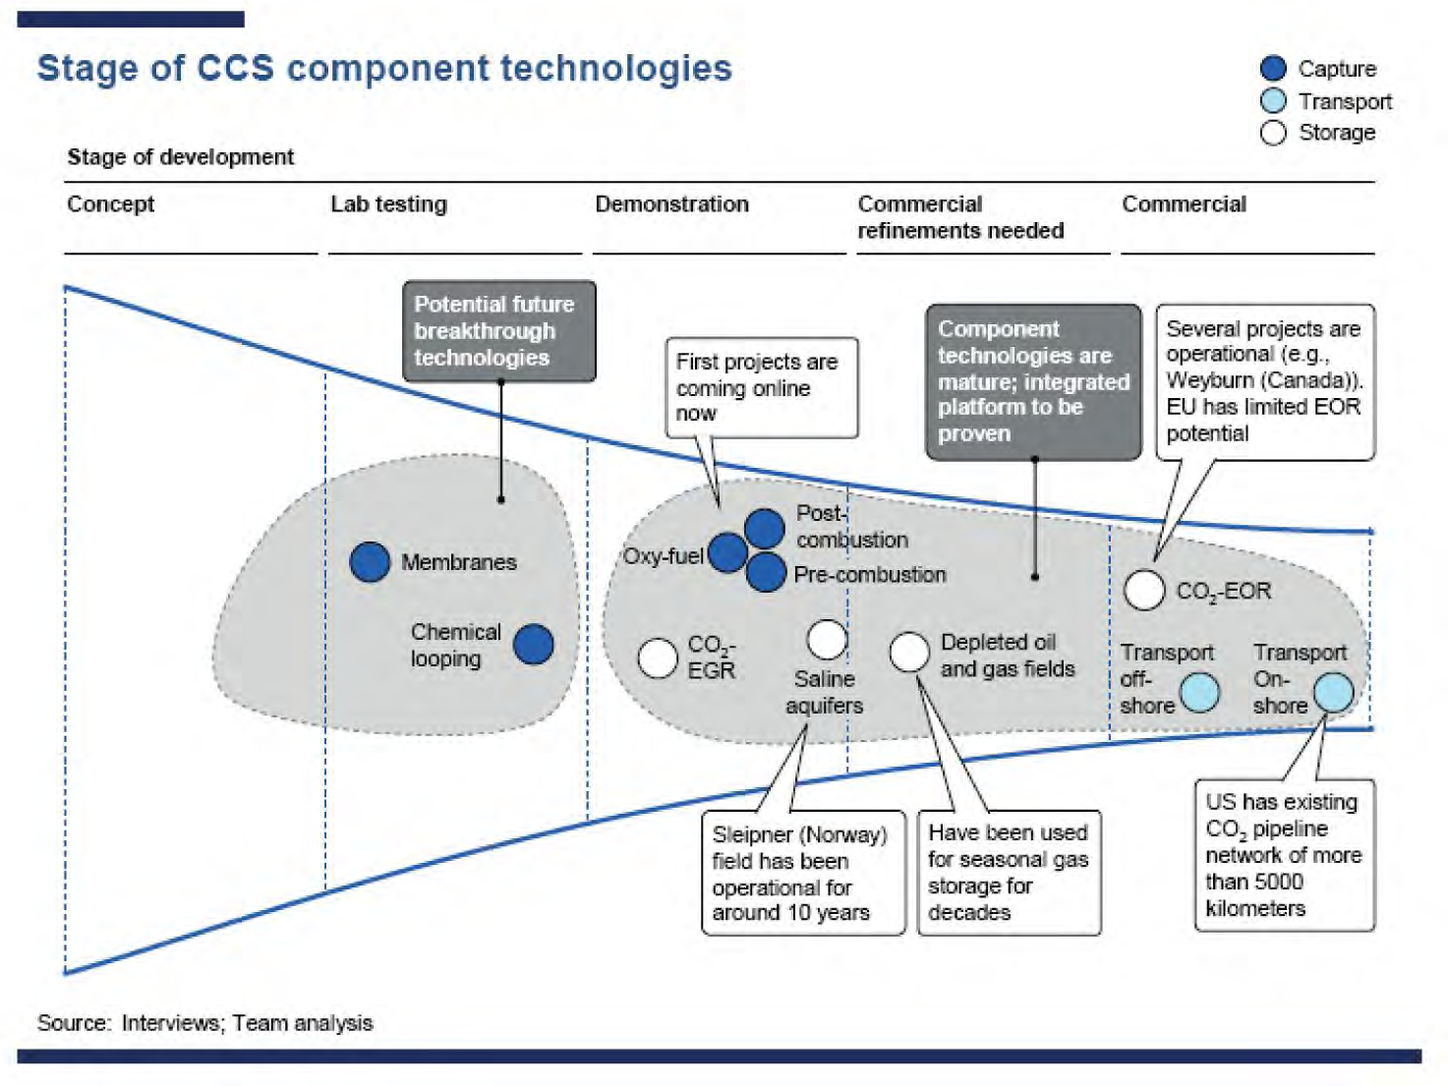
Research to Commercialization:
CCS Pipeline
B
E
S
W
O
R
K
S
H
O
P
?
?
?
Source: McKinsey & Company (2008), Carbon Capture and Storage: Assessing the Economics

Slide 15
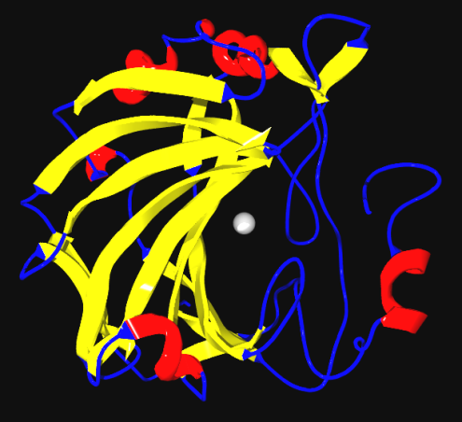
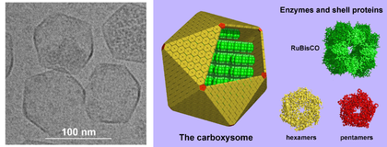
Biology and CO₂
Nature and CO₂
Plants
  Deal with dilute CO₂ (not efficiently)
  Carbonic Anhydrase - in plants – increases CO₂ concentration
  RuBisCO – plant enzyme converts CO₂ to sugar – 3 CO₂/sec
Bacteria
  Carboxysome - concentrates CO₂ levels to increase chemical transformation
  Strategy: Concentrate, isolate and transform
Ribbon diagram of human carbonic anhydrase with Zn atom in center
Carboxysomes – protein bacterial organelles
on left is electron microscope image,
on right is model of structure
Source: http://en.wikipedia.org/wiki/File:Carbonic_anhydrase.png and http://en.wikipedia.org/wiki/Carboxysome

Slide 16

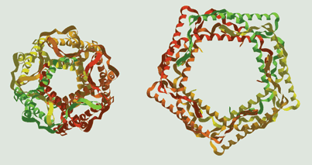
Nature’s Triggers
While nature does not deal with CO₂ ideally for post-combustion capture – can provide hints for non-thermal triggers
  Ecoli have a channel protein that opens and shuts with pressure –
    Has been modified to open and shut with light¹
  Synapses electrical field triggers release of neurotransmitter
Channel proteins modified with spiropyran
opens or closes
channel with light.
Reversible spiropyran photo-switch.
¹Source – Science, 2005, 309,755, Copied from C&E News report http://pubs.acs.org/cen/news/83/i31/8331notw1.html

Slide 17
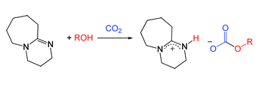
Novel Approaches: Base + Alcohol
Alternate science approach may offer a better pathway in the future - Heldebrant, PNNL
Eliminate water and H bonding – reduces energy of stripping
  Lower specific heat of organic liquids
    Same strip temperature, considerable energy savings
Organic amidine or biological guanidine base plus alcohol
  Binds CO₂ – reversed with heat
  Higher binding capacity for CO₂ than commercial MEA (monoethanolamine)
    Design base to minimize hydrogen bonding – more energy savings
    Demonstrated uptake in 50% CO₂/ 50% N₂ , strip 90 to 130 C
    Issue - water form bicarbonate salt of base – strips MEA temperature
Source: Heldebrant et al. Energy Procedia, 1 (2009) 1187-1195

Slide 18
Summary
Carbon Capture: Beyond 2020
  Goal: Identify priority research directions for the challenges beyond 2020
Fundamental science needs to advance existing approaches more rapidly
Need for new approaches and materials that would require significantly less parasitic energy

Slide 19
Thank you
Questions?

Slide 20
Backup Information

Slide 21
Key Characteristics for CO₂ Capture
(Post-Combustion)
Perform in presence of water (steam) and trace contaminants including SO_{x} and NO_{x}, etc.
Temperature stability over a wide temperature range
If Solid sorbent – mechanical stability, If liquid – no viscosity change
Sustainable
High selectivity for CO₂ over N₂
Work in dilute streams (10% CO₂)
Rapid kinetics for capture (scrubbing) and regeneration (stripping)
Non-corrosive
High cycle life
Low energy regeneration (stripping)
Be utilized at unprecedented scale - Cheap

Slide 22
Science – Beyond 2020
CO₂ sorbent that can be stripped with minimal energy
    Look to Nature for ideas on triggers but unlikely to be a biological solution
    Electrical, electrochemical, pressure, light, pH, phase change (liquid crystal)*
    Nanoscale approaches
Build the knowledge base to facilitate a rationale design of sorbents from first principles
  Advanced computational modeling and theory - First-principles methods for capture and release of nonpolar molecules
  Advanced characterization tools, including those supported by BES, to
    Identify structure of binding sites
    Understand kinetics and thermodynamics of sorption/desorption in realistic conditions
  New chemistries for advanced sorbents
    New sorbents
    Synthesis
*Source: Advanced Post-Combustion CO₂ Capture, prepared for Clean Air Task Force, Howard Herzog, Jerry Meldon and Alan Hatton

Slide 23
Approaches Under Development
Newer Materials
  ZIFs – zeolite imidazole frameworks
    Imidazoles increase selectivity
    Non silicates – resistant to degradation from steam
  Membranes – functionalized with amines or other groups to enhance selectivity (>200), increase cycle life
    Chemical functionalization of polymer can increase selectivity beyond what is achieved with size separation
    Fibrous membranes coated with amines (glass or carbon fiber mesh)
  Poly (ionic liquids)
    Some have higher sorption than ionic liquids
    Avoid viscosity increases seen with some ionic liquids
  Ion Engineering – amines in ionic liquids (65% cost savings over water)
Source: Advanced Post-Combustion CO₂ Capture, prepared for Clean Air Task Force, Howard Herzog, Jerry Meldon and Alan Hatton
Notes:
23

Slide 24
Current BES Related Research
Directly related (EFRC funding) – CO₂ from N₂
  Zeolitic imidazolate framework (ZIFs) , metal organic frameworks (MOFs), membranes for separation
  Synthesis, characterization, computation/modeling
CO₂ Binding/Separation
  Often from CH₄
  MOFs, ZIFs
  Polymer membranes
  Computation, theory, modeling
Hydrogen – Binding and Separation
  H₂ sorbents
  Inorganic clathrates, MOFs
  Membranes
Separation Sciences, Materials, Theory & Computation
  Membrane synthesis
  Transport
  Theory and Computation

Slide 25
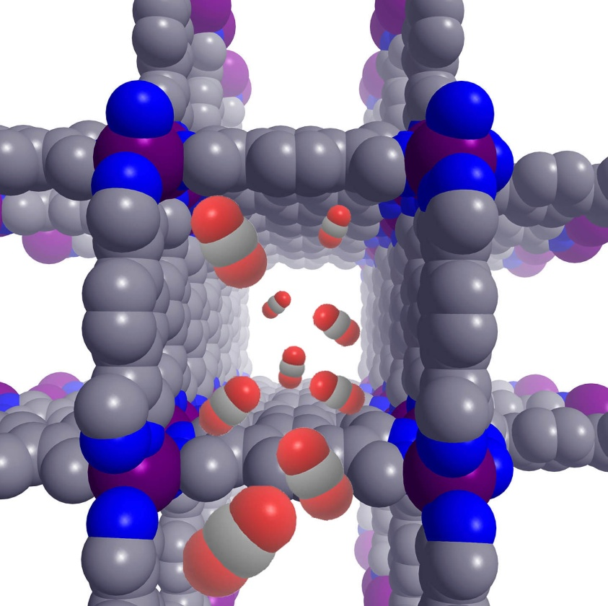
EFRC: Gas Separations for Clean Energy Technologies: (Smit, Berkeley)
Synthesis: Generate high surface area MOFs & self-assembled synthetic biomimetic polymer films
Characterization: Atomic-level structural characterization - before and after exposure to gas, accurate means of assessing the selectivity, kinetics, and thermodynamics of gas adsorbate binding – use to test computational models
Computational Separations: Strong computational component - understand chemical interactions at a molecular level, guide synthetic efforts
Goal: New strategies and materials for energy efficient selective capture or separation of CO₂ from gas mixtures based on molecule-specific chemical interactions

Slide 26
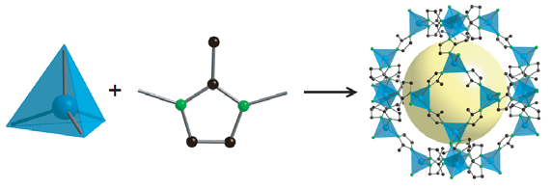
EFRC: Molecularly Engineered Energy Materials (Ozolins, UCLA)
Capture is 1/3 of this EFRC: Novel ZIFs for gas separation including CO₂ capture
Yaghi – Synthesis, characterization
Asta – Electronic structure calculations
Laird & Houndonougbo – Monte Carlo Simulations
ZnN₄

Slide 27
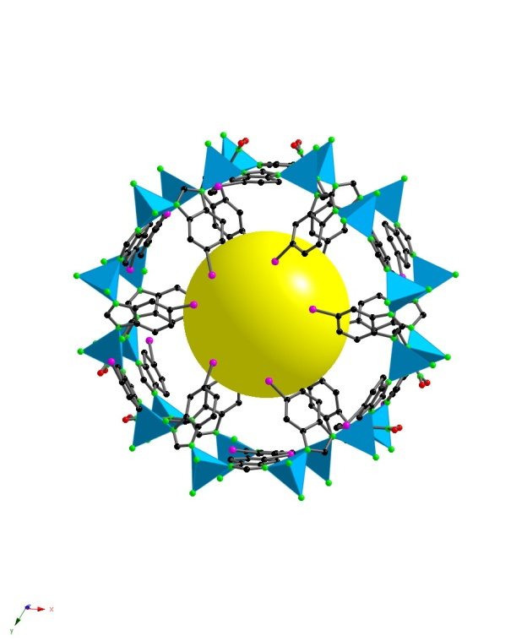
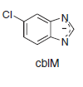
CO₂ Uptake in ZIF-69
Separate CO₂ from CO
Surface areas to 1970 m²/g
Stable to 390 °C, 1 liter ZIF-69 holds ~83 liters of CO₂ at 273 K
Gas adsorption isotherms of CO (red) and CO₂ (blue) into ZIF-69 at 273 K. Uptake and release are represented by solid and open symbols, respectively. ZIF-69 has been shown to have substantially greater uptake capacity for CO₂ over CO.
Yaghi’s group, UCLA, SCIENCE VOL 319 15 FEBRUARY 2008

Slide 28
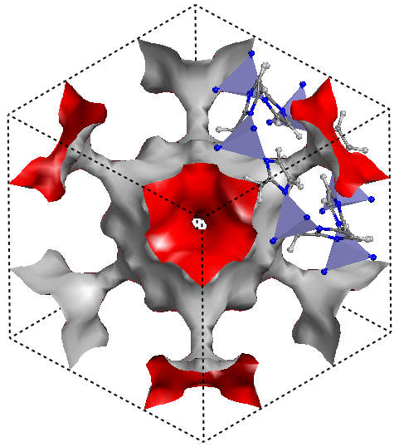
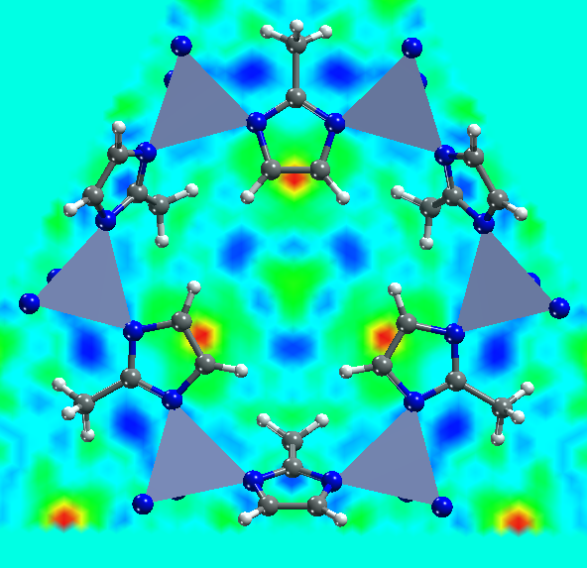
Where Does Hydrogen Go in ZIFs?
Apply Technique to CO₂
Calculated isosurface in ZIF-8
- Available nanopore volumes are connected by narrow channels
Difference Fourier analysis, showing the main-H₂ absorption sites in ZIF-8 are near the top of C-C bond of the linker and NOT the metal center
From: Taner Yildirim, U Penn and NIST
Notes:
28

Slide 29
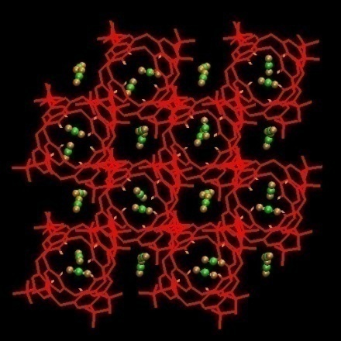
Examples of BES-Supported Projects in Theoretical and Computational Modeling
One interpretation: Computer simulations show that at ambient temperatures, CO₂ molecules require ~ 4 times more energy than average to desorb. Novel Strategies for selective heating may be necessary.
Computational studies of load dependent guest dynamics and free energies of inclusion for CO₂ in low density p-tert-butylcalix[4]arene at loadings up to 2:1.
John L. Daschbach, Xiuquan Sun, Tsun-Mei Chang, Praveen. K. Thallapally, B. Peter McGrail, and Liem X. Dang. J. Phys. Chem. A, Vol. 113, No. 14, 2009
PNNL: Dang et al
Theoretical and Computational Chemistry (Start FY09): Modeling CO₂ capture and separation in zeolitic imidazolate frameworks (Wisconsin, Schmidt)
Molecular Level Mechanism of CO₂ adsorption?
Specificity of CO₂ over N₂ ?
Mechanism for CO₂/N₂ Selectivity in ZIFs ?
Thermal and Solvent Stability?

Slide 30
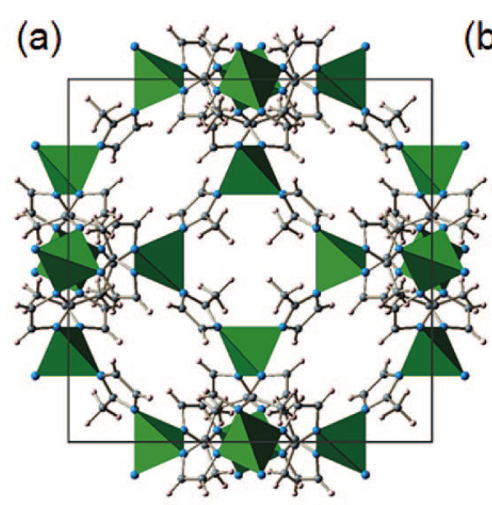
Neutron Diffraction
Studied CD₄ absorption in a ZIF with a deuterated methyl imidazolate linker.
Structure of ZIF
  Changes with sorption
  Changes with temperature
Identify binding sites
  Primary and stronger binding site - imidazolate
  Secondary and weaker site - center
Note: This can be used with CO₂ since the organic linkers in the ZIF can be deuterated
Source: Yildirim - J. Phys. Chem. C, Vol. 113, No. 7, 2009
NIST Center for Neutron Research

Slide 31
ARPA-E Projects for Carbon Capture
Lehigh University $566,641
  Bethlehem, PA Carbon Capture Electric field swing adsorption for carbon capture using high surface area conductive solid carbon sorbents. Uses electric fields to change the interaction of molecules on a surface, capturing and then releasing the CO2 using far less energy than current approaches
Nalco Company (Argonne National Laboratory) $2,250,487
  Naperville, IL Carbon Capture An electrochemical process for CO2 capture using Resin-Wafer Electrodeionization. Uses pH changes to adsorb and desorb CO2 from flue gas without energy intensive, costly processes such as heating or a vacuum.
Ohio State University (PSRI, CONSOL Energy, Inc., Shell/CRI, The Babcock and Wilcox Company) $5,000,000
  Columbus, OH Carbon Capture Syngas Chemical Looping (SCL) to convert coal or biomass into electricity while efficiently capturing the CO2. Has successfully been demonstrated at laboratory scale; this project will scale it up to a pilot plant at the National Carbon Capture Center.
Porifera Inc. (University of California Berkeley, LLNL) $1,077,992
  Hayward, CA Carbon Capture Carbon nanotubes integrated into polymer membranes to increase the flux of CO2 capture membranes by two orders of magnitude. Could enable much less expensive carbon capture from coal plants.
United Technologies Research Center (Hamilton Sundstrand, CM-Tech, Inc., Worley-Parsons, Columbia University) $2,251,183
  East Hartford, CT Carbon Capture Synthetic enzymes for capturing CO2 from coal plant flue gas streams. Uses a synthetic form of the enzyme carbonic anhydrase, which our bodies use to remove CO2. Could dramatically reduce the cost of carbon capture.

