Slide 1
CSGB Strategic Planning Process
BESAC Meeting
July 7, 2015
Tanja Pietraß

Slide 2
CSGB Division Mission and Goals
“The division supports experimental, theoretical, and computational research to provide fundamental understanding of chemical transformations and energy flow in systems relevant to DOE missions. This knowledge serves as the basis for the development of new processes for the generation, storage, and use of energy and for the mitigation of the environmental impacts of energy use.”
CSGB research programs embrace two strategies:
Discovery or Grand Challenge Research:
Understand, direct, and control matter and energy flow in materials and chemical processes.
May be conducted on model systems not immediately relevant to energy technologies.
Use-Inspired Basic Research:
Basic research required for the development of transformative energy technologies.
Usually conducted on systems that have a clear potential relevance to energy technologies
2

Slide 3
Divisional Structure
Fundamental Interactions
Gas Phase Chemical Physics
Photochemistry & Biochemistry
Solar Photochemistry
Photosynthetic Systems
Chemical Transformations
Catalysis
Heavy Element Chemistry
Geosciences
CPIMS
Physical Biosciences
Separations and Analysis
CTC
Hub and EFRCs
AMOS
3

Slide 4
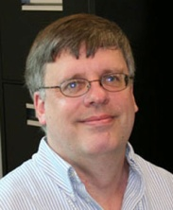
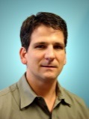
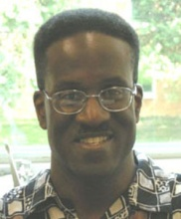
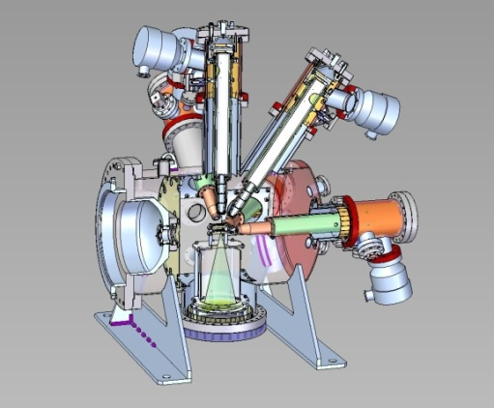
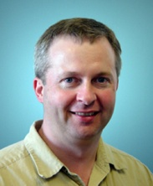
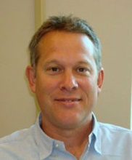
Fundamental Interactions Team
Understanding reactive chemistry at full quantum detail
Atomic, Molecular, and Optical Science
Fundamental interactions of atoms, molecules, and nanostructures with photons and electrons to characterize and control their behavior
Gas Phase Chemical Physics
Dynamics and rates of chemical reactions at conditions characteristic of combustion, and the chemical and physical properties of key intermediates, to enable computational models of combustion systems
Condensed Phase and Interfacial Molecular Science
Molecular-level understanding of chemical and electron-driven processes in aqueous media and at interfaces, confronting the transition from molecular-scale chemistry to collective phenomena in complex systems
Computational and Theoretical Chemistry
Development and integration of theoretical and computational approaches for the accurate and efficient description of chemical processes
First experiments at the LCLS reveal the physics possible with the intense ultrafast LCLS hard x-ray pulses: Neon atoms are stripped of all electrons from the inside-out via inner shell photoionization.
4

Slide 5
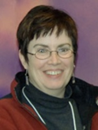
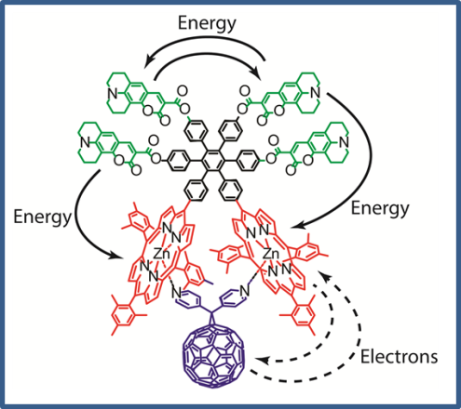
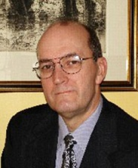
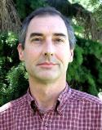
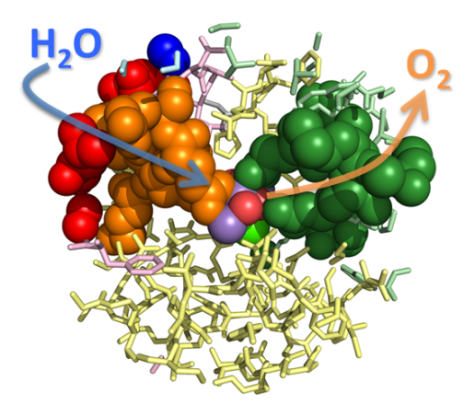
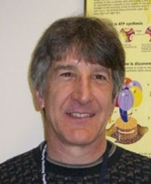
Photochemistry and Biochemistry Team
Light energy capture and conversion into chemical and electrical energy through biological and chemical pathways
Solar Photochemistry
Investigations of solar photochemical energy conversions including organic and inorganic photochemistry, photo-induced electron and energy transfer, and photo­electrochemistry
Photosynthetic Systems
Fundamental understanding of the biological conversion of solar energy to chemically stored forms of energy in photosynthetic systems in plants, algae, and microbes
Physical Biosciences
Combines experimental and computational tools from physical sciences with biochemistry and molecular biology for basic understanding of the complex processes that convert and store energy in plants, algae, and microbes
Red porphyrin and blue fullerene components form an artificial reaction center where absorbed light energy is transferred to molecules to drive electron transfer reactions. (Garg et al., J Phys Chem B. 2013 117:11299) (ASU)
Proposed pathways for water and molecular oxygen were identified in Photosystem II from cyanobacteria. (Frankel et al., J. Biol Chem 2013, 288:23565) (LSU)
5

Slide 6
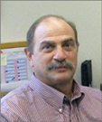
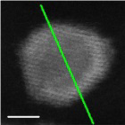
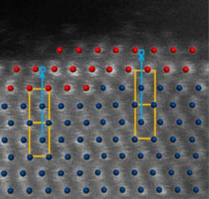
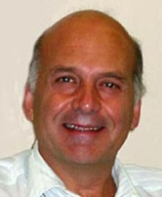
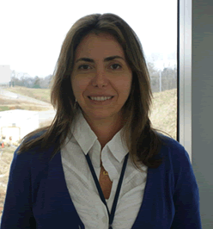
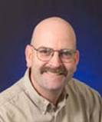
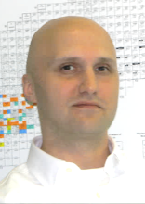
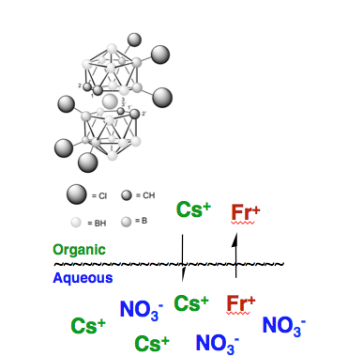
Chemical Transformations Team
Characterization, control, and optimization of chemical change
Catalysis Science
Catalytic methods for the clean and efficient production of fuels and chemicals, including inorganic, organic, and hybrid complexes; surface chemistry; nanostructured catalysts; and bio-inspired processes
Heavy Element Chemistry
Spectroscopy, bonding, and reactivity of actinides and fission products
Separations and Analysis
Chemical separations for actinide chemistry, carbon capture, critical materials
Geosciences
Analytical and physical geochemistry, including mineral-fluid interactions and flow/transport phenomena
Core-shell Ru@Pt electro-catalysts have high activity for hydrogen oxidation in fuel cells and better tolerate CO impurities. Atomic resolution STEM (CFN) shows crystalline order for Pt shell (red dots) on Ru core nanocrystals (blue dots). (Y.-C. Hsieh, Y. Zhang, D. Su, V. Volkov, R. Si, L. Wu, Y. Zhu, W. An, P. Liu, P. He, S. Ye, R. R. Adzic, and J. X. Wang, Nature Comm. 2013)
The first-ever experimentally determined thermodynamic values for francium have been measured, using liquid-liquid extraction, providing insight on the likely discovery of next super heavy, element 119.
(Delmau, L. M.; Moine, J.; Mirzadeh, S.; Moyer, B. A. J. Phys. Chem. B 2013, 117 (31), 9258-9261)
?
6

Slide 7
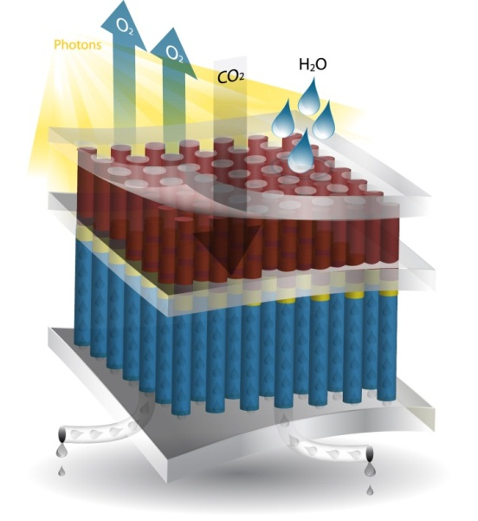
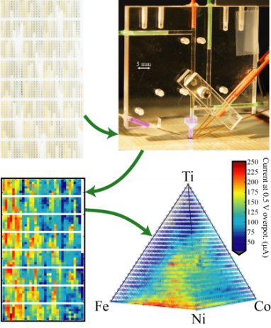
Fuels from Sunlight Hub Joint Center for Artificial Photosynthesis (JCAP)
Overview:
Mission: Develop a solar-fuels generator to produce fuel from the sun 10x more efficiently than crop plants
Launched in Sept. 2010; DOE announced renewal in April 2015
Led by Caltech with LBNL as primary partner; additional partners are SLAC, UC San Diego and UC Irvine
First Funding Cycle: Development of prototypes capable of efficiently producing hydrogen via photocatalytic water splitting
Second Funding Cycle: Focus on CO₂ reduction discovery science
Goals and Legacies:
Library of fundamental knowledge
Prototype solar-fuels generator
Science and critical expertise for a solar fuels industry
Photoelectrochemical Solar-Fuel Generator
Research Accomplishments:
Discovered method to protect light-absorbing semiconductors (e.g. Si, GaAs) from corrosion in basic aqueous solutions while still maintaining excellent electrical charge conduction
Developed novel high throughput capabilities to prepare and screen light absorbers and electrocatalysts
Established benchmarking capabilities that provide quantitative, objective evaluations of catalysts and light absorbers
Designed, fabricated and tested integrated artificial photosynthetic prototypes with optimized properties
Developed new multi-physics modeling tools for analysis of solar-fuels prototypes and processes
Notes:
Note about High Throughput Experimentation (HTE) figure: The development of artificial photosynthesis systems requires transformational materials that absorb sunlight and efficiently catalyze chemical reactions that produce fuel. Conventional research approaches have not yet yielded such materials, prompting JCAP researchers to greatly amplify these efforts by developing the technology to make and screen enormous libraries of candidate materials. Similar high throughput methods have yielded breakthroughs in drug discovery and related fields, but have not been widely applied to energy science. JCAP has developed unique capabilities to make and characterize potential photocatalytic materials in unprecedented throughput – capabilities that can be scaled to a million samples per day. Initial demonstrations of this technology involve the synthesis of new metal oxide compositions and the rapid evaluation of their optical and catalytic performance. For example, by screening 5456 different mixtures of Fe, Co, Ni and Ti oxides, the group discovered a new, unpredicted high performance catalyst. Such newly discovered materials are further investigated by carefully crafted teams of scientists and engineers in JCAP, ultimately leading to the creation of new artificial photosynthesis devices. JCAP is applying its high throughput methods to explore a plethora of materials with other atomic compositions, accelerating the discovery of light absorbers and catalysts necessary for the large-scale production of solar fuels.
The HTE figure on this slide presents a novel scanning drop electrocatalyst screening method, one of ten analytical pipeline tools that have been developed to evaluate large libraries of candidate materials for artificial photosynthesis. The (Fe-Ni-Co-Ti)O_{x} library (pictured top left) printed using a novel ink-jet method is evaluated by a scanning drop electrochemical cell (pictured top right) to produce a map of catalytic current (plotted bottom left) that is rearranged to indentify catalytic activity trends in the 3D composition space (plotted bottom right).

Slide 8
Divisional Structure 2007
8

Slide 9
Divisional Structure 2008
9

Slide 10
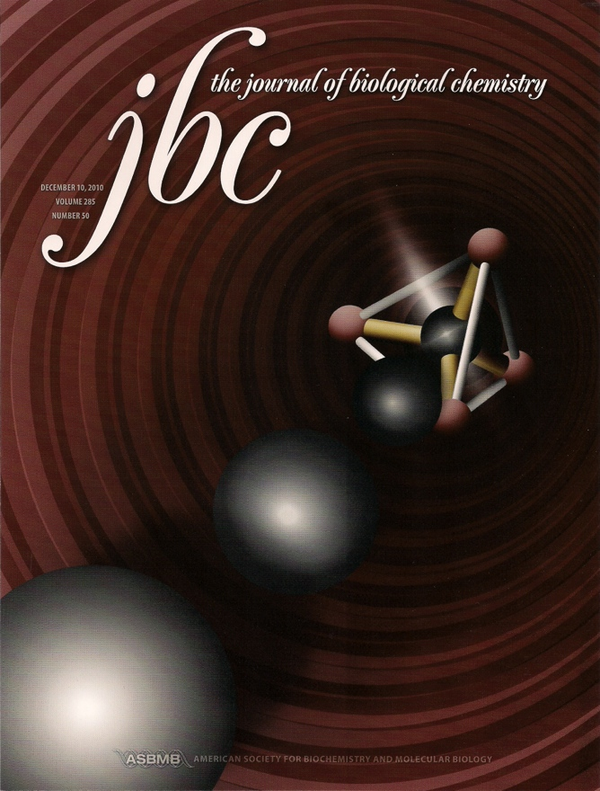
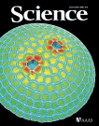
Biosciences Integration
1999: The Energy Biosciences Division was integrated into the newly formed Chemical Sciences, Geosciences, and Biosciences Division.
Energy Biosciences conducted basic research on plants and non-medical microorganisms:
Plant growth and development, genetic regulation, and plant-microbe interactions.
Scientific foundations for energy related biotechnologies.
2008: Photochemistry & Biochemistry combined Solar Photochemistry with Photosynthetic Systems and Physical Biosciences.
Research on (bio)chemical, physical, and molecular mechanisms that plants and non-medical microbes use to capture, convert, and store energy.
Study of natural mechanisms to provide insights for improvement of existing and development of new energy technologies
to efficiently capture and utilize solar energy and
to convert renewable resources into fuels and other energy-enriched products.
Greater emphasis on synergies/coordination with other DOE Programs and Offices.
10

Slide 11
Integrative Themes
Gas Phase Chemical Physics
Solar Photochemistry
Photosynthetic Systems
Catalysis
Heavy Element Chemistry
Geosciences
CPIMS
Physical Biosciences
Separations and Analysis
CTC
Hub and EFRC
AMOS
Redox Chemistry
Catalysis
Interfaces
Computation/Theory
Nano/mesoscale Phenomena
Surface Chemistry
Chemical Measurement and Imaging
+
-
Chemical Synthesis
Electrochemistry
Self Assembly
Emergent Phenomena
Solvation
Extreme Scale Computing
11

Slide 12
Budget History (FY 2000-2015)
Inflation adjusted total
12
Notes:
Note: All data taken from official budget submissions; FY is obtained from FY+2 submission. These are the enacted budget numbers.
Inflation adjusted totals are based on the Consumer Price Index (CPI) obtained from http://www.bls.gov/cpi/tables.htm. The 2014 CPI is as of August 2014.

Slide 13
University/Lab Balance (FY 2014)
University
Lab
Division total: 48% university and 52% lab
13
Notes:
Updated using Donetta’s numbers

Slide 14
Lab Programs
 | AMOS | GPCP | CPIMS | CTC | Cat | S&A | HEC | Geo | Photosyn. Systems | Physical Biosci. | Solar Photo.
AMES |  |  | a | a | a | a |  |  |  | a
ANL | a | a | a | a | a |  | a | a | a |  | a
BNL |  | a | a |  | a |  | a |  |  | a | a
LANL | a |  |  | a |  |  | a | a
LBNL | a | a | a | a | a | a | a | a | a |  | a
LLNL |  |  |  | a
NREL |  |  |  |  |  |  |  |  | a |  | a
ORNL |  |  |  |  | a | a | a | a
PNNL |  |  | a | a | a | a |  | a |  | a | a
SNL/NM |  |  |  |  |  |  |  | a
SNL/CA |  | a |  | a
SLAC | a |  |  |  | a
14
Notes:
Note: All data taken from official budget submissions; FY is obtained from FY+2 submission. These are the enacted budget numbers.
Inflation adjusted totals are based on the Consumer Price Index (CPI) obtained from http://www.bls.gov/cpi/tables.htm. The 2014 CPI is as of August 2014.

Slide 15
Research Projects in FY 2014
Program | Program Manager(s) | Grants | FWPs | Total
AMO Science | Jeff Krause, Tom Settersten (detailee) | 44 | 9 | 53
Gas-Phase Chemical Physics | Wade Sisk | 26 | 10 | 36
Computational Theoretical Chem | Mark Pederson | 68 | 8 | 76
CPIMS | Greg Fiechtner | 20 | 11 | 31
Solar Photochemistry | Mark Spitler, Chris Fecko, Nada Dimitrijevic (detailee) | 57 | 13 | 70
Photosynthetic Systems | Gail McLean (Steve Herbert – FY 15) | 45 | 8 | 53
Physical Biosciences | Bob Stack | 60 | 5 | 65
Catalysis Science | Raul Miranda | 103 | 17 | 120
Heavy Element Chemistry | Philip Wilk | 18 | 12 | 30
Separations & Analysis | Larry Rahn | 31 | 9 | 40
Geosciences | Nick Woodward | 56 | 14 | 70
 | Division Totals | 528 | 116 | 644
15
Numbers include new, Early Career, fully funded, continuations, renewals, and no-cost extension projects.
Notes:
NOTE: FWP information was pulled from the August FY14 Fin Plan.
NOTE: Grants information was pulled from PAMS and the FY14 Research Summaries Exercise.
Grants numbers can be found in Excel Workbook: CSGB Current and Active Numbers -- updated combined numbers for 2014_120514.xlsx, Worksheet: Grants
FWP numbers can be found in Excel Workbook: FWP information from CSGB August FY 14 Fin Plan.xlsx
Overall table found in Excel Workbook: CSGB Current and Active Numbers -- updated combined numbers for 2014_120514.xlsx, Worksheet: Active Project Totals

Slide 16
Early Career (FY 2010 – 2015)
Program | 2010 | 2011 | 2012 | 2013 | 2014 | 2015 | Sum
AMOS | 1 | 1 | 1 | 1 | 1 | 0 | 5
Catalysis Science | 3 | 1 | 3 | 4 | 1 | 1 | 13
CTC | 1 | 2 | 1 | 2 | 0 | 1 | 7
CPIMS | 1 | 0 | 1 | 2 | 0 | 1 | 5
Gas Phase Chemical Physics | 0 | 1 | 1 | 0 | 0 | 1 | 3
Geosciences Research | 1 | 1 | 0 | 0 | 1 | 1 | 4
Heavy Element Chemistry | 0 | 0 | 1 | 1 | 2 | 1 | 5
Photosynthetic Systems | 1 | 1 | 0 | 0 | 0 | 0 | 2
Physical Biosciences | 0 | 0 | 1 | 1 | 0 | 1 | 3
Separations and Analysis | 1 | 1 | 1 | 1 | 0 | 1 | 5
Solar Photochemistry | 1 | 2 | 1 | 0 | 1 | 1 | 6
Total | 10 | 10 | 11 | 12 | 6 | 9 | 58
16
Notes:
Updated using Donetta’s numbers

Slide 17
FY14 Implementation of Full Funding of Financial Assistance Awards
# of Proposals
# of Proposals
To comply with full funding of all awards under $1 M, the two research divisions are making a concerted effort to use all available options, including shortened budget periods, “terminal renewals,” and no cost extensions (NCE) to maintain quality and portfolio balance.
While the NCE approach affords extra flexibility to adjust to the full funding requirement, it also delays the time for the divisions to return to the normal portfolio size and success rates.
For MSE, the renewal rate was reduced from ~80% (historic value) to ~70% in FY 2013 (anticipation of full funding) to 65% in FY 2014. The new award rate decreased from ~22% to 15%.
For CSGB, the renewal rate was reduced from ~80% (historic value) to ~70% in FY 2013 to 68% in FY 2014. The new award rate was reduced from ~40% to 19%.
Notes:
For CSGB –
Left Histogram:
The green bar is the total amount of renewal proposals received in FY14 = 239
The blue bar is the amount of no cost extensions that were granted or expected to be granted at the time of BESAC = 78
This number was obtained by asking each PM how many NCEs they had given or were expecting to give at the time of BESAC
The pink bar is the amount of 2 and 3 year renewals granted or expected to be granted at the time of BESAC = 79
The yellow bar is 1 year renewals or terminal renewals granted or expected to be granted at the time of BESAC = 29
From these numbers, the number of renewal proposals declined would be 43.
Right histogram:
The green bar is the total amount of new proposals received for FY14 = 133
The pink bar is new conference/supplemental awards granted or expected to be granted = 23
The blue bar is new grant proposals granted or expected to be granted = 18
From these numbers, the number of new proposals, including supplemental requests, declined would be 92.

Slide 18
Strategic Planning Process
Analysis
Formulation
Execution
Evaluation
18

Slide 19
CSGB Strategic Planning Process
Analysis
Formulation
Execution
Evaluation
BESAC Reports
BRN, NAS Reports
Community Input
Council Workshops
Strategic Discussions
Program Discussions
19

Slide 20
CSGB Councils
Council | Council Chair
Chemical and Biosciences | Bob Blankenship, Wash. U.
Earth Sciences | Susan Brantley, Penn State
Identify emerging research needs and opportunities through focused workshops/panel studies
Published workshop papers in peer-reviewed publications in archival journals
Workshop examples
“What is the Efficiency of Photosynthesis?” (Chem/Bio 2009); R. E. Blankenship et al., “Comparing Photosynthetic and Photovoltaic Efficiencies and Recognizing the Potential for Improvement”, Science 2011, 332, 805-809.
“CO₂ Fixation” (Chem/Bio 2011); “Frontiers, Opportunities, and Challenges in Biochemical and Chemical Catalysis of CO₂ Fixation”, A. M. Appel et al., Chem. Rev. 2013, 113, 6621-6658.
“Unraveling the Interpretations of Attosecond Measurements” (Chem/Bio 2012); “What will it take to observe processes in ‘real time’?, S. R. Leone et al., Nature Photonics 2014, 8, 162-166.
“Crystallization by Particle Attachment” (Geo 2013); “Crystallization by Particle Attachment in Synthetic, Biogenic, and Geologic Environments”, J. J. De Yoreo et al., Science 2015, in press.

Slide 21
Program Discussions
Program Discussions
12/18/14: CTC/Geosciences
01/22/15: Gas Phase Chemical Physics
02/23/15: Solar Photochemistry
03/17/15: AMOS/Separations & Analysis
04/08/15: CPIMS
07/22/15: Heavy Element Chemistry
07/28/15: Catalysis Science
TBD: Physical Biosciences/Photosynthetic Systems
21

Slide 22
Strategic Discussions
Divisional Strategic Discussions
Jan. 30: World Scientific Leadership (via email)
Feb. 23: Budget Allocation Process
March 17: Visibility of Funded Research
April 8: Portfolio Balance
June 4: Portfolio Impact
22

Slide 23
Strategic Discussions – World Leadership
Definition
“Broad recognition by an international community of the originality and impact of the research”
Metrics
International conferences (“buzz”, invited speakers, PI presence, invited talks)
Publications (number, impact factor, citations)
Proposals (PI, topic, reviews)
NAS reports
Nobel prizes; professional society and other awards
23

Slide 24
Strategic Discussions – Budget Allocation Process
PM Satisfaction
“depends”
Discussion Points
Long-term lab projects need to be balanced with university projects
Large FWPs in small programs make it difficult to reallocate funds
DD incentives vs. PM latitude in selecting projects
24

Slide 25
Strategic Discussions – Visibility of CSGB Funded Research
Issue
CSGB funded research is underrepresented on the DOE website and in news releases.
Discussion Points
Use of highlights
Strategic solicitation of highlights
PI-PM communication
25

Slide 26
Strategic Discussions – Portfolio Balance
Questions
In times of constrained resources:
How do you balance university grants vs. lab FWPs? Does the balance shift when resources become tight?
How do you determine the optimal grant size? Is there a minimum quantum in award size?
How do you balance funding out-of-the-box ideas with solid, proven approaches that will be successful, even if they provide only incremental progress?
How do you ensure that we have enough new scientific talent in the pipeline while also providing stable funding to established scientists?
26

Slide 27
Strategic Discussions – Portfolio Balance
Discussion Points
Labs vs. universities
Grant size (group size)
Equipment cost
Metrics of productivity
Maturation timeline (planned sunsets)
Reviewer selection/panel vs. ad hoc review
27

Slide 28
Strategic Discussions – Portfolio Impact
Questions
How do we ensure that our scientific staff remains sharp, open to fresh ideas, cognizant of new developments and does not fall into the trap of running an “exclusive” network program?
Do we attract enough paradigm-shifting ideas? If so, do they get funded or are they perceived as too risky in this constrained fiscal environment? If not, is there a need to increase the pool and how would we go about it?
28

Slide 29
Strategic Discussions – Portfolio Impact
Discussion Points
The pursuit of risky ideas is often embedded in renewals and overall larger grants.
New reviewers help identify new ideas.
New ideas often come from early career scientists.
Workshops often are places for “old” (=safe) ideas; conferences are more suited to spark innovative ideas.
Many reviewers favor conservative ideas.
Panels at PI meetings, seed grants, conference discussions, and interagency discourse could all serve as mechanisms to encourage/identify innovative ideas.
29

Slide 30
Formulation (in progress)
Portfolio Balance and Impact
Create (maintain) an impactful portfolio that produces world-class science in alignment with our mission through
Wisely balancing innovative, risky ideas with established approaches;
Wisely balancing national laboratory with university investments;
Developing new talent to become the leaders of the future.
Portfolio Visibility
Effectively showcase the results of CSGB funded research.
30

Slide 31
Dissemination
News Releases
Featured Articles
Web Highlights
31

Slide 32
Execution (in progress)
Portfolio Visibility
Meetings with representatives from the SC Communications Office on News Releases, Featured Articles, university research and the CSGB website (Jan./Feb. 2015)
Division presentation by Kate Bannan on university research (March 17, 2015)
Post-BESAC Meeting with laboratory Division Directors (Feb. 27, 2015)
Summer intern (Joshua Haines) joined on June 1, 2015 to manage highlights
PM Greg Fiechtner works with SC Communications Office to maximize use of highlights on CSGB website (summer 2015)
32

Slide 33
News Releases/Featured Articles/Web Highlights
Raising awareness on the visibility of CSGB funded Research
02/27/15: Meeting of National Lab POCs
PI Meetings
Discussion Points
Strategies to disseminate complicated results
Importance of graphics
PI/Communications Office as key relationship
Preliminary Outcomes
07/14 - 06/15 | Before 03/15 (8 months) | After 03/15 (4 months)
Web Highlights | 5 | 8
News Releases | 18 | 11
Featured Articles | 7 | 2
33

Slide 34
Execution – Web Highlights
Year | Total | BES | CSGB
FY12 | 70 | 40 | 4
FY13 | 101 | 50 | 6
FY14 | 58 | 19 | 11
FY15 | 82 | 53 | 13
34

Slide 35
Next Steps
Divisional Strategic Discussions (recurring)
07/23/15: Staffing needs/CRA assessments
TBD: Selection statement best practices
TBD: Review mechanisms
…
Other Planned Activities
Website development (Fiechtner, Haines, Groves)
Divisional data library (Haines)
Program discussions (recurring)
35

Slide 36
Summary
Gas Phase Chemical Physics
Solar Photochemistry
Photosynthetic Systems
Catalysis
Heavy Element Chemistry
Geosciences
CPIMS
Physical Biosciences
Separations and Analysis
CTC
Hub and EFRC
AMOS
Ultimate Goals
Support an impactful portfolio that produces highly visible world-class science in alignment with DOE’s mission.
Integrate seemingly disconnected areas into a synergistic, cohesive whole.
Redox Chemistry
Catalysis
Interfaces
Computation/Theory
Nano/mesoscale Phenomena
Surface Chemistry
Chemical Measurement and Imaging
+
-
Chemical Synthesis
Electrochemistry
Self Assembly
Emergent Phenomena
Solvation
Extreme Scale Computing
Process
Use BESAC reports as guiding documents in portfolio development
Solicit community input (Councils, ACS, PI meetings)
Continue annual program discussions
Continue strategic discussions
Hire strategically for tomorrow’s portfolio
Increase PM conference attendance
36

