Slide 1
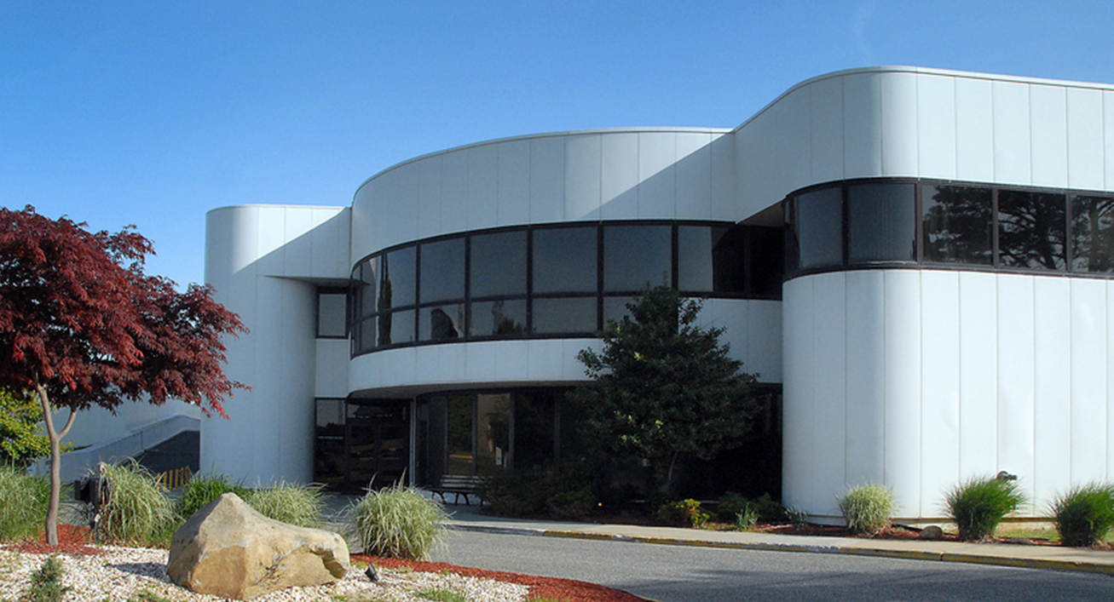
NSLS Science Transition
Erik Johnson
Deputy Associate Laboratory Director for Photon Sciences
Brookhaven National Laboratory
February 27, 2014

Slide 2
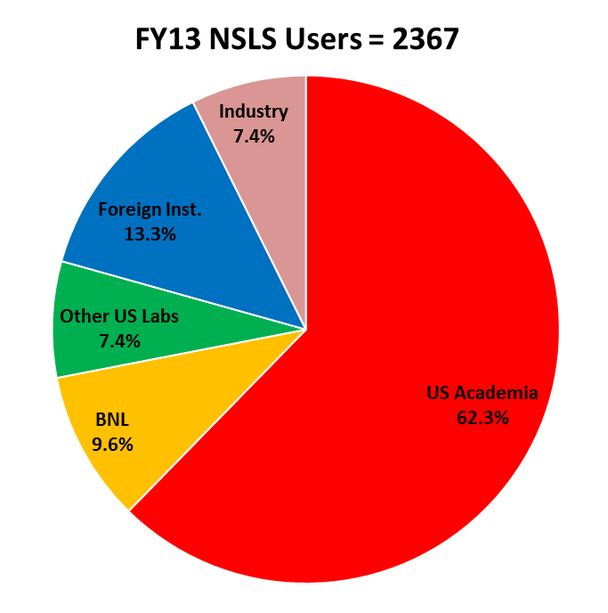
NSLS Users Count and Publications in FY13
NSLS users and PS staff produced 881 publications in FY13
About 20% (171) publications are in premier journals

Slide 3
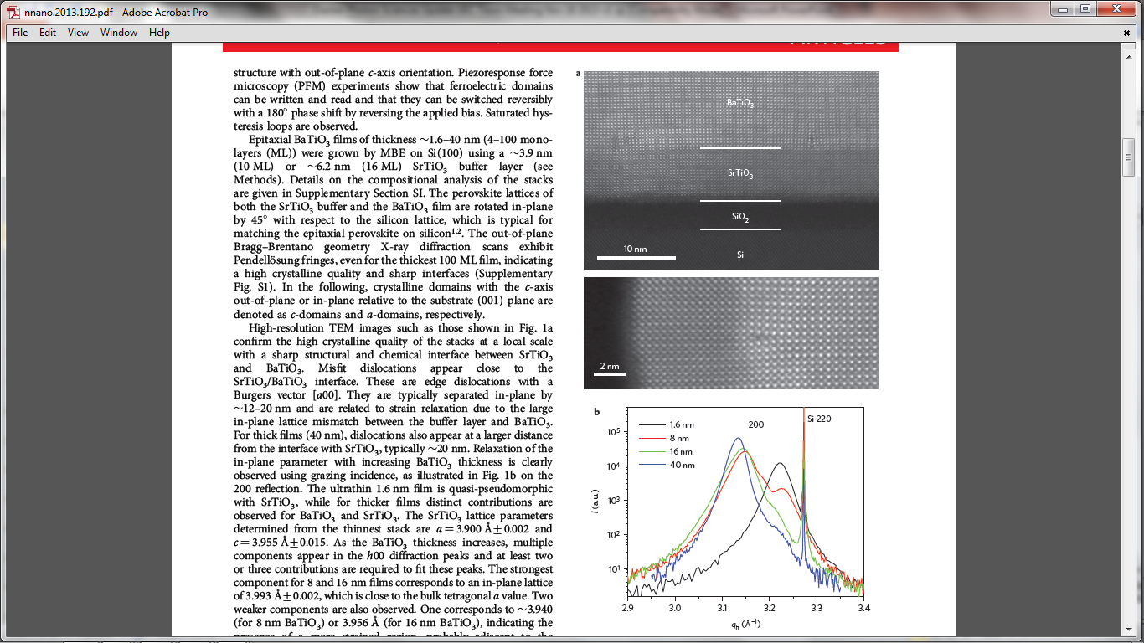
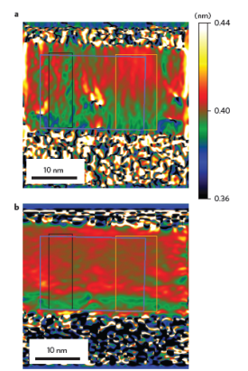
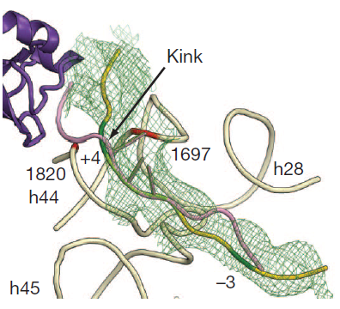
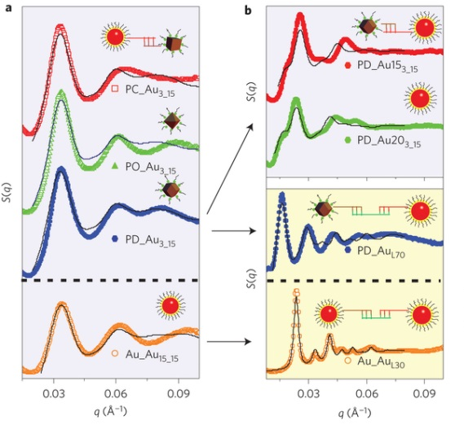
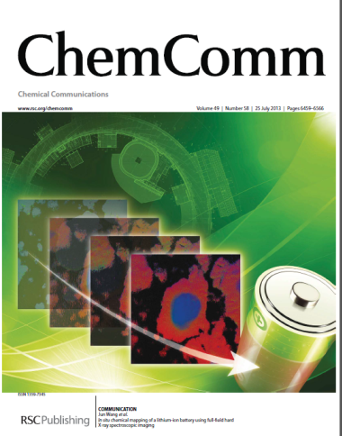
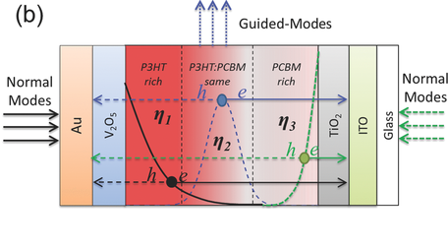
Recent NSLS Science Highlights
X25/X29
X9
X20A
Switching of ferroelectric polarization in epitaxial BaTiO3 films on Si without conducting bottom electrode. Nature Nanotech. (Sep 2013)
Structural mechanism of mRNA scanning in ribosomal subunits 40S. Nature (Aug 2013)
DNA-mediated self-assembly of functional nanoparticles into heterogeneous systems. Nature Nanotech. (Oct 2013)
In situ chemical mapping of a lithium-ion battery using full-field hard X-ray spectroscopic imaging. Chemical Comm. (Jul 2013)
Mapping spatially resolved charge collection probability within P3HT:PCBM bulk heterojunction photovoltaics. Adv. Energy Materials (Aug 2013)
U7A
X8C

Slide 4
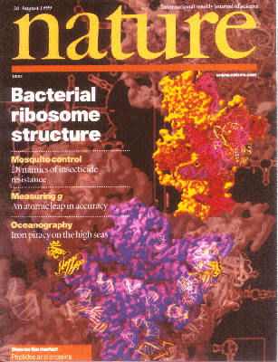
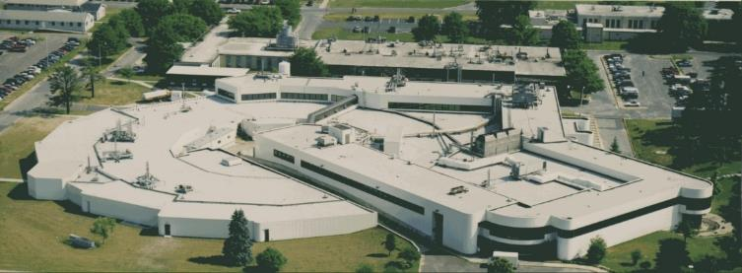
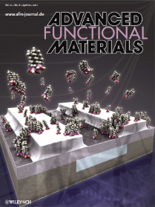
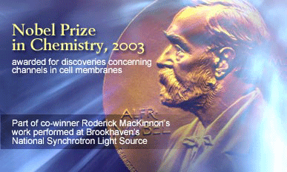
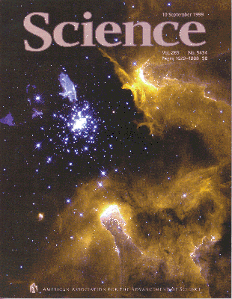
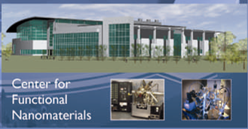
NSLS: Outstanding Scientific Productivity
  Many Scientific Programs
Material & Chemical Sciences, Life Sciences, Geological & Environmental Sciences, Applied Science & Engineering, and others
Diverse Capabilities over Broad Spectral Range
Scattering, Diffraction, Spectroscopy, Imaging
Highly Productive & High Impact FY13 Since 1982
Users 2,367 ~ 57,000
Publications 881 17,182
Protein Databank Deposits ~ 600 7,122
2 Nobel Prizes (2003, 2009)
Crucial resource
  Universities: SBU, Columbia, BU, U of I, Rutgers, others
  Industry: IBM, ExxonMobil, GE, Pharmaceuticals
BNL: CFN, CMP, Catalysis, Structural Bio, Env Sci, others
Will cease operations on Sep 30, 2014
59 Beamlines

Slide 5
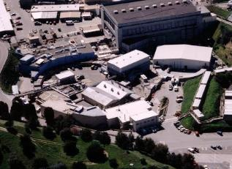
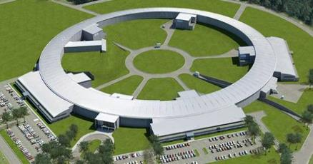
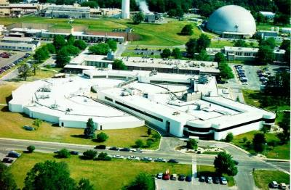
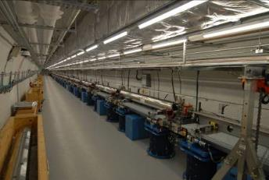
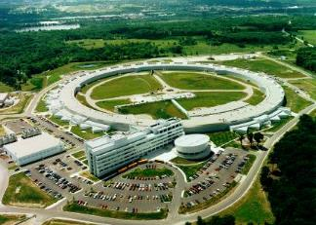
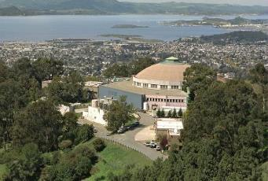
DOE-BES Light Sources
SSRL 1974 & 2004
NSLS-II 2015
NSLS 1982
LCLS 2009
APS 1996
ALS 1993
LCLS
APS
ALS
SSRL
NSLS
NSLS Hosts ~23% of all users of DOE light sources

Slide 6
User Transition
Impacts on users, facilities, and science
  Loss of capabilities and capacity until NSLS-II is fully built out
  Displacement of substantial fraction of user community
Mitigation Options
  Build out NSLS-II
  Identify and communicate to users similar capabilities at ALS, APS, SSRL
  Adjust capacities at ALS, APS, SSRL

Slide 7
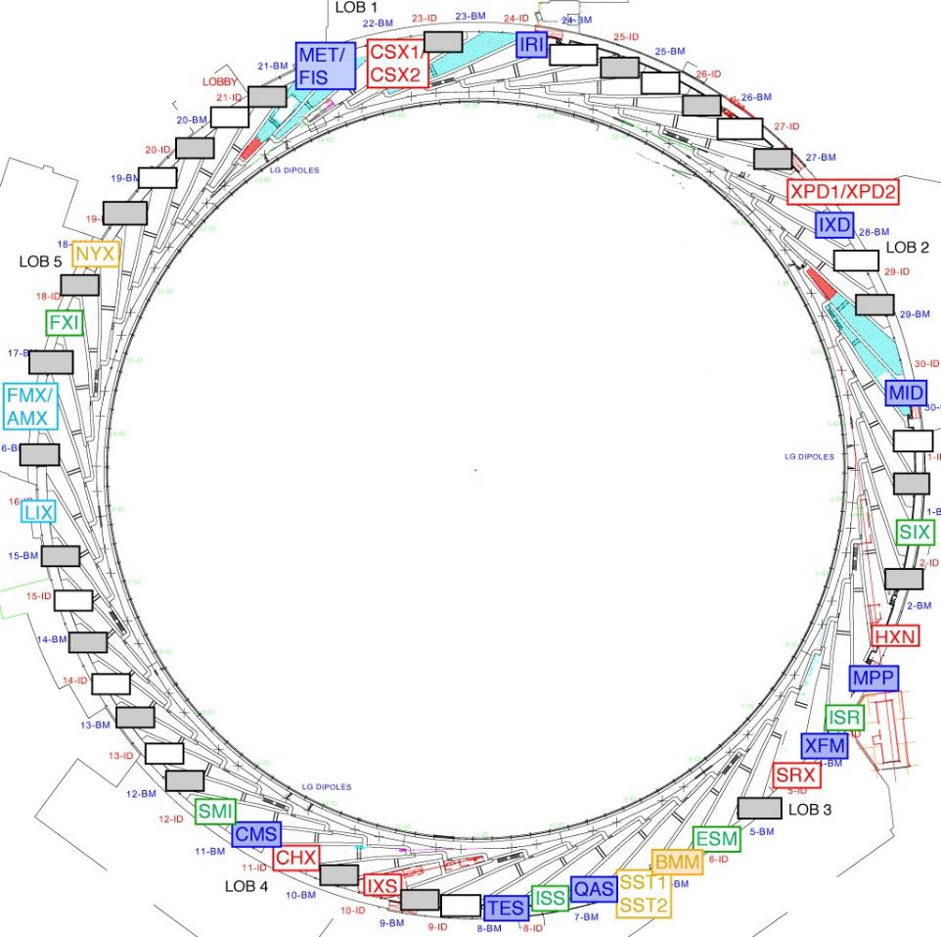
Developing the NSLS-II Beamline Portfolio
8 NSLS-II Project Beamlines
Inelastic X-ray Scattering (IXS)
Hard X-ray Nanoprobe (HXN)
Coherent Hard X-ray Scattering (CHX)
Coherent Soft X-ray Scat & Pol (CSX1, CSX2)
Sub-micron Res X-ray Spec (SRX)
X-ray Powder Diffraction (XPD1, XPD2)
6 NEXT Beamlines
Photoemission-Microscopy Facility (ESM)
Full-field X-ray Imaging (FXI)
In-Situ & Resonant X-Ray Studies (ISR)
Inner Shell Spectroscopy (ISS)
Soft Inelastic X-ray Scattering (SIX)
Soft Matter Interfaces (SMI)
3 ABBIX Beamlines
Frontier Macromolecular Cryst (FMX)
Flexible Access Macromolecular Cryst (AMX)
X-ray Scattering for Biology (LIX)
5 Partner Beamlines
Spectroscopy Soft and Tender (SST1, SST2)
Beamline for Mater. Measurements (BMM)
Microdiffraction Beamline (NYX)
X-ray Footprinting (XFP)
8 NxtGen Beamlines
Complex Materials Scattering (CMS)
Magneto, Ellipso, High Pressure IR (MET/FIS)
Metrology & Instrum Development (MID)
In-situ X-ray Diffraction Studies (IXD)
Materials Physics & Processing (MPP)
Quick X-ray Absorption and Scattering (QAS)
Tender X-ray Absorption Spectroscopy (TES)
X-ray Fluorescence Microscopy (XFM)
MID
ESM
Outline = ID
Solid = BM / 3PW / IR
NSLS-II Project, NEXT, ABBIX, and Partner Beamlines deliver world-leading capabilities
  All together, ~ 60% of the straight sections will be built out within first few years of NSLS-II operations
NxtGen beamlines will balance the beamline portfolio with complementary, often high throughput, capabilities and add significant capacity
NxtGen will build out ~ 33% of BM/3PW/IR ports
XFP

Slide 8
NSLS & NSLS-II Beamlines
New NSLS-II capabilities will spawn new programs and user communities
Clear transition path to NSLS-II for many NSLS programs but multi-year gap in some cases
  Working with other facilities to assist users during transition
All NSLS-II beamlines will be in high demand
Working to fully build out NSLS-II as rapidly as possible
  Dramatically enhances capabilities of DOE-BES light source portfolio
  Significantly enhances capacity: NSLS-II will host over 4000 users/year when fully built out

Slide 9
NxtGen Beamlines
NxtGen arose from the confluence of two activities
  2007 beamline transition working group – what could be moved from NSLS to NSLS-II?
    Looked at many options – winnowed down to 14 beamlines that might realistically be translated to NSLS-II
  2010 Call for Beamline Development Proposals (BDP) proposals
    Bending magnet, three pole wiggler, and infrared beamlines needed at NSLS-II to provide complementary capabilities to the ID beamlines, including high throughput, and significant additional capacity
Eight beamlines selected for NxtGen as a DOE-BES operations activity
  Only SAC approved BDPs
    science case and user demand demonstrated by the user community
    approved through extensive peer review process by the Photon Sciences Science Advisory Committee
  Only approved BDPs that aligned with DOE-BES mission interests
  Must realize reasonable facsimile of beamline envisioned by BDP
Complex Materials Scattering (CMS)
Magneto, Ellipso, High Pressure IR (MET/FIS)
Metrology & Instrum Development (MID)
In-situ X-ray Diffraction Studies (IXD)
Materials Physics & Processing (MPP)
Quick X-ray Absorption and Scattering (QAS)
Tender X-ray Absorption Spectroscopy (TES)
X-ray Fluorescence Microscopy (XFM)

Slide 10
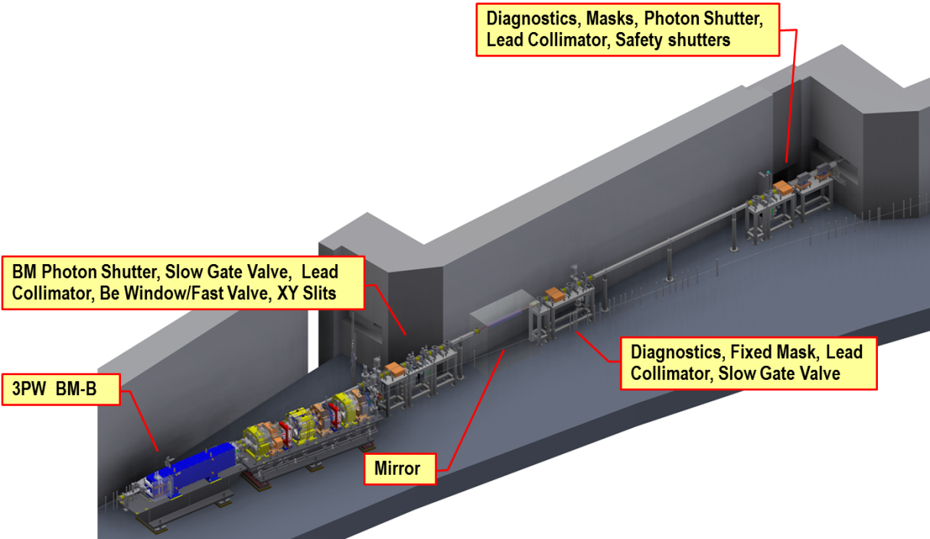
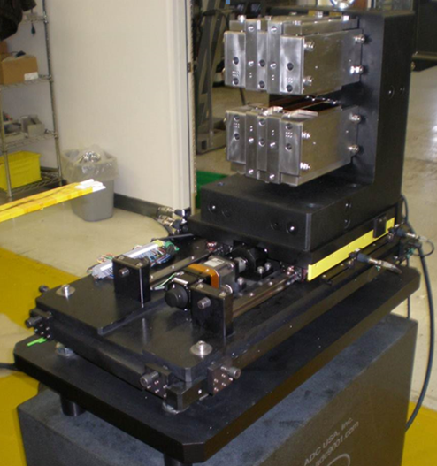
NxtGen Development
NxtGen beamlines are inspired by programs existing on NSLS that have an important place in the research planned for NSLS-II however:
Not Plug-n-play from NSLS to NSLS-II
Physical plant of NSLS and NSLS-II is quite different – adaptation required
Sources, Front-Ends and First Optical Enclosures new at NSLS-II
Many components refurbished from NSLS beamlines
Often equipment is ‘mix-and-match’ from NSLS beamlines
3PW-BM Front End
Source comparison | NSLS | NSLS-II
 | X-ray | 3PW | BM
beam energy (GeV) | 2.8 | 3 | 3
ring current (mA) | 300 | 500 | 500
magnetic field (T) | 1.36 | 1.13 | 0.4
critical energy (keV) | 7.1 | 6.8 | 2.4
max fan / mrad | 10 | 3 | 3
max total power (W) | 380 | 250 | 69
3PW first article

Slide 11
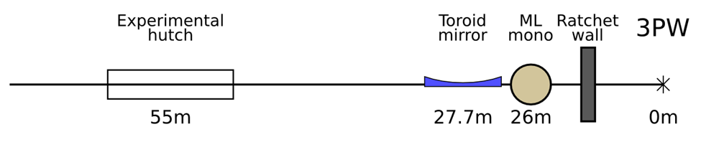
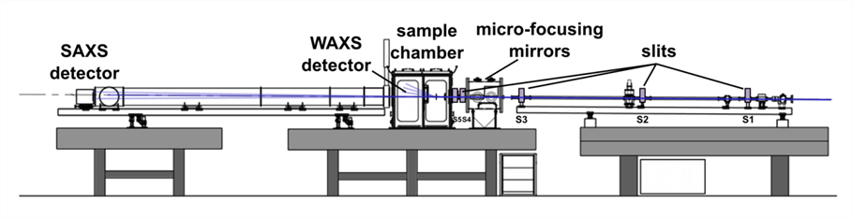
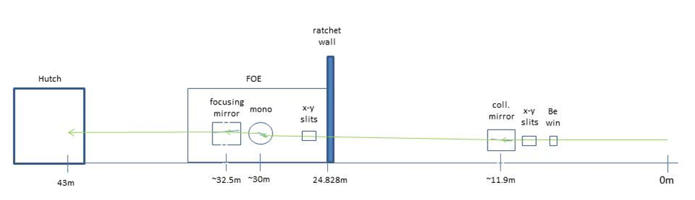
Complex Material Scattering - CMS
Probe structural order in hierarchical multicomponent materials
study of hierarchical materials and next-generation nano- or meso- structures
microfocusing for grazing-incidence (GISAXS/GIWAXS) experiments on surfaces and thin films
CHX-CMS-SMI
CMS with the X9 experimental hutch centered at ~55 m from the 3PW source. Multilayer monochromator (10 to 17 keV) and a toroidal mirror to provide 1:1 focusing onto the sample position.
Based on X-9 design, a slit system (S1-S5) is used to collimate the beam. Microfocusing mirrors are optionally used to reduce beam size. Two area detectors are used simultaneously to capture a wide q-range.
Quick X-ray Absorption and Scattering - QAS
Spatial and temporal study of catalytic systems In situ and in operando
fast kinetics (~10 ms time resolution) of working catalysts and fuel cells
study size, shape, structure and morphology of metal nanocatalysts through the course of catalytic reaction
SST-QAS-ISS
Major Components:
X7B flat collimating mirror with bender
X18A mono – Si(111) channel-cut
4.7 – 35 keV (ΔE/E)~2x10⁻⁴
X21 cylindrical mirror with bender
New FOE, repurpose large X21 hutch

Slide 12
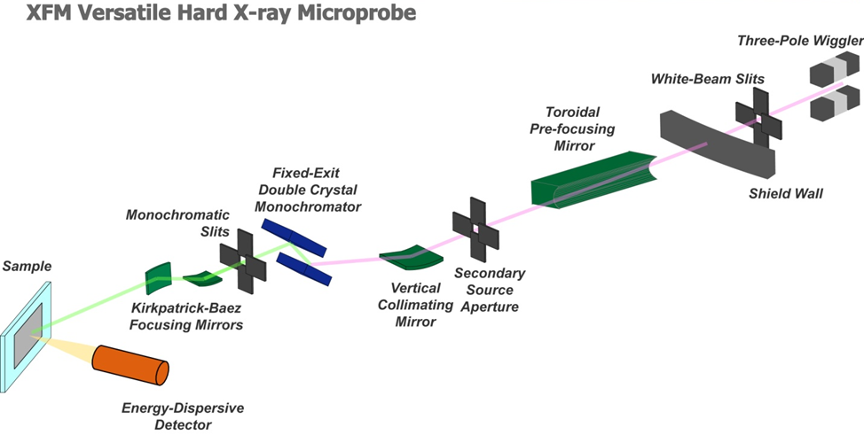
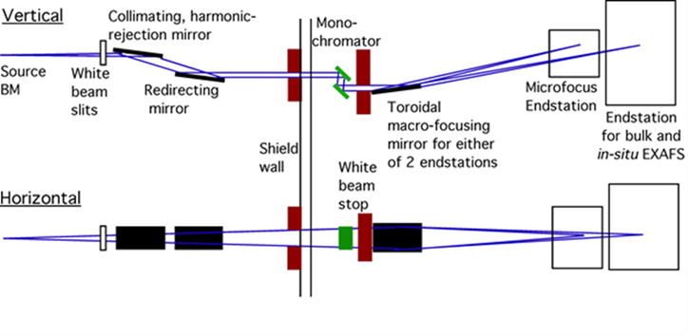
X-ray Fluorescence Microprobe - XFM
Characterization of chemically heterogeneous materials at the micron scale
optimized for microfocus Extened X-ray Absorption Fine Structure spectroscopy
includes microbeam x-ray fluorescence, diffraction and fluorescence computed mirotomography
ISR-XFM-SRX
Major Components:
X12B tank – X15B toroid mirror
X16A collimating mirror
X27A monochromator (5-21 keV)
Microprobe components from X26A and X27A
New FOE, Repurposed X12B hutch
Achieves ~100 gain in flux over existing NSLS instruments
Tender Energy x-ray absorption Spectroscopy - TES
Tender-energy spatially spectroscopy of multi-scale heterogeneous and dynamic systems
mm to micrometer beam X-ray Absorption Spectroscopy from 1.2-8 keV
in situ, in operando rapid-scanning XAS for chemistry & materials or XAS, GIXAS, XRF+XAS imaging
ISS-TES-___
Major Components:
New collimating and redirecting mirrors (on order, contributed)
X15B monochromator
New microfocusing mirrors (on order, contributed)
Other equipment from X1A, X15B, X19A
New FOE, repurpose X13B hutch

Slide 13
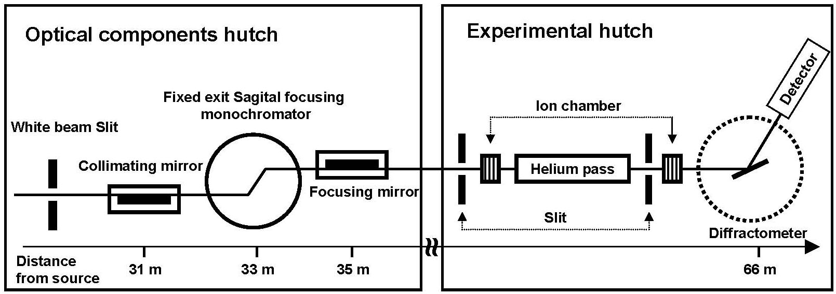
In-situ X-ray Diffraction - IXD
In situ and ex situ X-ray Powder Diffraction measurements in materials
Structural and chemical changes of energy materials in their operating environments
High q-resolution scattering with tunable energies up to 25 keV
XPD-IXD-___
Major Components:
X14A focusing mirror
X14A sagittal focusing monochromator
New FOE, relocate X14A hutch
Supporting research on – batteries, supercapacitors, fuel cells, catalysis, high-temperature materials, light-metal production….
Materials Physics and Processing - MPP
Diffraction and scattering for study of materials (thin films, stacks, nanopatterned samples and bulk)
high flux- low resolution mode for real-time in situ studies of phase transformations
Medium-to-high resolution x-ray diffraction on samples in different environments
HXN-MPP-ISR
Major Components:
Toroidal mirror from X20, bender from X10
X20 2” offset monochromator
NSLS Si (111) for high res, multilayers for low res
Toroidal mirror from X20
New FOE, relocate X20C hutch

Slide 14
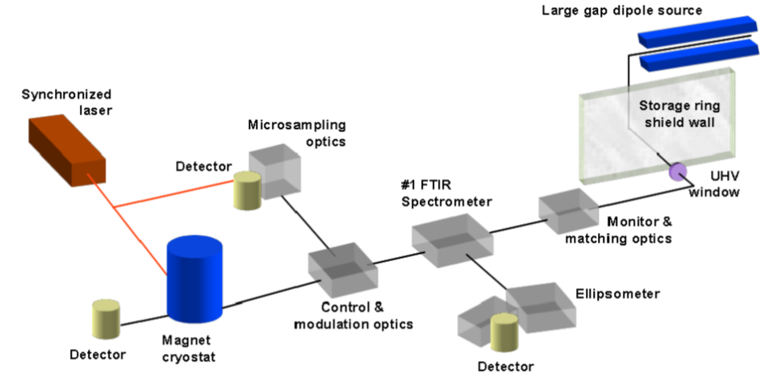
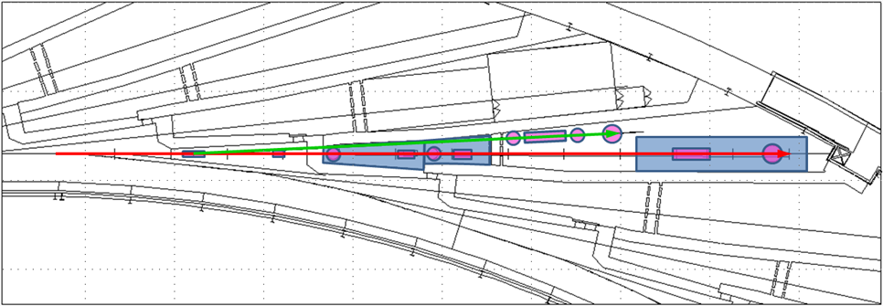
Frontier IR Spectroscopy / Magneto, Ellipsometric and Time Resolved IR – FIS/MET
Materials science and extreme conditions communities
high-brightness and pulsed THz, infrared and visible light for probing electronic properties and dynamics
CSX-FIS/MET-RF
Major Components:
New wide gap dipole chamber and extraction optics required
Key capabilities:
250 meV to 5 eV energy range
Optics for small aperture diamond anvil cells to pressures ~250 Gpa
Ellipsometry to directly extract optical constants (e and m independently)
Samples in magnetic fields to 10T and temperatures to 1.5K
Laser systems for photoexcitation (pump probe) and heating to extreme temperatures
Photoconductivity capability from ~5Hz up to 1 GHz
Note- source is 23BM, occupies sector 22 floor space
Metrology and Instrumentation Development - MID
Dedicated beamline for x-ray instrumentation development
3PW beam onto floor and up to three white beam capable hutches
RF-MID-___
Modular beamline optics from NSLS:
channel-cut monochromators from X12A and X6B
mirror system from X16A
4-circle diffractometer from X16B
tables from X7A, X16A
Instrumentation from various beamlines

Slide 15
BES Synchrotron Capability Assessment
Even with the rapid build-out of NSLS-II, there will still be a reduction in capacity for several years
Met with DOE BES and Synchrotron Facility leadership to discuss in August 2011
Reviewed assessment of scientific capability changes anticipated with shutdown of NSLS and ramp up of NSLS-II
Established working group with other facilities -
  BNL- NSLS/NSLS-II Erik Johnson
  LBNL- ALS Michael Banda
  ANL- APS Denny Mills
  SLAC - SSRL Piero Pianetta

Slide 16
User Community Overlap
Part of working with APS/ALS and SSRL to understand the impacts
Of the 2312 FY11 NSLS users 507 used 1,2 or 3 of the other DOE Synchrotron Facilities
NSLS Only, 1805
In common with the 2312 FY 11 NSLS Users
APS – 363 (16% of NSLS)
ALS – 92 (4% of NSLS)
SSRL – 55 (2% of NSLS)

Slide 17
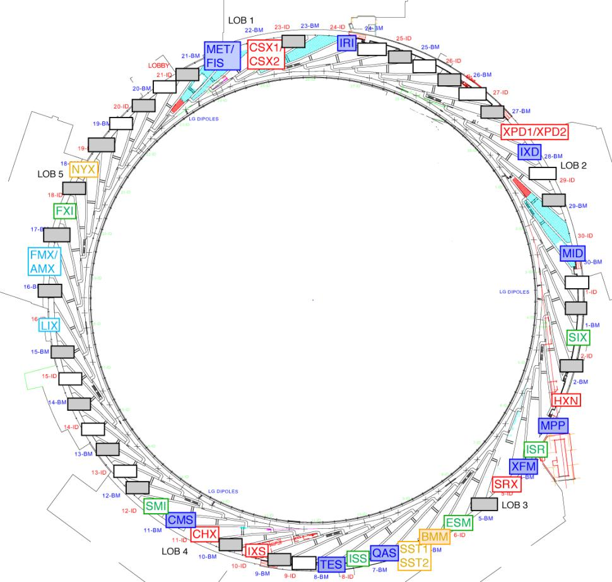
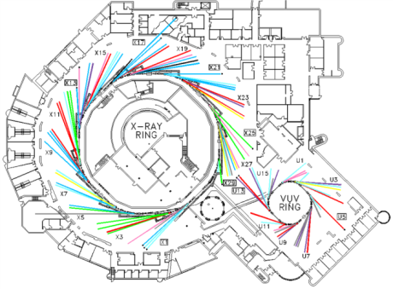
NSLS User Transition Planning Forum
2012 NSLS/CFN Joint Users Meeting
May 21, 2012 1:30 to 5:30 PM
Committee:
Jen Bohon (UEC Chair)
Dan Fischer
Annie Heroux
Erik Johnson
Tony Lanzirotti (NUFO)
Ryan Tappero
From other DOE SR Facilities:
Denny Mills (APS)
Zahid Hussain (ALS)
Piero Pianetta (SSRL)
Peter Lee (DOE)

Slide 18
DOE Synchrotron Beamlines
Experimental techniques at Light-Source Beamlines http://science.energy.gov/~/media/bes/pdf/Synchrotron_Techniques.pdf
Divides techniques into 3 broad categories
12 basic techniques
SPECTROSCOPY
01 Low-Energy spectroscopy
02 Soft X-ray spectroscopy
03 Hard X-ray spectroscopy
04 Optics/Calibration/Metrology
SCATTERING
05 Hard X-ray diffraction
06 Macromolecular X’tal
07 Hard X-ray scattering
08 Soft X-ray scattering
IMAGING
09 Hard X-ray Imaging
10 Soft X-ray Imaging
11 Infrared Imaging
12 Lithography
Worked with peers across the complex -
Compiled list of DOE facility beamlines with techniques available at NSLS or NSLS-II
Goal – see what is available where through the transition

Slide 19
Beamlines
2012 estimate of available Beamline Equivalents (BE) by technique across the DOE synchrotron light sources
BE is used as some beamlines perform multiple techniques
Includes factors such as anticipated staffing level and operations schedules

Slide 20
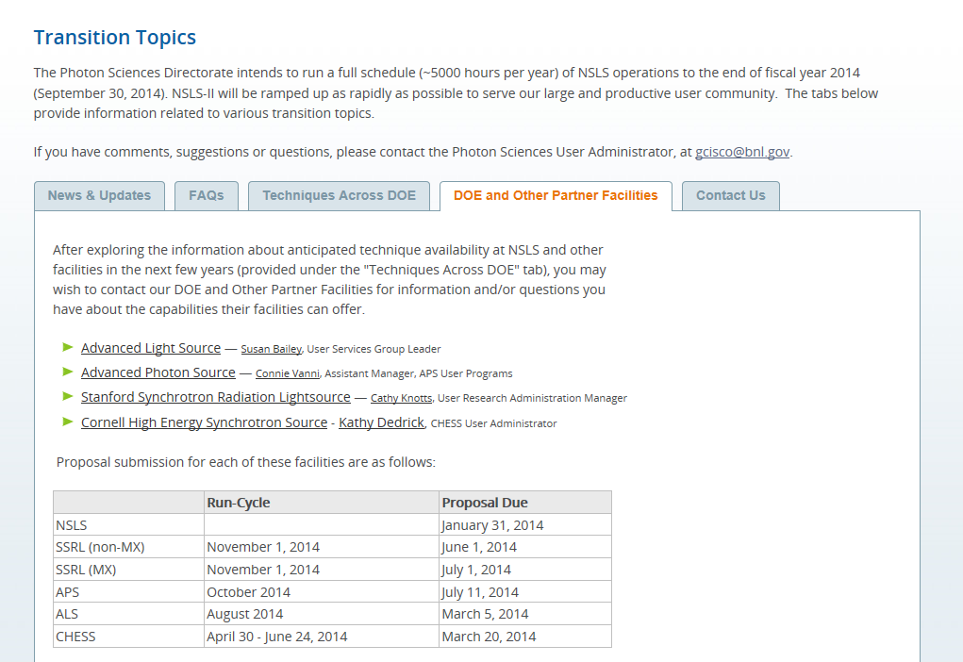
Informing the User Community and Stakeholders
http://www.bnl.gov/ps/transition
Discussions continuing with other facilities (ALS, APS, SSRL, CHESS) on coordination of user support for NSLS users during FY15-16
  similar beamlines/capabilities
  proposal cycle dates posted on PS transition website
Interaction with DOE-BES and NIH/DOE-BER programs about transition plans

Slide 21
Options
 |  |  | Opportunities for expanded user operations
 | Technique |  | ALS |  |  |  | APS |  |  |  |  | SSRL |  |  | NSLS-II
Spectroscopy
 | Low Energy Spectroscopy
 | IR |  | 1.4, 5.4 | 2.4 |  |  |  |  |  |  |  |  |  |  | FIS/MET
 | Soft X-ray Spectroscopy
 | Soft / UV |  |  |  |  |  |  |  |  |  | 8-1, 8-2, 10-1 |  |  |  | SST-1, SST-2, ESM
 | Tender X-ray |  | 9.3.1 |  |  |  |  |  |  |  | 14-3
 | Hard X-ray Spectroscopy
 | Hard X-ray |  |  |  |  | 9-BM | 10-BM | 12-BM |  |  | 2-2 | 4-1, 4-3, 7-3 |  |  | QAS, BMM, ISS
 | Optics/Calibration/Metrology
 | Optics/Metrology |  |  |  |  |  |  |  |  |  |  |  |  |  | MID
Scattering and Diffraction
 | Hard X-ray Diffraction
 | Powder Diffraction |  |  |  |  | 11-BM | 1-BM | 17-BM-B |  |  | 1-5 | 2-1,11-3, 7-2 |  |  | XPD-1, IXD
 | 4-Circle, general Diffraction |  |  |  |  | 12-BM | 33-BM-C |  |  |  |  |  |  |  | MPP
 | Diffraction - Extreme Conditions |  |  |  |  | 5-BM-C | 6-BM | 13-BM-C | 14-BM-D
 | Rapid Acquisition PDF |  |  |  |  |  |  |  |  |  |  |  |  |  | XPD-2
 | Energy Dispersive |  |  |  |  | 6-BM
 | Microbeam Diffraction |  |  |  |  |  |  |  |  |  |  |  |  |  | CHX
 | Macromolecular Crystallography
 | Protein crystallography |  |  |  |  | 19-BM-D | 22-BM-B | 23-BM-B | 14-BM-C |  | 9-1 | 7-1 | 14-1 |  | FMX,AMX, NYX
 | X-ray footprinting |  |  |  |  |  | 24-BM-B |  |  |  |  |  |  |  | XFP
 | Hard X-ray Scattering
 | SAXS/WAXS/GISAXS/Liq |  |  |  |  | 33-BM-C |  |  |  |  | 1-4 | 2-1,11-3, 7-2 | 4-2 |  | CMS, LIX, SMI
 | In-situ/ Magnetic Scattering |  |  |  |  |  |  |  |  |  | 1-5 |  |  |  | MPP, ISR
 | Inelastic |  |  |  |  |  |  |  |  |  | 15 |  |  |  | IXS
 | XPCS, CDI |  |  |  |  |  |  |  |  |  |  |  |  |  | CHX
 | Soft X-ray Scattering
 | Soft X-ray Scattering |  |  |  |  |  |  |  |  |  |  |  |  |  | CSX-1, CSX-2
 | Inelastic |  |  |  |  |  |  |  |  |  |  |  |  |  | SIX
Imaging
 | Hard X-ray Imaging
 | Hard X-ray, nanoprobe |  |  |  |  |  |  |  |  |  |  |  |  |  | HXN, SRX
 | Hard X-ray, microprobe |  | 5.3.2.1 | 10.3.1 |  | 8-BM |  |  |  |  |  |  |  |  | XFM
 | Hard X-ray, nano CT |  |  |  |  | 32-ID |  |  |  |  | 6-2 |  |  |  | FXI
 | Hard X-ray, micro CT, Topography |  |  |  |  | 1-BM | 2-BM | 5-BM-C |  |  |  |  |  |  | MID
 | Coherent Diffraction Imaging
 | Soft X-ray Imaging
 | Soft / UV, full-field |  |  |  |  |  |  |  |  |  |  |  |  |  | CSX-2, ESM
 | Soft / UV, nanoprobe
 | Infrared Imaging
 | IR (microprobe, full-field) |  | 5.4.1
Evaluated options for expanded capabilities on existing beamlines
Issues:
Staffing
Equipment
Cost to reconfigure
Some developed and available to users
NSLS-II only beamlines underway shown

Slide 22
NSLS Transition Planning
X-ray Absorption Spectroscopy
  Conversion of BM beam line 2-2 from white beam to XAS program
  Hardware, infrastructure and software planning, procurement and implementation coordinated between SSRL and NSLS
  CAP complete – Appendices in final stage – anticipate formal signatures this month
Macromolecular Crystallography
  Beam time to be provided on SSRL MC beam line(s)
  Access and support staff details agreed on between SSRL and NSLS
  MOU in draft form - anticipate formal signatures this month
Initial discussions underway
  TXM and BNL detector groups

Slide 23




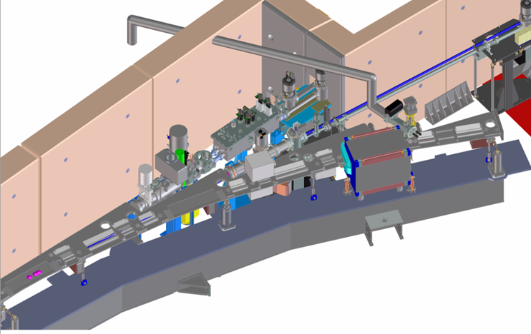
ALS Support for NSLS IR Users
Five NSLS IR BLs turn off Sep. 2014. ALS runs the only other Infrared Beamlines in the U.S.A.
DOE BES Facilities provided $500k to ALS with directive to increase IR capacity to support NSLS Users.
Hosted workshop together with NSLS IR scientists Lisa Miller and Larry Carr on how to best accomplish this support.
A new IR port.
    Location identified as BL 2.4.
    Front end duplicate of BL 5.4.
    Endstation space available near BL 1.4.
    NSLS expertise to couple novel optics to
    full-field IR imaging microscope
Start front end installation May/June 2014 shutdown
Approved Program submitted to ALS
    Lisa Miller & Larry Carr are co-PI’s
    Begin Oct 1, 2014 with 15% of 1.4 and 5.4 time
    NSLS staff to come to ALS to support NSLS IR users ~3 weeks / cycle
    Collaborate on full-field imaging at BL 2.4
    Proposals through NSLS PASS system, allocated into AP block of beamtime.
    BL 2.4 goes into user operations, AP grows to cover more BL 2.4 beamtime.

Slide 24
NSLS Transition Planning at the APS
Working with NSLS staff and NSLS user groups, we have targeted investments to increase capacity on several under-utilized beamlines.
Beamlines with increased capacity:
  1-BM (topography)
  2-BM (tomography)
  6-BM (white beam high pressure studies and energy dispersive diffraction)
  9-BM (spectroscopy)
  12-BM (spectroscopy and diffraction)
  17-BM (powder diffraction)
  32-ID (transmission x-ray microscopy)
The increased capacity from the beamlines listed about amounts to approximately 3 beam line equivalents (BLEs).
We are continuing discussions with other NSLS user groups to see how we might accommodate them during the transition period and are open to additional cooperative arrangements.

Slide 25
NSLS User Coordination with Other Facilities
Photon Sciences has actively coordinated with the other light source facilities to develop specific plans to help existing users during NSLS/NSLS-II transition
Arrangements in four areas where users have been very productive at NSLS and will be strategically important to the science programs at NSLS-II
  X-ray Spectroscopy: SSRL BL2-2 (~80% available beamtime)
    Spectroscopy collaboration: Case Western (NSLS X3A), SCC, and PS
    Collaborative Access Proposal (CAP) being finalized with SSRL
  Protein Crystallography: ALS (distributed among several PX beamlines), SSRL BL14-1 (50%)+ access to ID beamline(s), and APS 23-BM (50 %) + access to 23-ID
    Survey is being conducted among the PXRR and X6A user communities
    Coordination plan is being drafted, and NIH/DOE-BER are being kept in the loop
  Energy Dispersive XRD: APS 6-BM (~75%)
    EDX collaboration (COMPRES for 6-BM-B, Materials/Battery Group for 6-BM-A)
    draft Management Plans (MOUs) have been developed and are being iterated with APS
  Infrared Program: − Proposal for an Approved Program has been submitted to ALS
PS will commit resources to continue to support users from these communities during the transition at other facilities, including beamline staffing, user proposal administration, and possibly loaned equipment

Slide 26
Developing Transition Plans with User Groups
  We are working with NSLS user groups to identify & develop specific plans to help them maintain their programs during the transition period:
  Identify suitable NSLS-II beamlines among the initial suite to establish arrangements in the interim
  Working out specific arrangements with other sister facilities to accommodate their needs during the dark period
  Encouraging partnership in developing and construction of specific beamlines to meet their science needs at NSLS-II
Some examples:
Group | Near Term | Longer Term
Synchrotron Catalysis Consortium (SCC) | SRX, SSRL arrangement | ISS, QAS, TES
Consortium for Mat Prop Research in Earth Sciences (COMPRES) | XPD, APS 6-BM arrangement | New SCW beamline
Center for Emergent Superconductivity (CES) | CSX | ESM, SIX
Protein Crystallography Research Resource (PXRR) | PX arrangement at ALS, APS, SSRL | FMX, AMX, LIX
NY Structural Biology Center (NYSBC) | PX arrangement at ALS, APS, SSRL | NYX
Case Center for Synchrotron Biosciences (CSB) | SSRL arrangement | XFP, ISS
BNL Center for Functional Nanomaterials (CFN) | CHX | ESM, SMI, CMS
Industry (GE, IBM, others…) | APS 6-BM arrangement | MPP, New SCW BL

Slide 27
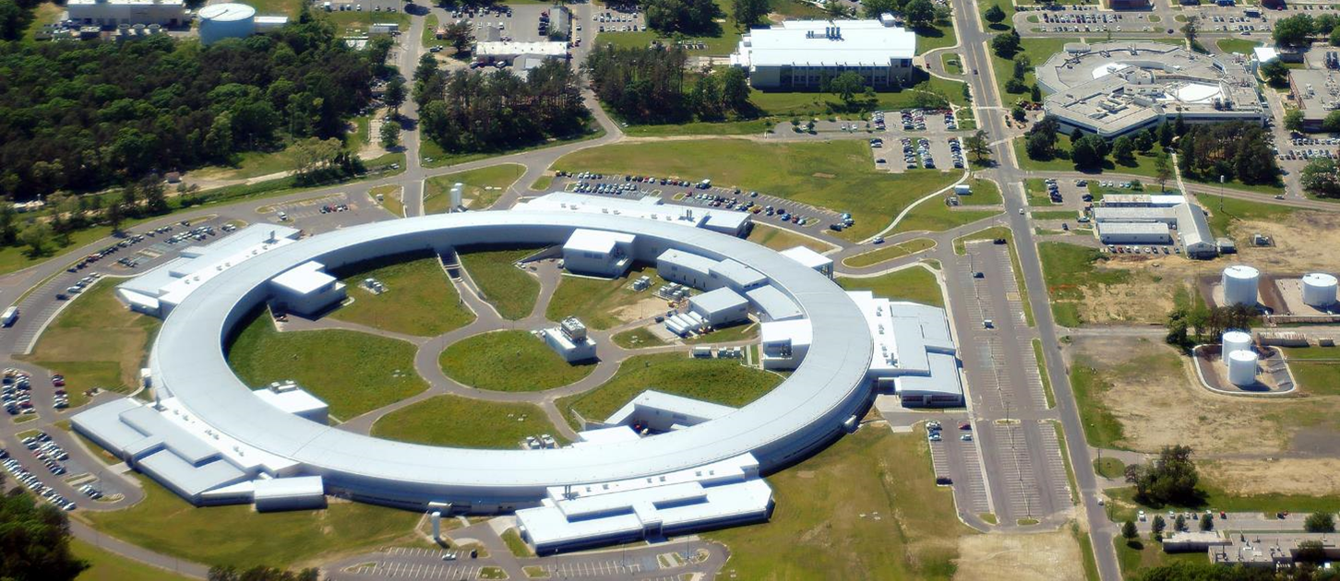
NSLS to NSLS-II: A Bright Future
The closure of NSLS will bring an end to one era and the beginning of another with the world leading performance that NSLS-II will deliver
30 beamlines underway that will provide world class capabilities
The entire community is helping NSLS users weather the dark period at the dawn of the NSLS-II era of synchrotron radiation research

