Slide 1
Basic Energy Sciences Update
BES Advisory Committee Meeting
July 26, 2012
Harriet Kung Director, Basic Energy Sciences
Office of Science, U.S. Department of Energy

Slide 2
Outline
FY 2012 Budget & Program Highlights
FY 2013 Appropriation Status
Upcoming Activities
BES Staffing

Slide 3
FY 2012 BES Budget Appropriation
Research programs
Energy Innovation Hubs
Battery and Energy Storage Hub (+$20M)
Energy Frontier Research Centers
Core Research
Plan to initiate new projects in materials and chemistry by design
Scientific user facilities operations
All facilities operate below optimum level
Synchrotron light sources
Neutron scattering facilities
Nanoscale Science Research Centers
FY 2012 Approp:
$ 1,688M
(+$10M from FY 2011)
SUF Research
25
SBIR/STTR & GPP
43
Hubs
44
Const, OPC, MIE
NSRCs 103
EFRC
100
233
Neutron Sources
249
CSGB
Research
240
Facilities
Ops
731
Light Sources
379
MSE
Research
274
Construction and instrumentation
National Synchrotron Light Source-II ($159M) and NEXT instrumentation ($12M)
Spallation Neutron Source instruments ($12M)
Advanced Photon Source upgrade ($20M)
Linac Coherent Light Source-II ($30M)

Slide 4
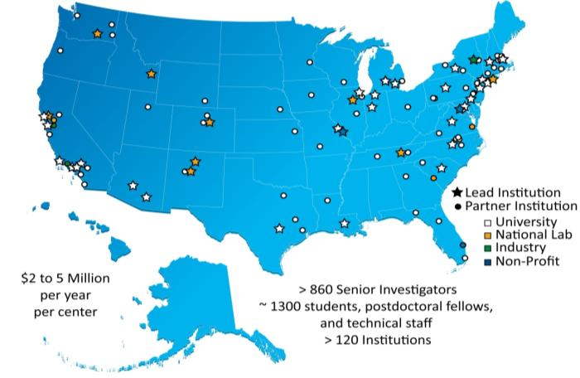
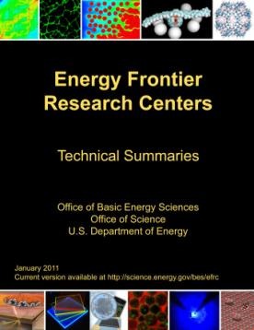
Energy Frontier Research Centers Grand Challenge and Use-Inspired Research
46 EFRCs in 35 States were Launched in Fall 2009
Science crosscuts energy-use-inspired and grand
challenge research
~850 senior investigators and ~2,000 students, postdoctoral fellows, and technical staff at ~115 institutions
>250 scientific advisory board members from 13 countries and >40 companies
Impact to date (~2.5 years):
>2,000 peer-reviewed papers including more than 60 publications in Science and Nature.
> 40 patents applications and nearly 50 additional patent/invention disclosures by 28 of the EFRCs.
at least 9 start-up companies with EFRC contributions
Assessment of Progress:
All EFRCs have undergone mid-term peer review to assess progress towards goals and plans for the next 2 years of R&D
http://science.energy.gov/bes/efrc/
4

Slide 5
FY 2012 EFRC Science Reviews - Background
Dates and Location:
January – April 2012, the third year of the five-year award period
Off-site in lower-cost regional cities near major airport hubs
Baltimore, Charlotte, Chicago, Denver, and Philadelphia
Reviews clustered according to both topical and regional considerations
Review Process:
Comprehensive review document addressing:
Strategic vision, scientific plans and progress, and technical accomplishments
Management; synergy that makes an EFRC “greater than the sum of its parts.”
One full day of scientific presentations, posters, and small group discussions for each EFRC
Review by a panel of three to four expert peer reviewers with complementary email reviews if needed to ensure coverage of the technical breadth of the EFRC
Included DOE BES participants (2- 4) and DOE observers (from other offices)
EFRC participants: 12 to18 people including the EFRC Director(s), EFRC Leadership, and a mix of senior investigators, postdoctoral staff, and graduate students

Slide 6
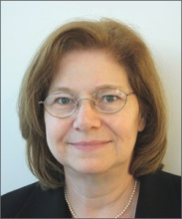
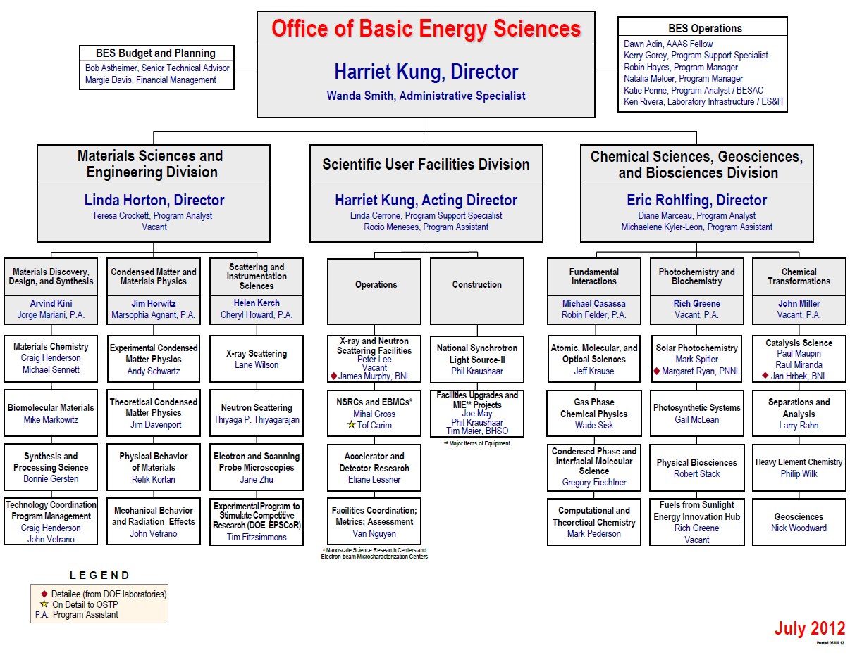
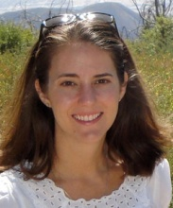
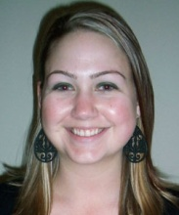
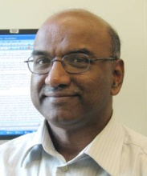
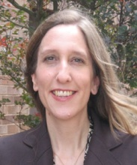
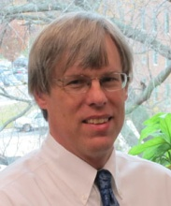
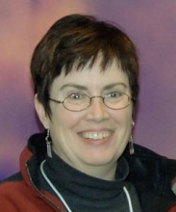
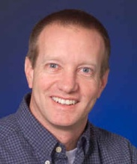
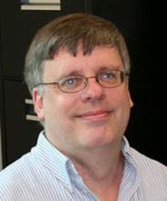
EFRC Management Team Matrixed Across BES
Linda Horton
Team Lead
(interim)
Dawn Adin
Kerry Gorey
Thiyaga P.
Thiyagarajan
Robin Hayes
Craig
Henderson
Gail McLean
John Vetrano
Jeff Krause

Slide 7
Overarching Comments from EFRC Science Reviews
Reviewers all expressed a positive view of the EFRC program as a whole.
EFRCs accelerate research in grand challenge and use-inspired science by:
Tackling high-risk research that would otherwise would not be attempted.
Forming teams across disciplines that challenge the members to ask more difficult questions, leading to results that are potentially transformational.
Accelerating not just success, but also failure, from which lessons are rapidly learned and adjustments quickly made.
Fostering synergy among synthesis, characterization, theory, and computation.
Developing outstanding new experimental and theoretical tools.
Linking good management to coherent, high-quality science.
Training the next generation of energy scientists – the EFRCs have attracted high quality students and postdocs, most want to continue a career in energy science.

Slide 8
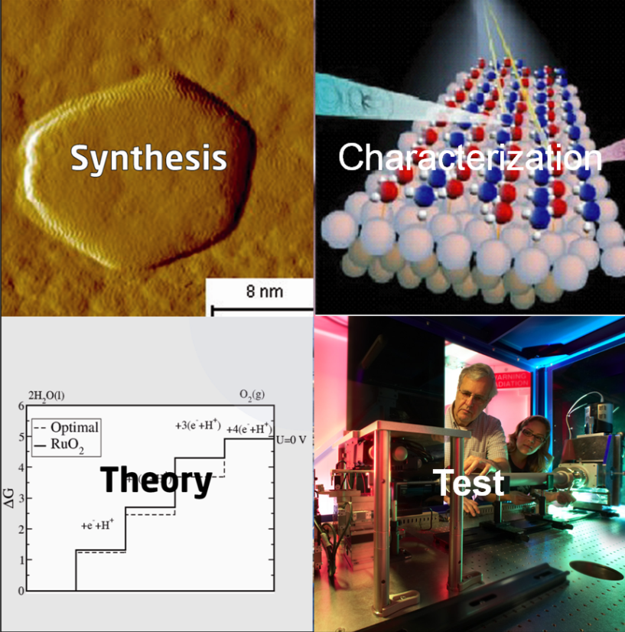
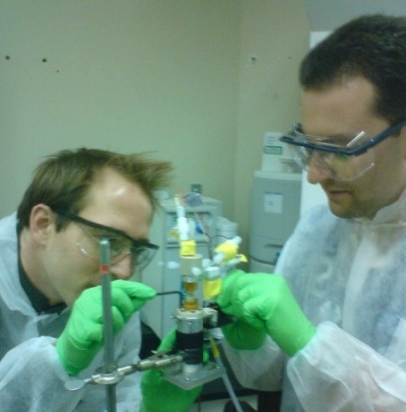
Two Opportunities in Computational Materials and Chemical Sciences in FY12
Predictive Theory and Modeling
Energy-Inspired
Software Development
Validation – Experiment
SciDAC
Partnership with Advanced
Scientific Computing Research
SciDAC Institutes
Leadership Class Computing Facilities

Slide 9
Two Funding Opportunities - Update
Predictive Theory & Modeling
Expression of Interest - February 2012, Proposals due May 10, 2012
~ $13.5 million/year, 3 to 5 year awards + ~$4 million for equipment
5 Software Innovation Centers, 2 glue, 12 small group – single investigator awards
Next generation electronic structure
Excited states, electron correlation
High throughput computational techniques, data management
Optical, thermoelectric properties of oxides, multi-phase materials, grain boundaries, self-assembly
Reaction pathways, catalysis, combustion
SciDAC
Proposals due March 12, 2012
7 Awards, ~$6 Million/year, 5 years (split with ASCR)
Improved quantum chemistry, quantum Monte Carlo and molecular dynamics, photovoltaic & photocatalytic materials, solvated ions, Li-ion batteries, superconductor transport

Slide 10
29 BES Early Career Awards in FY12
Office of Science Early Career Research Program – Started in FY10
Purpose: To support individual research programs of outstanding scientists early in their careers and to stimulate research careers in the disciplines supported by the Office of Science
Eligibility: Within 10 years of receiving a Ph.D., either untenured academic assistant or associate professors on the tenure track or full-time DOE national lab employees
5-Yr Awards: University grants $150,000/yr, National lab awards $500,000/yr min
FY12 Program
24 Program Areas in BES
~850 SC proposals received
29 BES Awards out of 68 total for SC
– 21 Universities, 8 National Labs
3-Yr Total = 86 BES Early Career Awards is ~40% of all 206 SC Awards
FY 13 Early Career Program Announced on July 20, 2012
http://science.energy.gov/early-career/

Slide 11
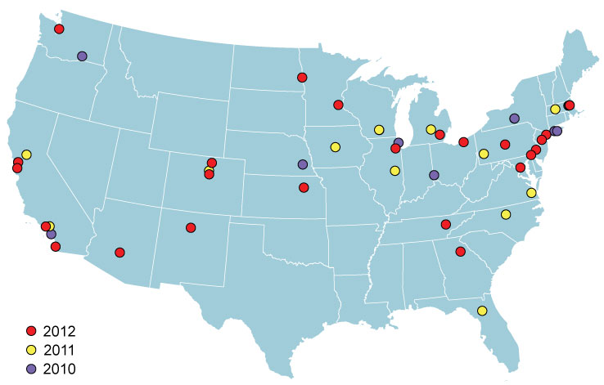
BES Early Career Awards are Broadly Distributed
States
Year | BES | All of SC
2012 | 19 | 25
2010 - 2012 | 25 | 33
Unique Institutions
Year | BES | All of SC
2012 | 26 | 47
2010 - 2012 | 51 | 87
Demographics
~ ¼ of BES Early Career Awards are at National Laboratories
Within 1st three years of BES Early Career Awards:
41 unique universities and 10 unique laboratories

Slide 12
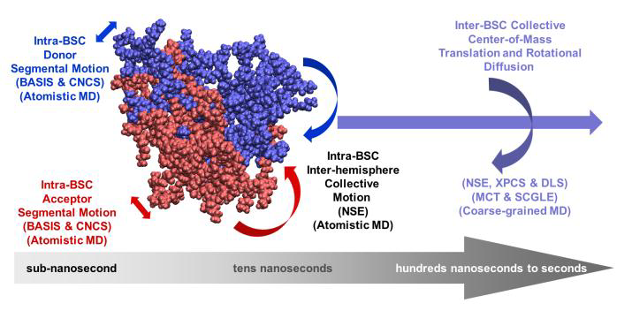
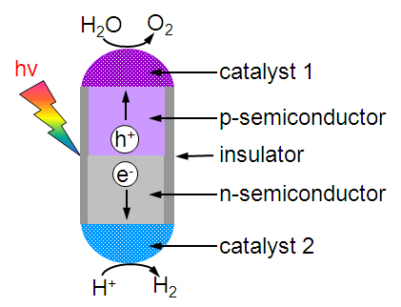
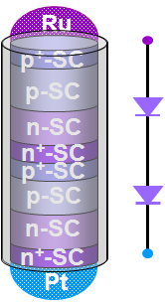
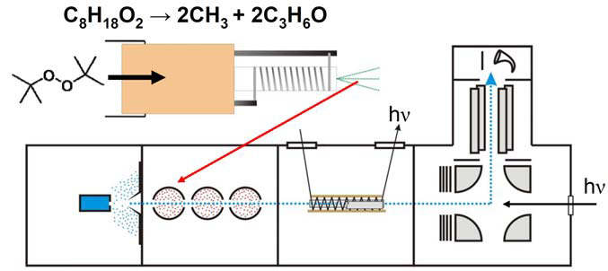
Early Career Awards Bring New Talent and Ideas to BES
Multiphasic soft colloids: From fundamentals to application of energy sustainability
Rational Design and Nanoscale Integration of Multi-Heterostructures as Highly Efficient Photocatalysts
PI: Xiangfeng Duan, UCLA
Goal: Synthesize nanostructured semiconductor photodiodes and investigate their fundamental electronic, optoelectronic properties to enable efficient charge separation, transportation and photon-to-electron conversion.
PI: Wei-Ren Chen, ORNL
Goal: Combine tailored synthesis, neutron scattering experiments, and computa-tional modeling to understand novel soft colloid systems for energy materials.
Assembling Microorganisms into Energy Converting Materials
Vibrational Spectroscopy of Transient Combustion Intermediates Trapped in Helium Nanodroplets
PI: Ozgur Sahin, Columbia
Goal: Investigate basic science aspects of using bacterial spores as functional materials that can robustly and efficiently convert energy from variations in ambient conditions.
PI: Gary Douberly, Univ. Georgia
Goal: Use HENDI (Helium nanodrop isolation) spectroscopy to make the first direct observation of the elusive combustion hydroalkyl peroxy radical (QOOH) and its oxygen adducts (O2QOOH) which play important roles in combustion.

Slide 13
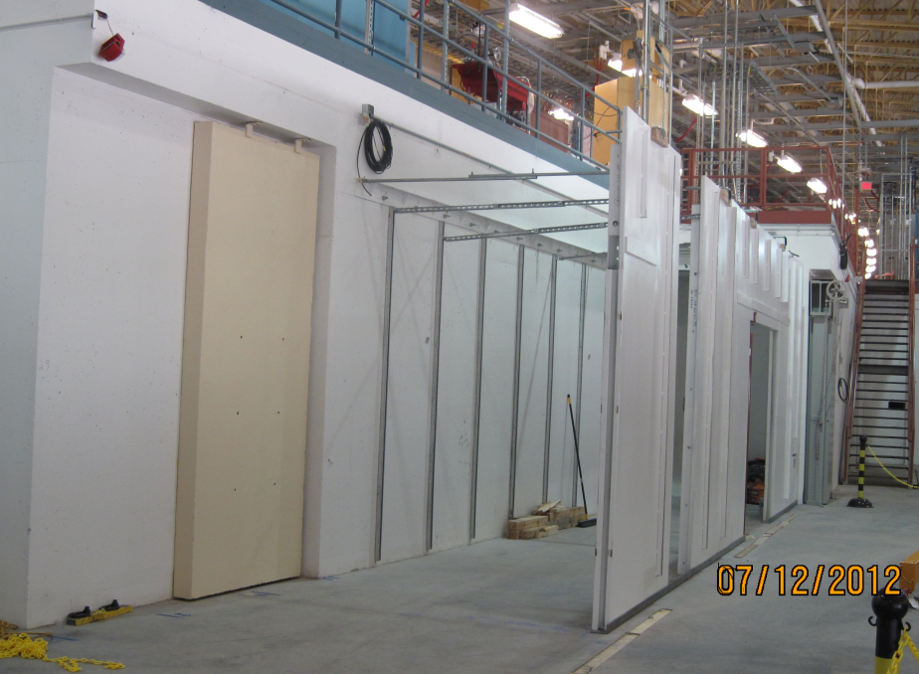
National Synchrotron Light Source- II Conventional Facilities Status
Photo From 7-12-12
Ring Bldg complete
Occupancy of entire Ring Building achieved
Ring Bldg contractor demobilizing
Final site grading & seeding nearly complete
LOB’s 1-3 completed in June
LOB interior fit-out underway
On-track to complete LOBs 4-5 by December
Hutch Installation in Progress

Slide 14
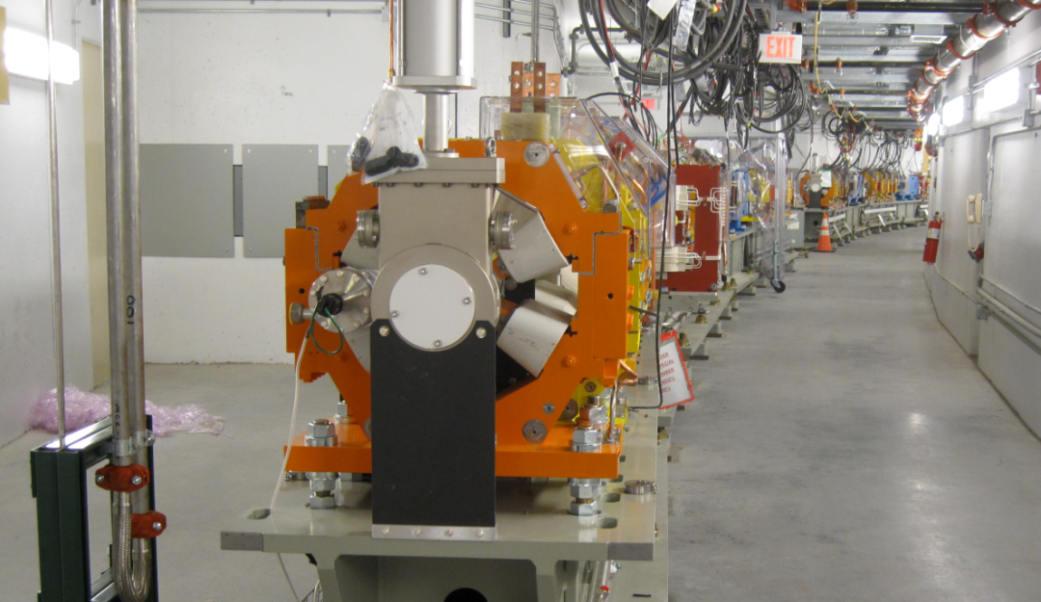
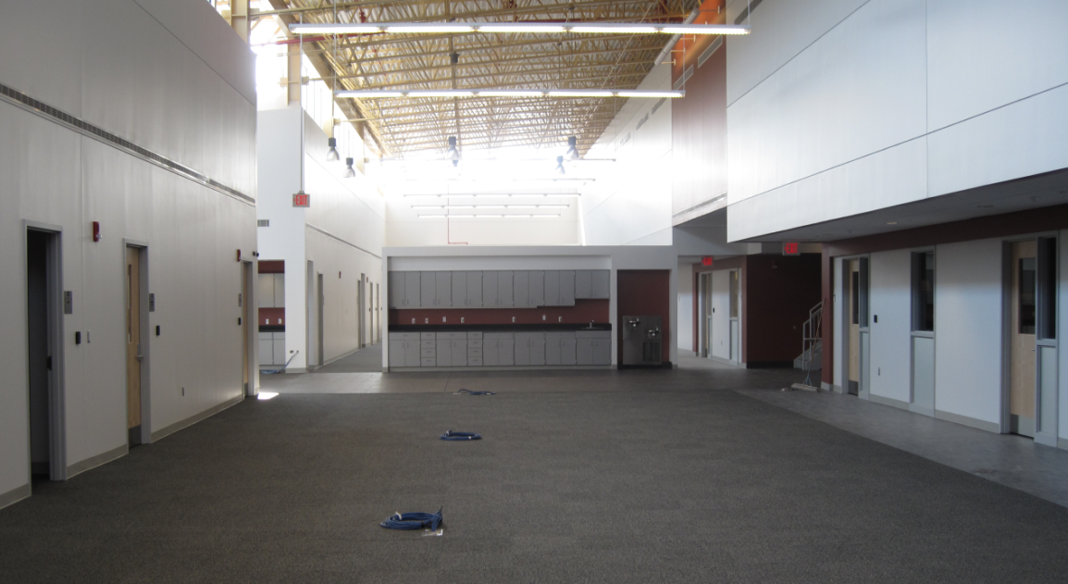
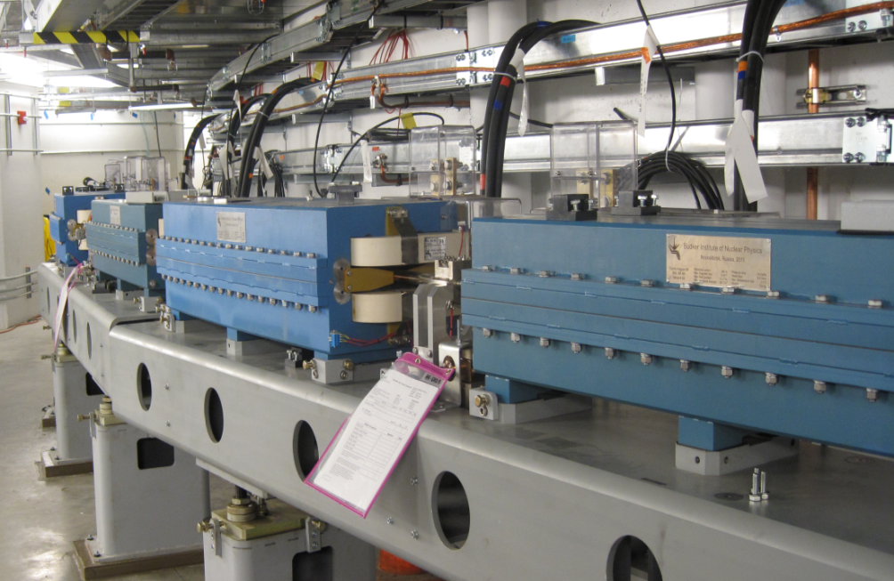
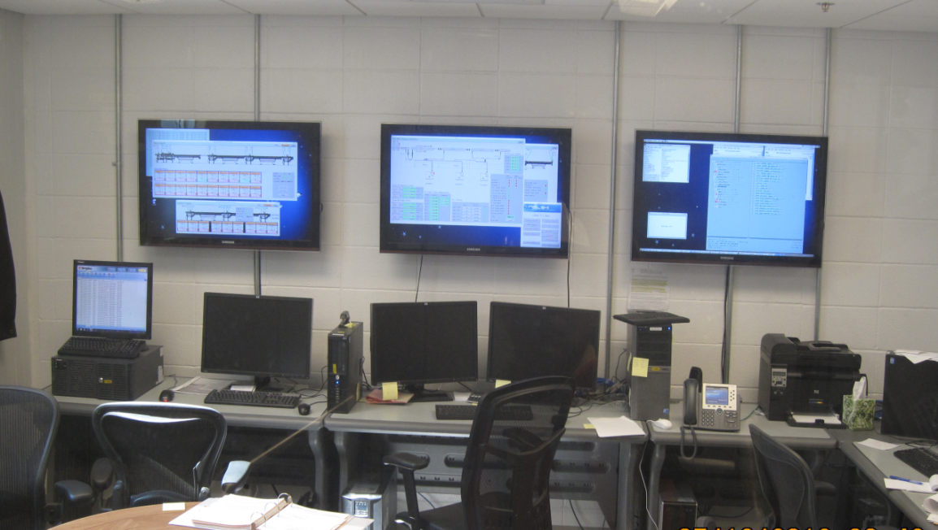
NSLS-II Accelerator Systems Installation Progress
RF
Storage Ring in Pentant 1
LOB 1 Interior Complete
Booster Girder Installation
Injection Control Room
Storage Ring in Pentant 1
LINAC
14

Slide 15
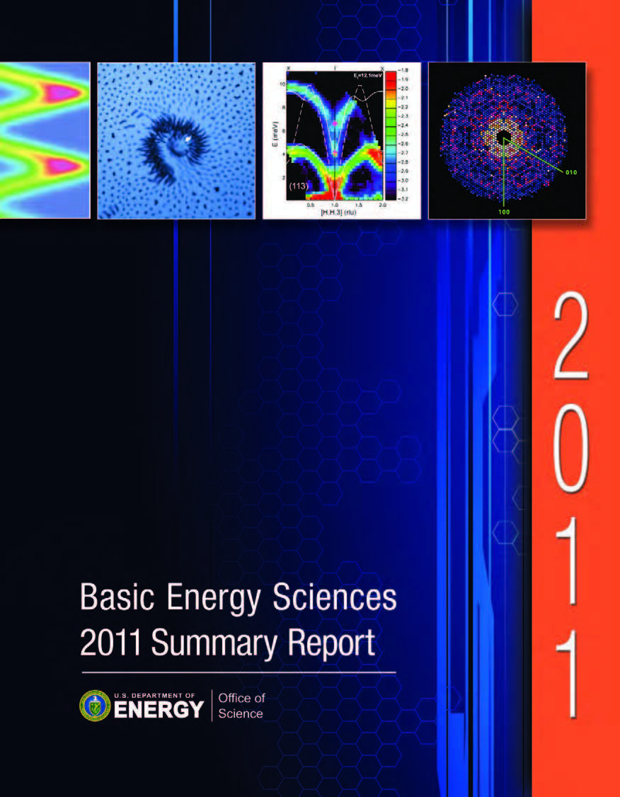
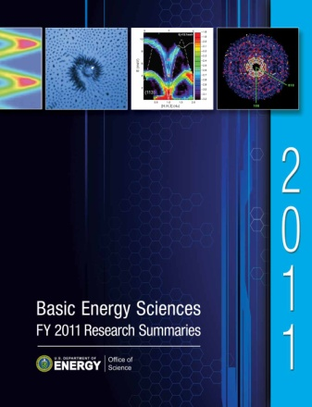
BES Publications for Improved Communication
BES 2011 Summary Report
Overview of BES
How BES does business
Descriptions and representative research highlights for 3 BES divisions, EFRCs, and Energy Innovation Hubs
BES FY 2011 Research Summaries
Summaries of more than 1300 research projects across 3 BES divisions, including senior investigators, postdocs, graduate and undergraduate students, and a brief project description
Science Serving the Nation (brochure)
Brief vignettes describing the impact of BES funded research on scientific innovation and its impact on end-use technology
http://science.energy.gov/bes/research/

Slide 16
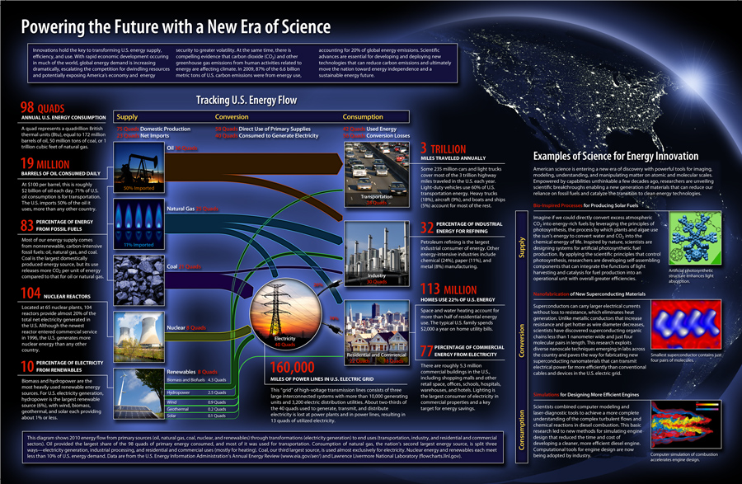
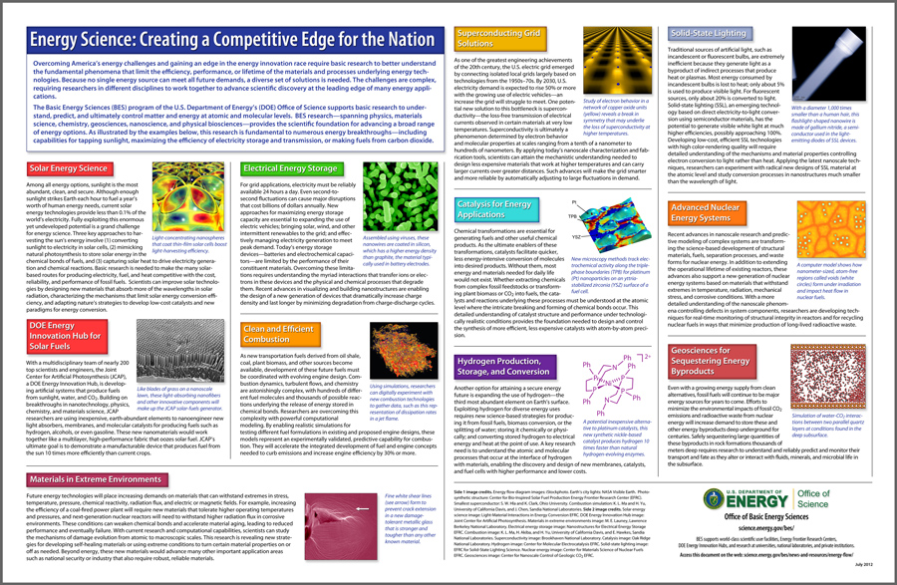
Powering the Future with a New Era of Science
11in. x 17 in. Eat-and-Learn Placemat
Front
U.S. energy flow diagram
Energy supply, conversion, and consumption facts
Three examples of science for energy innovation
Back
Eleven additional science examples based on Basic Research Needs workshop areas
http://science.energy.gov/bes/news-and-resources/energy-flow/

Slide 17
FY 2013 BES Budget Request
Research programs
Energy Innovation Hubs (+$5M)
Energy Frontier Research Centers
Joint EERE R&D (+$20M)
Core Research
Materials and Chemistry by Design (+$20M)
Science for Clean Energy (+$42M)
Scientific user facilities operations
Near optimum operations of all facilities (+$42M)
Synchrotron light sources
Neutron scattering facilities
Nanoscale Science Research Centers
Instrumentation for clean energy, joint with EERE (+$15M)
NSLS-II Early Operations (+$22M)
FY 2013 Request: $1,799.6M, +$111M
SUF Research
27
SBIR/STTR & GPP
51
Hubs 48
Const, OPC, MIE
NSRCs 114
EFRC
120
167
Neutron Sources
258
Facilities
Ops
810
CSGB
Research
260
Light Sources
439
MSE
Research
316
Construction and instrumentation
National Synchrotron Light Source-II
NSLS-II instrumentation (NEXT) ($12M)
Advanced Photon Source upgrade ($20M)
Linac Coherent Light Source-II ($64M)
17

Slide 18
FY13 BES HEWD Mark
The Committee recommends $1,657,146,000 for Basic Energy Sciences, $36,854,000 below fiscal year 2012 and $142,446,000 below the request.
The Committee recognizes the critical contribution that the program’s light sources, neutron sources, and other user facilities make to scientific discovery and American industry. The United States is currently host to the world’s most advanced and productive basic energy science user facilities, and the Department is urged to develop a plan for the next generation of light sources and other user facilities in order to maintain American leadership through the next decade.
$1,559,943,000 for Research within Basic Energy Sciences, $17,343,000 above fiscal year 2012 and $128,946,000 below the request. The recommendation includes $24,237,000 for the fourth year of the Fuels from Sunlight Energy Innovation Hub, the same as the request; $24,237,000 for the second year of the Batteries and Energy Storage Energy Innovation Hub, the same as the request; and $100,000,000 for Energy Frontier Research Centers (EFRC’s), $20,000,000 below the request. The Committee provides no funds, $8,520,000 below fiscal year 2012 and the request, for the Experimental Program to Stimulate Competitive Research.
MIE: $32,000,000 for major items of equipment, $41,500,000 below fiscal year 2012 and the same as the request, to include $20,000,000 for the Advanced Photon Source Upgrade and $12,000,000 for NSLS-II Experimental Tools, both the same as the request.
Facilities: $776,568,000 for facility operations, $46,000,000 above fiscal year 2012 and $33,426,000 below the request. The increase above fiscal year 2012 is for preliminary operations of the NSLS-II as it completes construction and to increase operating time of other Basic Energy Sciences facilities to near-optimal levels.
Construction.—$97,203,000 for Basic Energy Sciences construction projects, $54,197,000 below fiscal year 2012 and $13,500,000 below the request. The recommendation includes the first year of construction funding for the Linac Coherent Light Source II two-tunnel upgrade project.
The Committee recommendation includes … a rescission of $23,500,000 due to the Office of Science termination of two major items of equipment in fiscal year 2012.
18

Slide 19
FY13 BES SEWD Mark
The Committee recommends $1,712,091,000, a decrease of $87,501,000 below the budget request, for Basic Energy Sciences.
$692,666,000 is for research activities in materials science and engineering and chemical sciences, geosciences, and biosciences, and $908,725,000, which is $49,698,000 above fiscal year 2012 enacted levels, is to increase operating times to near optimum levels of world-class scientific user facilities. The Committee encourages DOE to continue research and development activities that will lead to even more powerful light source facilities, which are a key part of the nation’s innovation ecosystem and critical to America’s international economic competitiveness.
… up to $100,000,000 to support the 46 Energy Frontier Research Centers, $24,237,000 for the Fuels from Sunlight Hub, and $24,237,000 for the Batteries and Energy Storage Hub. $20,000,000 for EPSCoR ... No funding is provided for new collaborative efforts with the Office of Energy Efficiency and Renewable Energy that would expand the scope of work of Energy Frontier Research Centers and divert funding from operations of facilities.
MIE: $25,000,000 to support early operations of the National Synchrotron Light Source-II at Brookhaven National Laboratory and $32,000,000 for Major Items of Equipment, which includes $20,000,000 to continue the upgrade to the Advanced Photon Source at Argonne National Laboratory and $12,000,000 for activities that add beamlines to the National Synchrotron Light Source-II at Brookhaven National Laboratory.
Construction—$110,703,000 is provided for construction activities as requested, which includes $47,203,000 for the National Synchrotron Light Source-II at Brookhaven National Laboratory and $63,500,000 for the Linac Coherent Light Source-II at SLAC.
No funding is provided to expand mesoscale research efforts. …DOE has not provided sufficient justification for a significant new investment. The Committee directs the Office of Science to work with the Basic Energy Sciences Advisory Committee to develop a plan that can be presented to Congress for mesoscale science that identifies the scientific needs for pursuing this research, what facilities are available to effectively pursue this research, and possible measureable outcomes.
19

Slide 20
FY13 BES Appropriations: HEWD vs. SEWD
HEWD Mark
SEWD Mark
 | FY 12 Enacted | FY 13 Request | FY 13 House* | FY 13 House vs. FY 12 Approp. |  | FY 13 House vs. FY 13 Request
BES Total | 1,688,093 | 1,799,592 | 1,633,646 | -54,447 | -3.2% | -165,946 | -9.20%
MSE & CSGB | 677,666 | 770,012 | 677,492 | -174 | -0.03% | -92,520 | -12 %
SUFD | 859,027 | 918,877 | 858,951 | -76 | —— | -59,926 | -6.5%
Construction | 151,400 | 110,703 | 97,203 | -54,197 | -35.6% | -13,500 | -12 %
 | FY 12 Enacted | FY 13 Request | FY 13 Senate | FY 13 Senate vs. FY 12 Approp. |  | FY 13 Senate vs. FY 13 Request
BES Total | 1,688,093 | 1,799,592 | 1,712,091 | 23,998 | 1.4% | -87,501 | -4.90%
MSE & CSGB | 677,666 | 770,012 | 692,663 | 14,997 | 2.2% | -77,349 | -10 %
SUFD | 859,027 | 918,877 | 908,725 | 49,698 | 5.8% | -10,152 | -1%
Construction | 151,400 | 110,703 | 110,703 | -40,697 | -2.7% | —— | ——
The House continues most of the activities that are funded in FY 2012, including support of the EFRCs, two Energy Innovation Hubs, NSLS-II construction, and the operations of all BES user facilities at FY 2012 funding levels. The House mark keeps the core research approximately flat with FY 2012 and allows for the continuation of the APS upgrade and NSLS-II instruments MIEs.
No funding is provided for: (1) new research to enhance the role of science in supporting a clean energy agenda, (2) research to develop a science-based computational tool set to rationally predict and design materials and chemical processes to gain a global competitive edge in scientific discovery and innovation, and (3) jointly funded R&D efforts with EERE at EFRCs and BES user facilities.
The HEWD mark also eliminates funding for the DOE EPSCoR program and reduces the requested funding for the Linac Coherent Light Source-II project.
* Rescission of $23.5M.
The Senate mark will permit the facilities to perform needed maintenance and upgrades—much of which has been deferred— and will improve support to users in order to return facilities operations to near optimum levels in FY 2013.
BES research in FY 2013 will be approximately flat with 2012. No funding is provided for: (1) new research to enhance the role of science in supporting a clean energy agenda, (2) research to develop a science-based computational tool set to rationally predict and design materials and chemical processes to gain a global competitive edge in scientific discovery and innovation, and (3) jointly funded R&D efforts with EERE at EFRCs and BES user facilities.
All construction and MIE projects are funded at the request levels.
20

Slide 21
FY13 SC Appropriations: HEWD vs. SEWD
HEWD Mark
 | FY 12 Enacted | FY 13 Request | FY 13 HEWD | FY 13 HEWD vs. FY 12 |  | FY 13 HEWD vs. FY 13 Req.
SC Total | 4,873,634 | 4,992,052 | 4,801,431 | -72,203 | -1.5% | -190,621 | -3.8%
ASCR | 440,868 | 455,593 | 442,000 | 1,132 | 0.3% | -13,593 | -3%
BES | 1,688,093 | 1,799,592 | 1,657,146 | -30,947 | -1.8% | -142,446 | -7.9%
BER | 609,557 | 625,347 | 542,000 | -67,557 | -11 % | -83,347 | -13.%
FES | 400,996 | 398,324 | 474,617 | 73,621 | 18% | +76,293 | 19 %
HEP | 790,860 | 776,521 | 776,521 | -14,339 | -1.8% | —— | ——
NP | 547,387 | 526,938 | 547,938 | 551 | 0.1% | +21,000 | 4%
SEWD Mark
 | FY 12 Enacted | FY 13 Request | FY 13 SEWD | FY 13 SEWD vs. FY 12 |  | FY 13 SEWD vs. FY 13 Req.
SC Total | 4,873,634 | 4,992,052 | 4,909,000 | +35,366 | +0.7% | -83,052 | -1.7%
ASCR | 440,868 | 455,593 | 455,593 | +14,725 | +3.3% | —— | ——
BES | 1,688,093 | 1,799,592 | 1,712,091 | +23,998 | +1.4% | -87,501 | -4.9%
BER | 609,557 | 625,347 | 625,347 | 15,790 | +2.6% | —— | ——
FES | 400,996 | 398,324 | 398,324 | -2,672 | -0.7% | —— | ——
HEP | 790,860 | 776,521 | 781,521 | -9,339 | -1.2% | +5,000 | +0.6%
NP | 547,387 | 526,938 | 539,938 | -7,449 | -1.4% | +13,000 | +2.5%
21

Slide 22
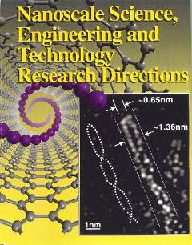
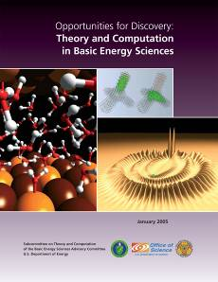
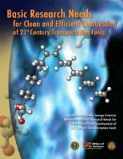
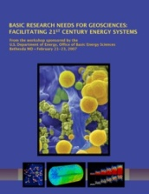
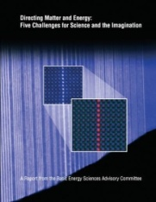
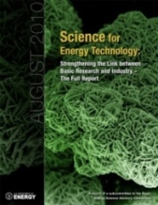
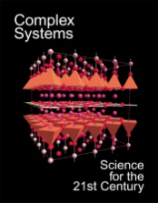
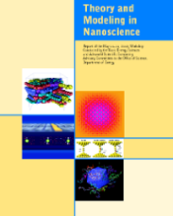
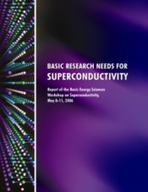
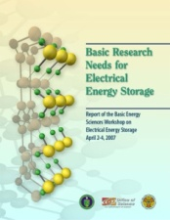
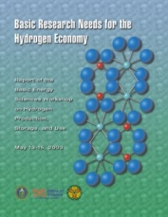
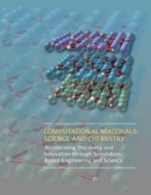
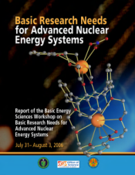
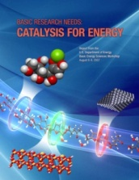
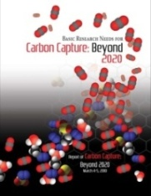
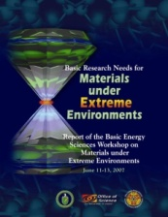
Timeline of BES Strategic Planning and Program Development: Nanoscience and beyond
1999
2000
2002
2004
2006
2008
2010
2012
NNI
All NSRCs operational
EFRCs
BatteriesHub
Fuels from Sunlight Hub
Predictive Theory & Modeling EOI
22

Slide 23
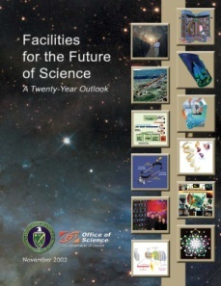
Timeline of BES Strategic Planning and Program Development: Linac Coherent Light Source
1992
1995
1998
2001
2004
2007
2010
2012
National Academies Report
LCLS Design Study Report
CD-0
CD-2b
CD-3a
First Light
LCLS-II
CD-1
CD-1
BESAC Photon Report
CD-3b
CD-2a
BESAC (Birgeneau) Report
Facilities for the Future of Science
Design Study Group (Cornacchia)
BESAC (Leone) Report
Proposal (Pellegrini), Study Group (Winick)
LCLS-II CD-0
CD-4
23

Slide 24
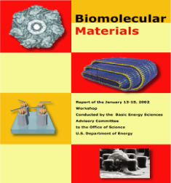
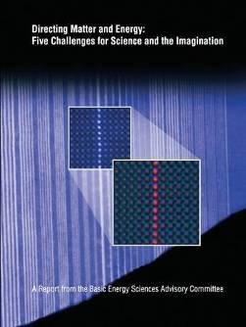
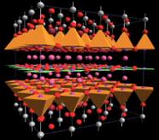
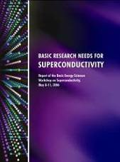
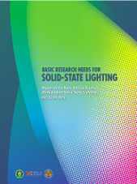
BES Strategic Planning Activities
Science for Discovery
Complex
Systems
Science for National Needs
National Scientific User Facilities, the 21st century tools of science
Detector R&D
24
24
Notes:
24

Slide 25
BES Neutron & Photon Detector R&D Workshop
August 1-3, 2012
Goals:
Assess the state-of-the-art and future development requirements, with emphasis on the science, engineering and technology necessary to realize the next generation of detectors to advance neutron- and photon-based science
Identify opportunities and needs for neutron and detector developments at the existing and future BES facilities
Identify the connections to data-intensive computing and high-speed networking capabilities necessary for efficient throughput
Identify models for deploying and supporting laboratory-developed detectors including roles for industry
Format:
Plenary on science-driven requirements –challenges unmet or foreseen, technologies, and implementation
Breakout session for state-of -the-art and future needs for neutron and x-ray detectors
Breakout sessions on electronics, sensors, and computing and data acquisition
Co-chairs: Gabriella Carini (SLAC), Peter Denes (LBNL) and Sol Gruner (Cornell)

Slide 26
New
Vacancy

